Slide 1
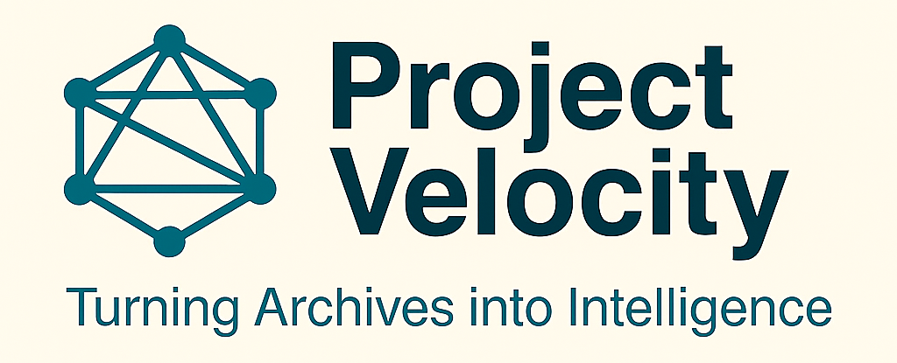
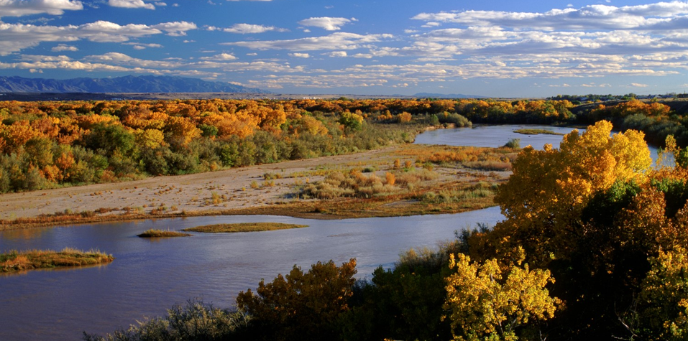
AI at Work in Environmental Programs
Meta Hirshl, Chief Data & Technology Stewart
New Mexico Environment Department
September 3, 2025

Slide 2
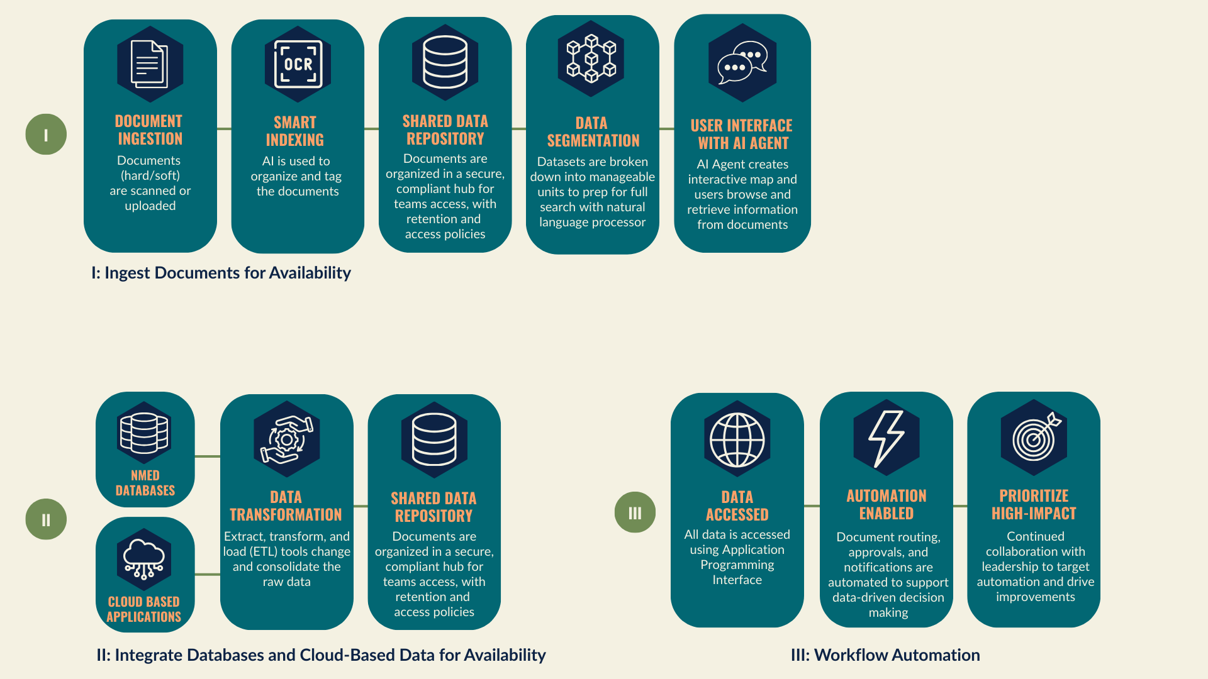
AI Framework Overview

Slide 3
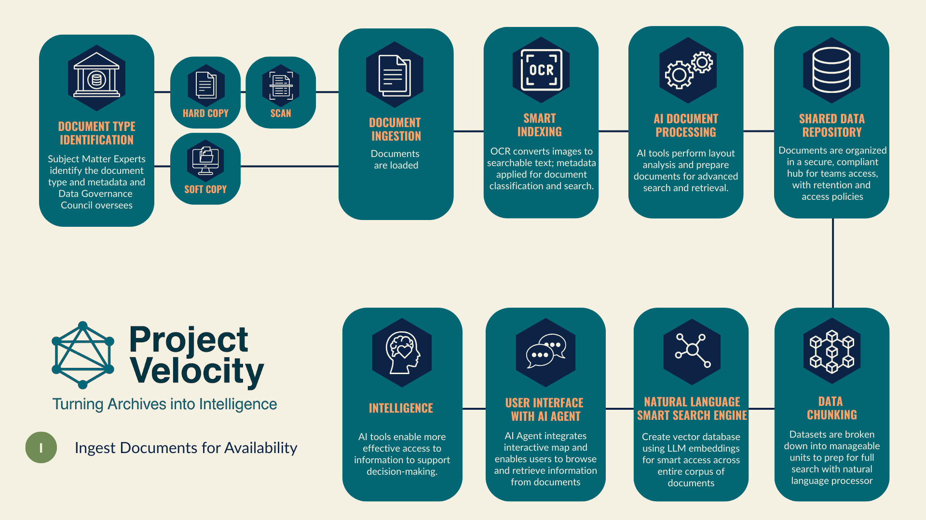
AI For Document Digitization & Search

Slide 4








Benefits in AI Implementation
Faster
Decisions
Centralized
Secure Access
Compliance
Oversight
Time/Cost
Savings
Eliminates Paper Storage
Promotes Recycling
Scalable
Integrative Design
Workflow
Automation
Encourages
Collaboration

Slide 5
















Obstacles in AI Implementation
Multi-Vendor | Chunking Gap | Platform Shift | UX Gaps
Governance Council | Metadata Load | Mass Migration | Learning Curve
Staff Trust | Updates | Show Early Benefits | Plain Language
Scanning Costs | Software Spikes | Multi-Vendor Cost | ROI Strain
Technical
Managerial
Communications
Financial

Slide 6









Overcoming Obstacles
Pilot Quick Wins | Hybrid Scanning Model | Vendor Coordination
Leadership Support | Data Governance Council | Weekly Meetings
Website | Help Channel | Onboarding Sessions
Categorize Docs A/B/C | Strong Oversight | Scanning Center
Technical
Managerial
Communications
Financial

