Slide 1
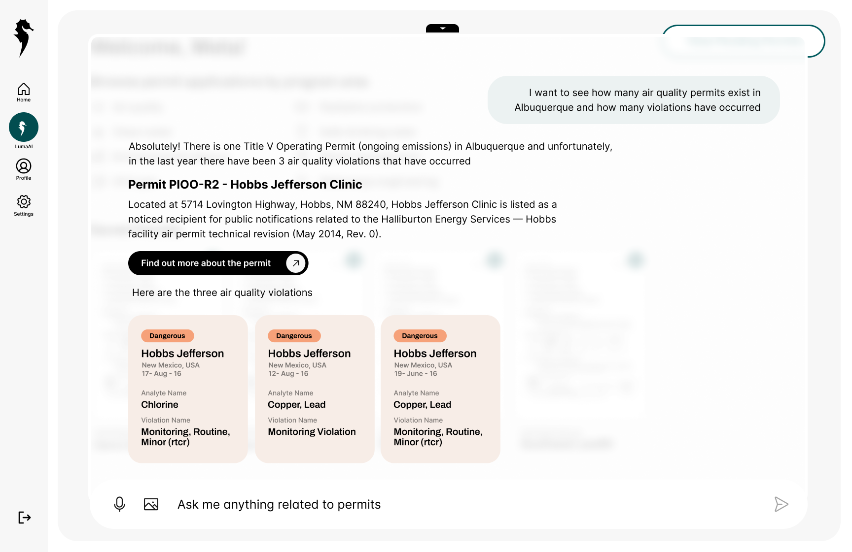



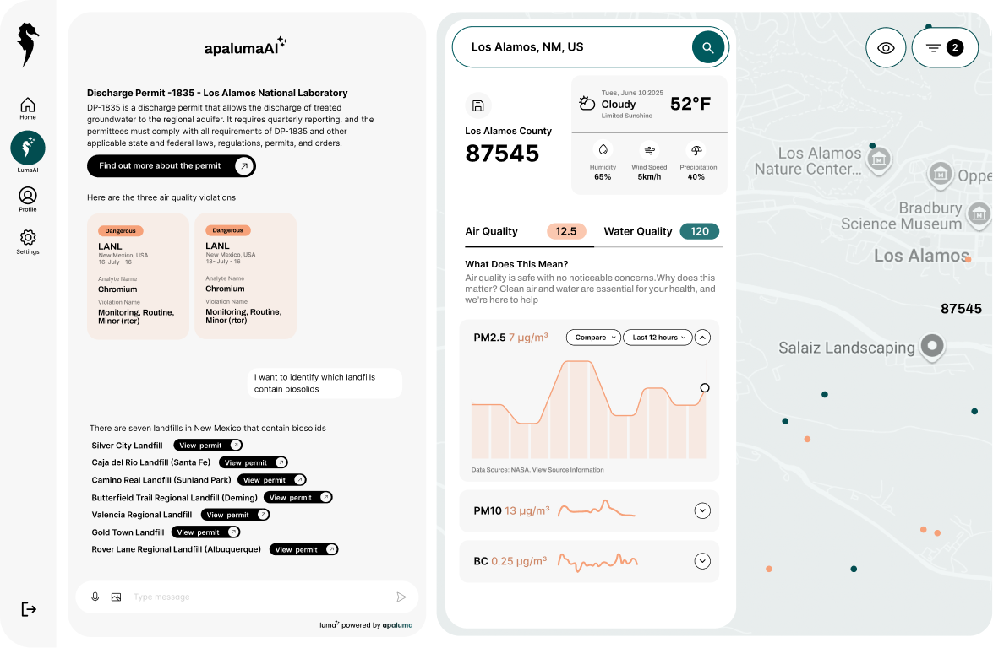
Illuminating Data for Actionable Intelligence
Alicia J. Keyes Founder & CEO
Notes:
Add back in Palantir
Apaluma is the intelligence layer for Government data regarding Air, Water, Energy and Waste. We illuminate data for Actionable Intelligence.
Illustration needs to be changed. This is more of product based problem than the actual illustration. Apaluma logo needs to be bigger. Get rid of the apaluma is a unified intellige Illuminating Data should be smaller.

Slide 2
Lesson #1:
Data Access
Notes:
Add back in Palantir
Apaluma is the intelligence layer for Government data regarding Air, Water, Energy and Waste. We illuminate data for Actionable Intelligence.
Illustration needs to be changed. This is more of product based problem than the actual illustration. Apaluma logo needs to be bigger. Get rid of the apaluma is a unified intellige Illuminating Data should be smaller.

Slide 3
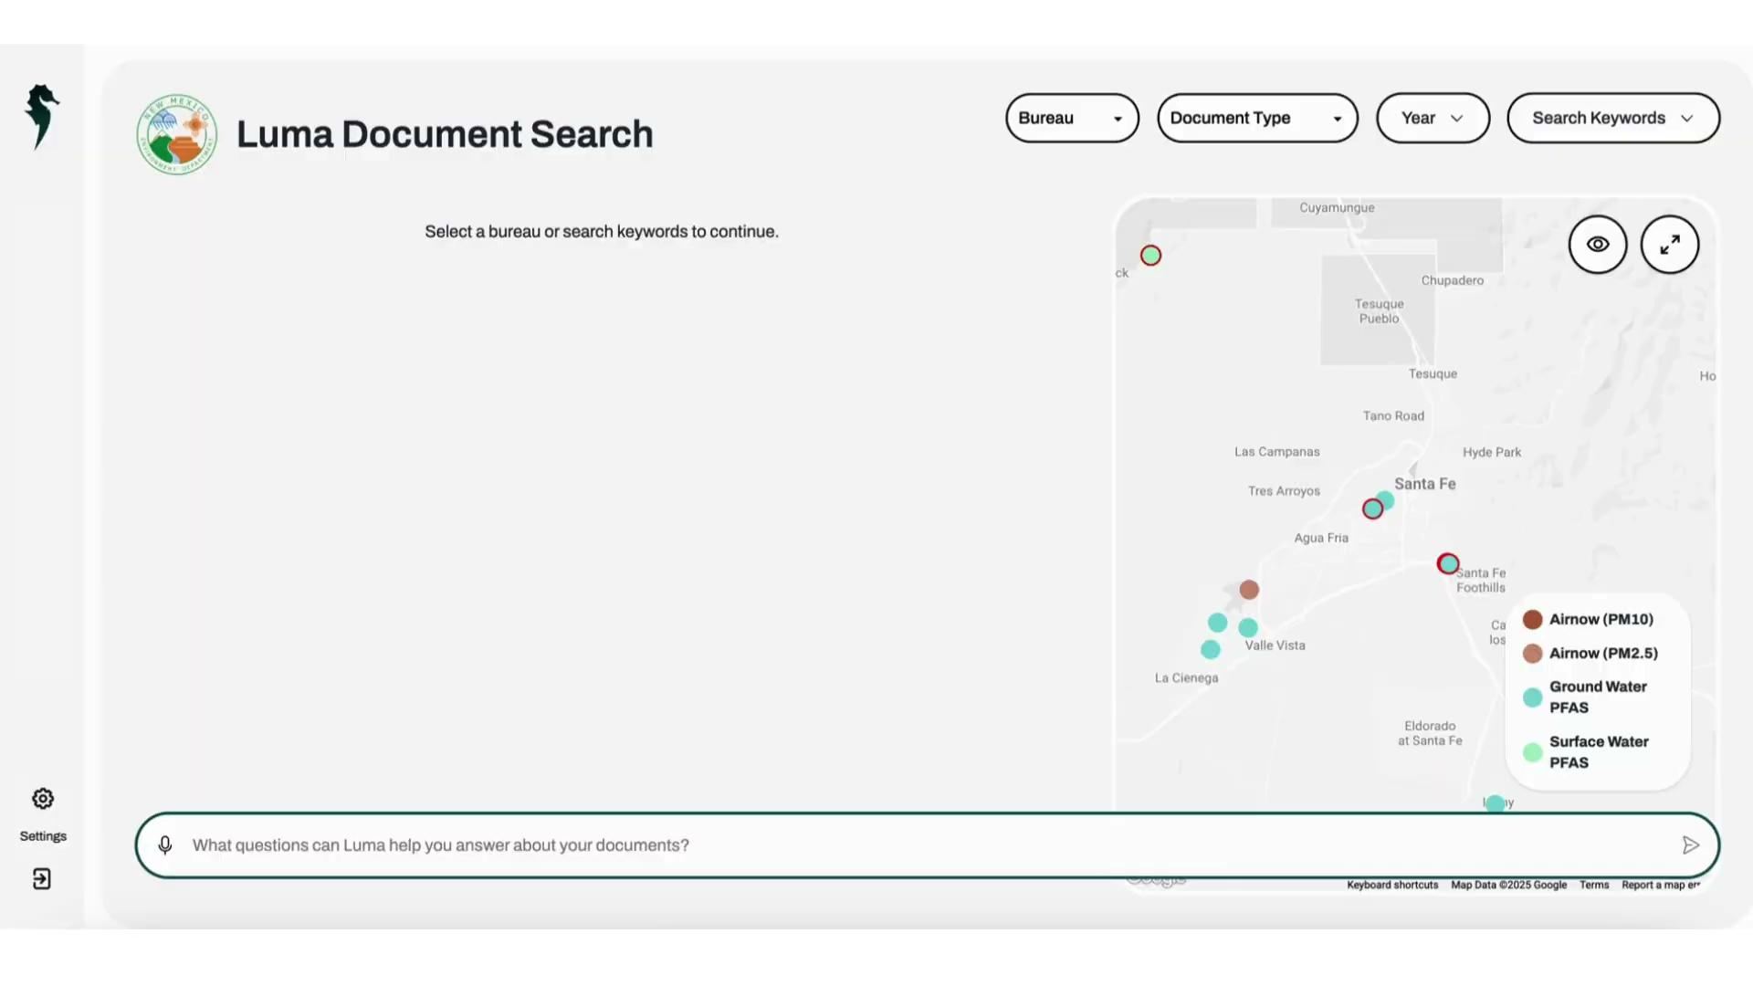

Slide 4
Lesson #2:
Document Classification
Notes:
Add back in Palantir
Apaluma is the intelligence layer for Government data regarding Air, Water, Energy and Waste. We illuminate data for Actionable Intelligence.
Illustration needs to be changed. This is more of product based problem than the actual illustration. Apaluma logo needs to be bigger. Get rid of the apaluma is a unified intellige Illuminating Data should be smaller.

Slide 5
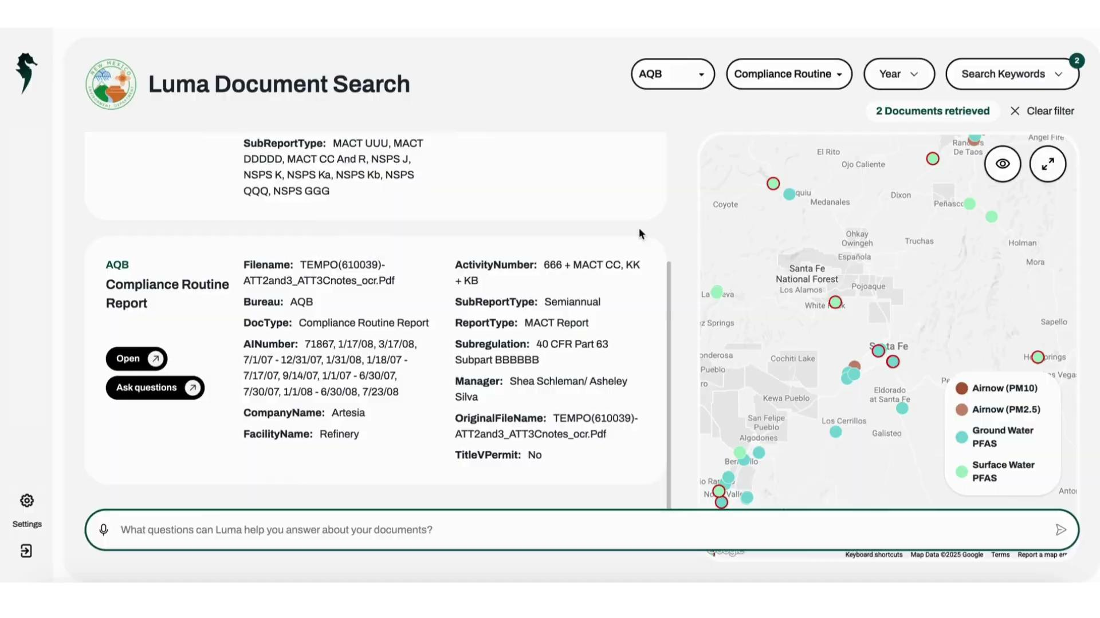

Slide 6
Lesson #3:
Department Commitment
Notes:
Add back in Palantir
Apaluma is the intelligence layer for Government data regarding Air, Water, Energy and Waste. We illuminate data for Actionable Intelligence.
Illustration needs to be changed. This is more of product based problem than the actual illustration. Apaluma logo needs to be bigger. Get rid of the apaluma is a unified intellige Illuminating Data should be smaller.

Slide 7
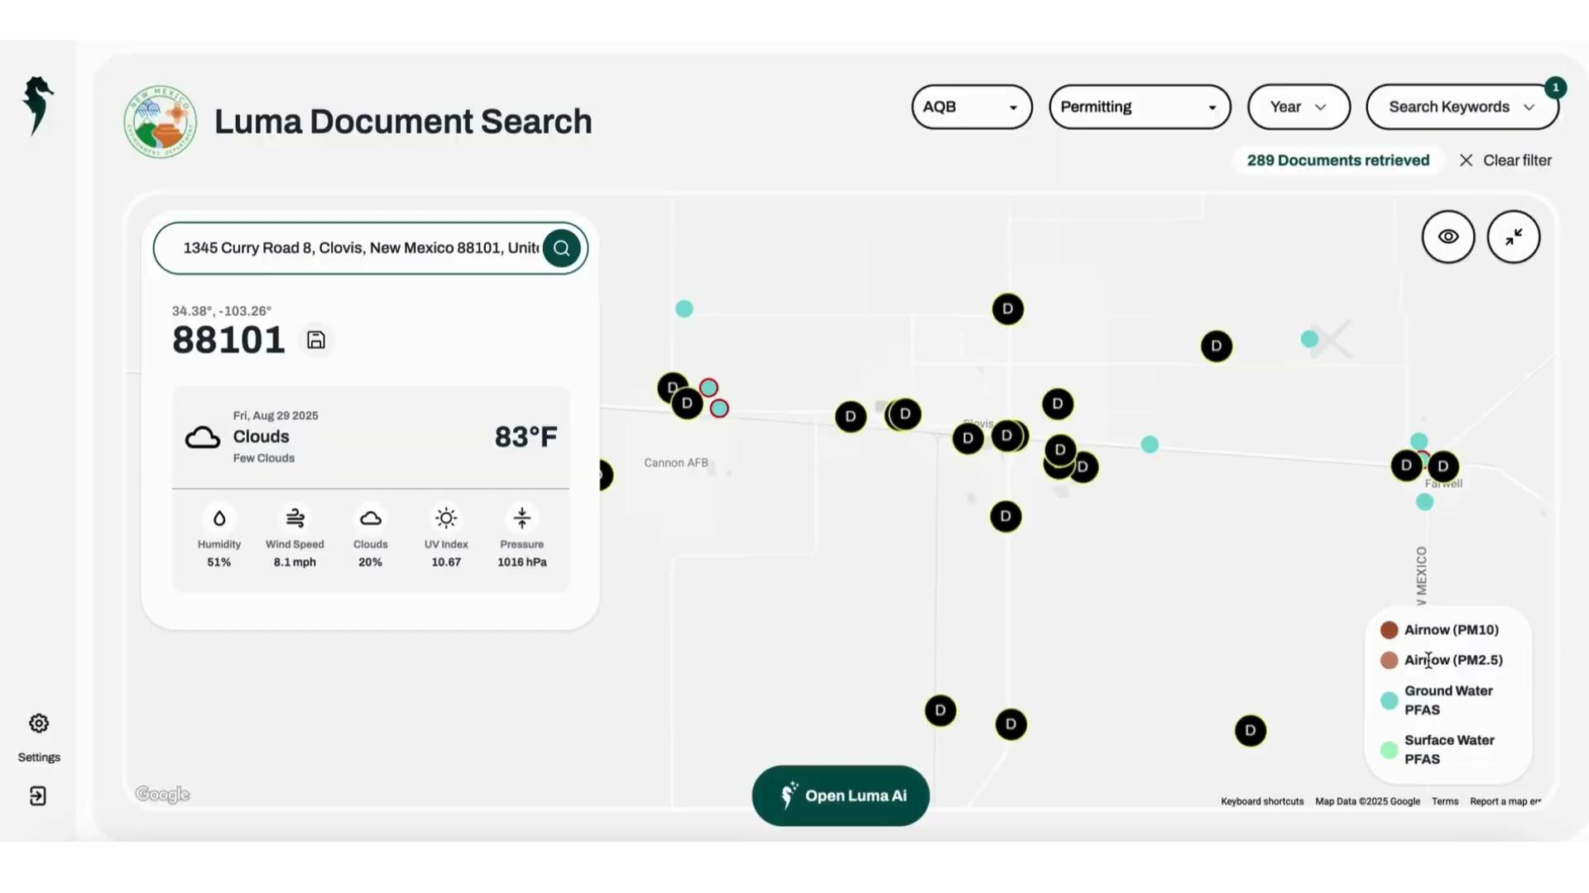
Notes:
Let’s look at Cannon Air Force Base as an example. On the map, we can see two water wells reporting PFAS - and right next to them, a permitting document. When we open it, we see it’s a General Construction Permit for Cannon Concrete Batch Plants, and we can begin to understand its potential environmental impacts.

Slide 8
Illuminating Data for Actionable Intelligence
Notes:
Add back in Palantir
Apaluma is the intelligence layer for Government data regarding Air, Water, Energy and Waste. We illuminate data for Actionable Intelligence.
Illustration needs to be changed. This is more of product based problem than the actual illustration. Apaluma logo needs to be bigger. Get rid of the apaluma is a unified intellige Illuminating Data should be smaller.

