Slide 1



Slide 2
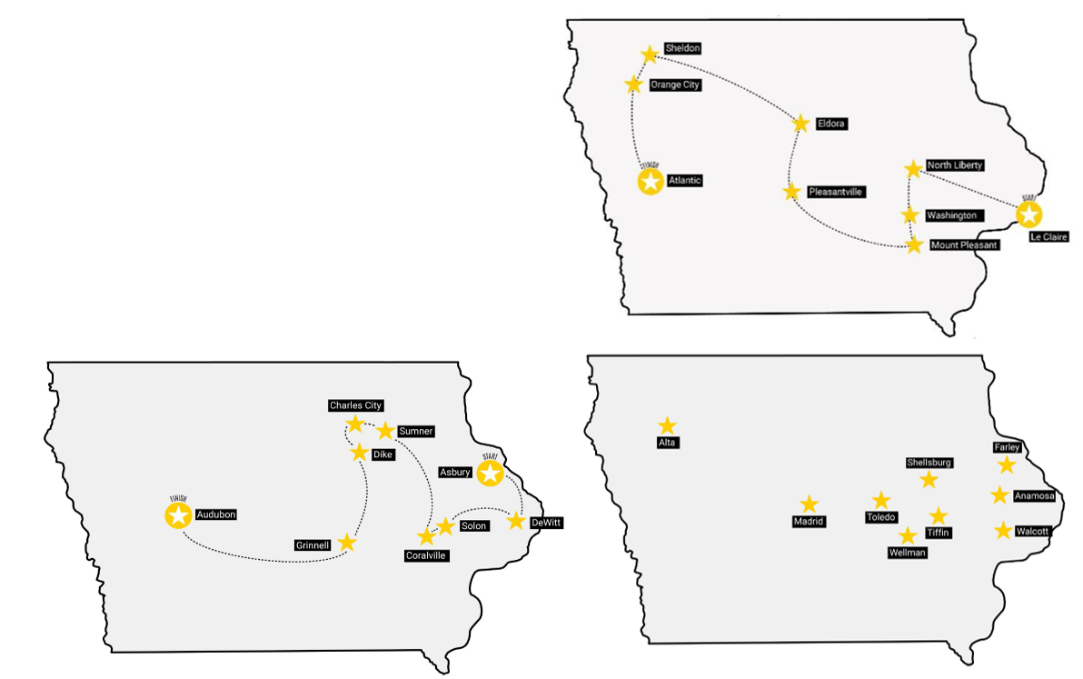
2022
GREAT WASTEWATER TREATMENT TOUR ACROSS IOWA
2023
2024

Slide 3
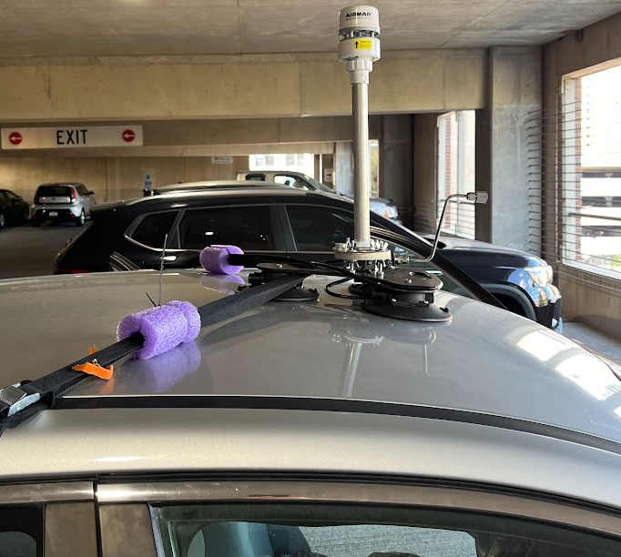
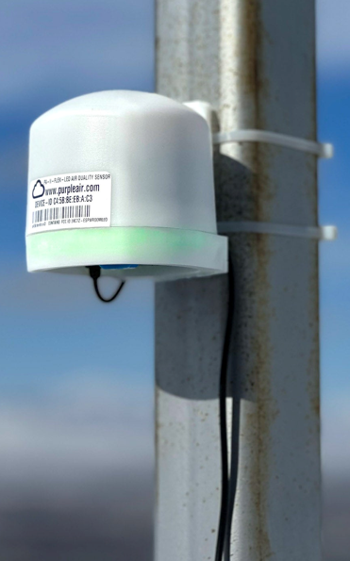
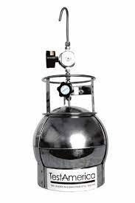
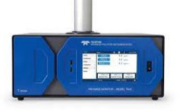

Do you have access to low-cost or advanced Field Monitoring equipment?

