Slide 1
Game Changing Technologies in Water Reuse, Methane Detection and Mitigation
Angela Zivkovich – Environmental and Conservation Policy Manager

Slide 2
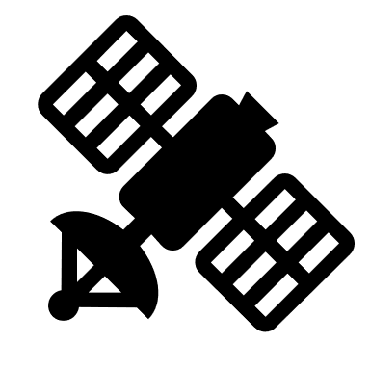
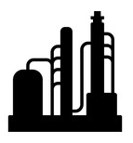













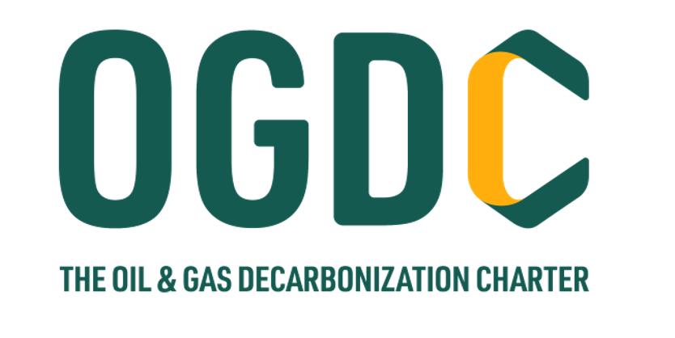





Find It
Fix It
Measure It
Predict It
Satellite
New Facility
Direct + Real-time
INTEGRATE IT ALL
Analyze trends
Identify equipment types with emissions
Design out emission sources
Update operational practices
Risk + Hazard ID
Plane + Camera
Retrofit
Drone + Camera
Deployed Team
Integrated
Direct
Accurate
Real-time
Camera
Automation
Direct Measurement
Field Staff
OGMP 2.0
Field Staff
Calculated
Contractors
Current Technology, Operations, and Carbon Accounting

Slide 3
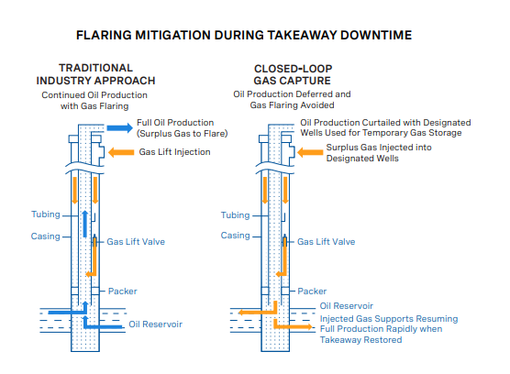
Closed-loop gas capture
Challenge: Limit gas flaring during periods of downtime due to temporary loss of gas pipeline takeaway capacity
Solution: Closed-loop gas capture
  Oil production continues at wells that have lost gas takeaway
  Oil production curtailed in designated gas injection wells
  Surplus gas injected into designated wells
  Injected gas supports resuming full production rapidly when gas pipeline takeaway is restored
Notes:
Purpose: eliminate flaring while minimizing production impacts from shut-in wells during takeaway interruptions
By shutting production side on select “gas storage” wells, we can temporarily store gas from other wells
Continue to sell oil and dispose of water
Reduce affected well count and production impact
Utilize existing gas lift infrastructure to minimize costs

Slide 4
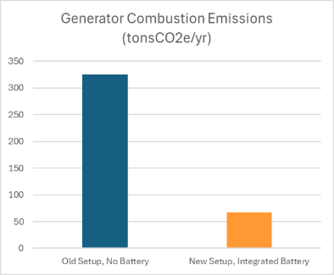
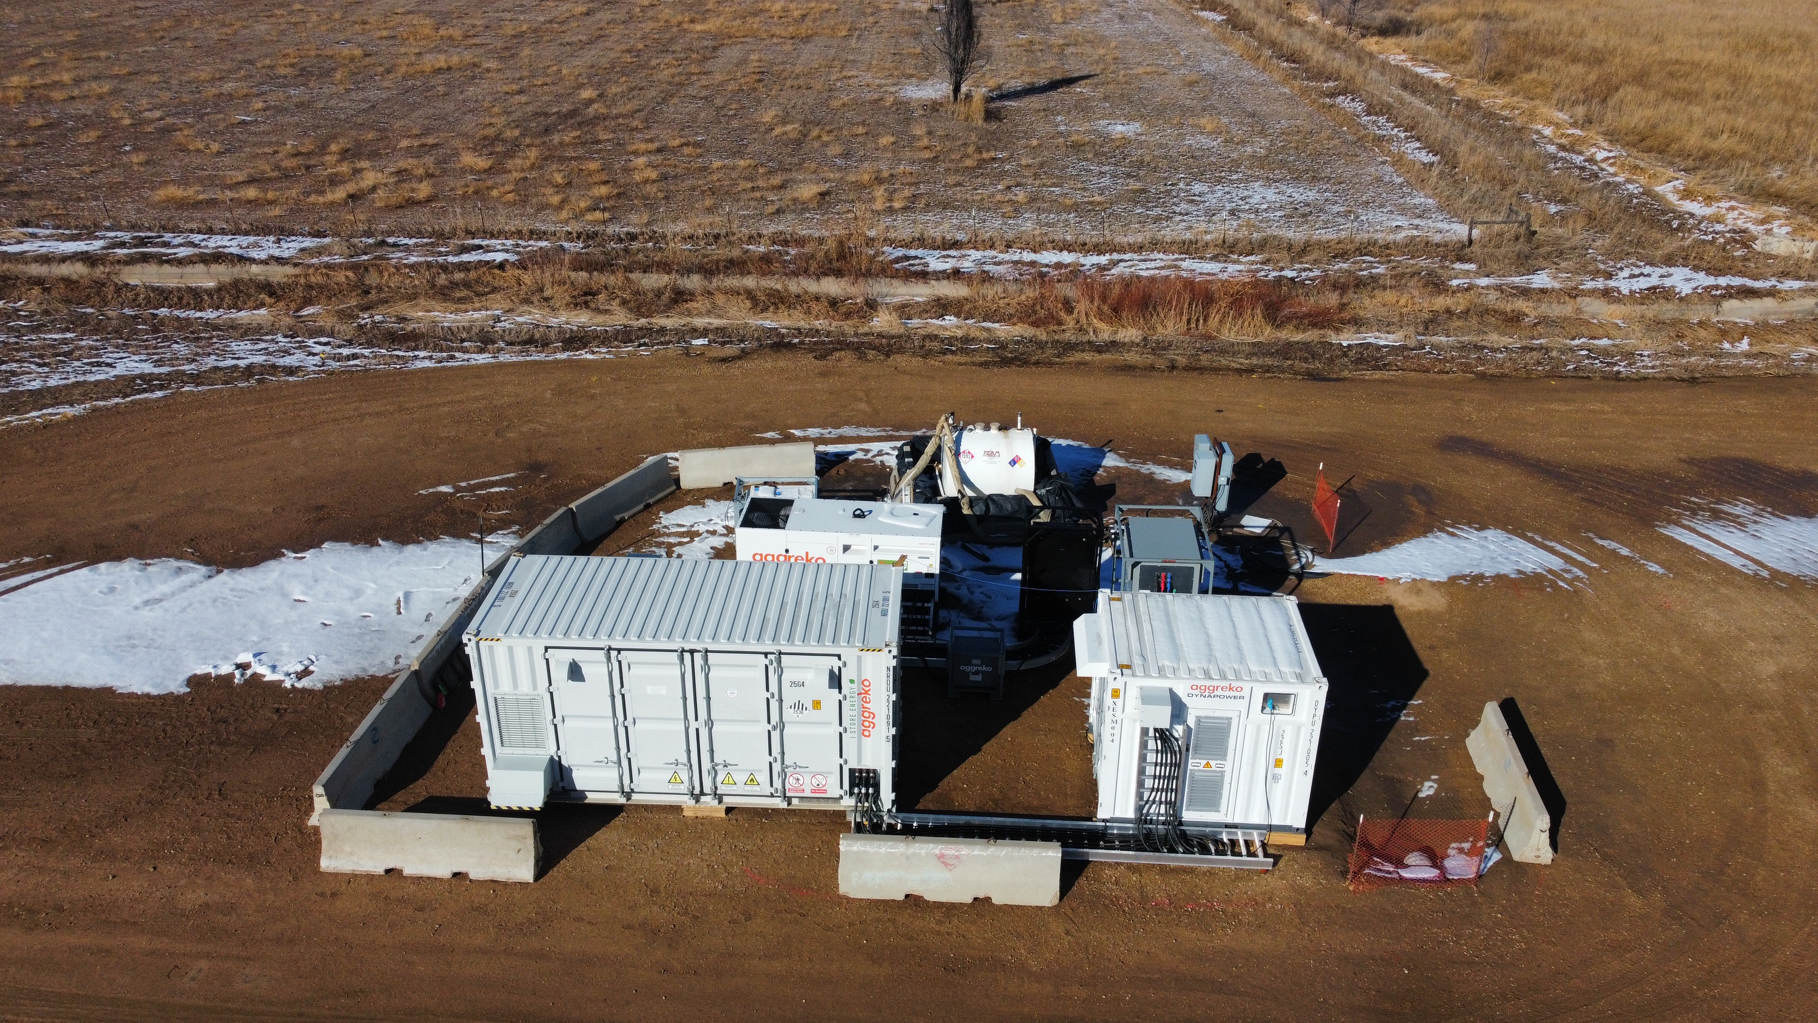
Hybrid Battery-Generator System
Challenge: Remote oil production locations without access to local electrical grid connectivity
  Requires diesel generator to run operations
  Fluctuations in power demands when equipment is utilized and generator is operated continuously
  Variability in load demand leads to inefficiencies and frequent generator adjustments
Solution: Hybrid battery-generator system
  Facility operates on battery power and manages fluctuating demands
  Generator powers the battery with significantly less runtime
  Reduces diesel usage and corresponding emissions by ~80%

Slide 5
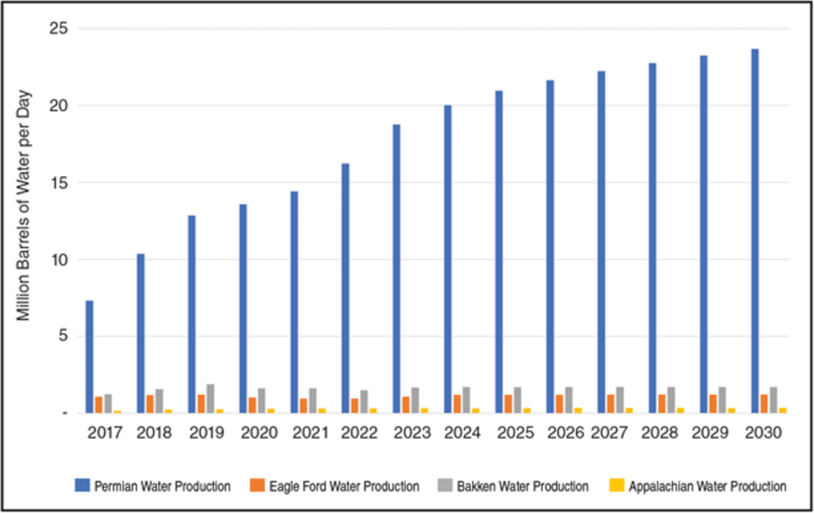
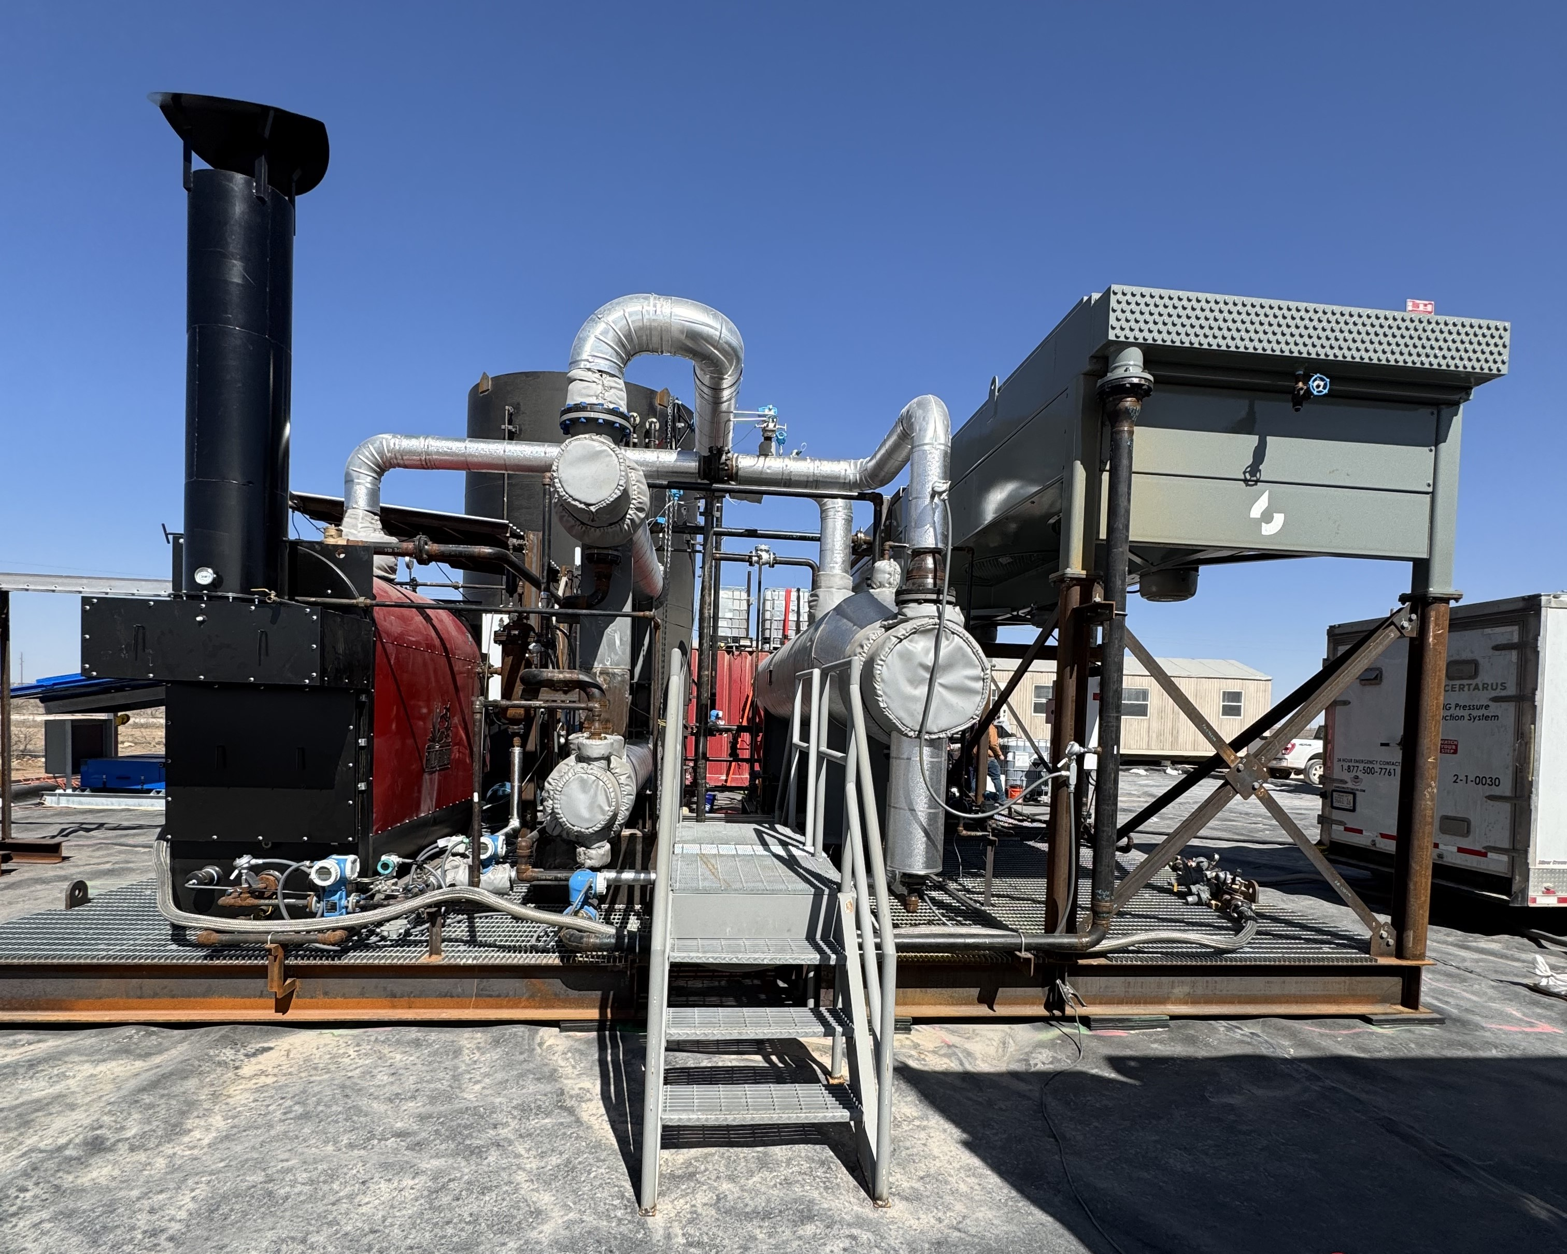
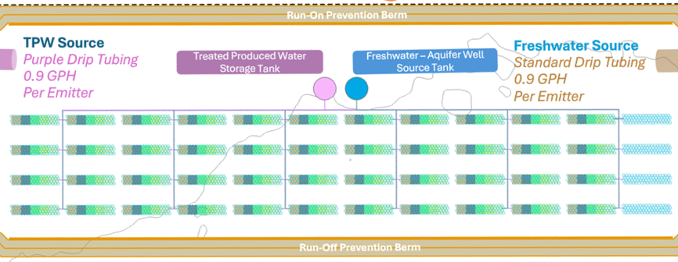
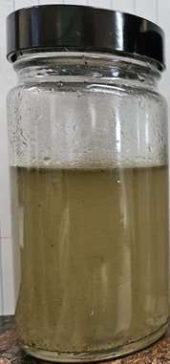
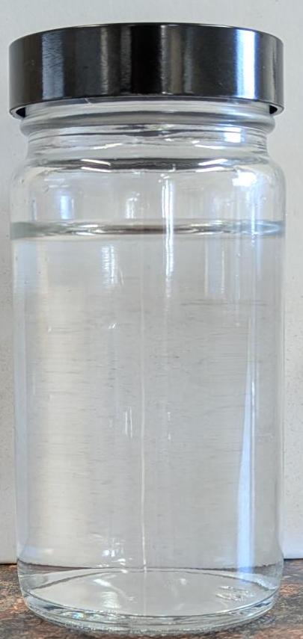
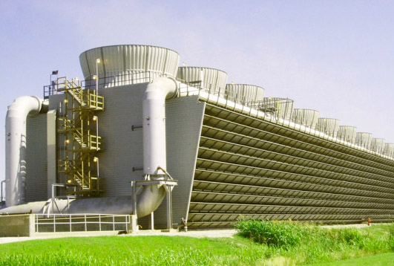
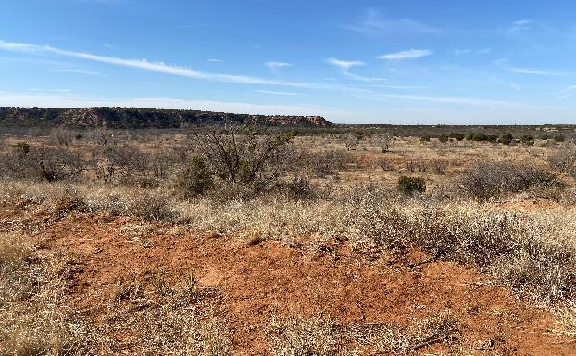
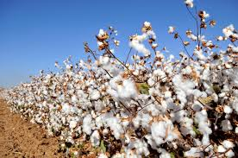
Oxy: industry Leader in Produced Water Treatment
20+ MMBPD “Wall of Water”
Oxy Desal Pilot 800 BPD_{Feed}
Oxy/Texas Tech Irrigation Study
Modified from RBN Energy
Native Existing Vegetation Native Plant Mix Cotton Sorghum Guayule
Pre-Treatment
Post-Treatment
To Inform
The oil and gas industry is one of the only “Water Positive” industries in the world
Internal
Operations
Land
Restoration
Non-Edible Crop
Irrigation
Paving the way for environmental stewardship & social beneficial use
Raw PW
135,000 ppm TDS
Desalinated PW < 100 ppm TDS

