Slide 1
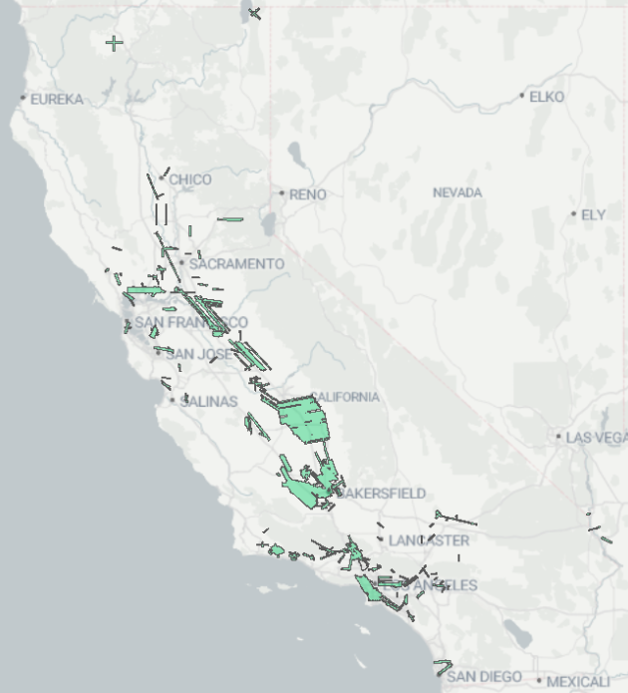
Aircraft Studies
California Methane Survey (2016-2018) and follow-up studies (2020, 2021, 2023)
Aircraft survey of methane sources in California
Focused on oil and gas fields, landfills, and dairies
Map of all observed areas from flight campaigns

Slide 2
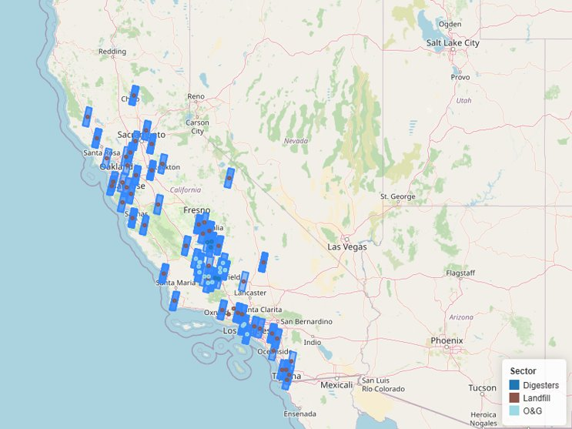
Planned Areas of Observation Using Satellites
Satellite launched August 2024
Observations aimed mainly at oil and gas operations, landfills and dairies
Some observations may be aimed at community priorities
Observations started May 2025
Data made public 30 days after observation

Slide 3
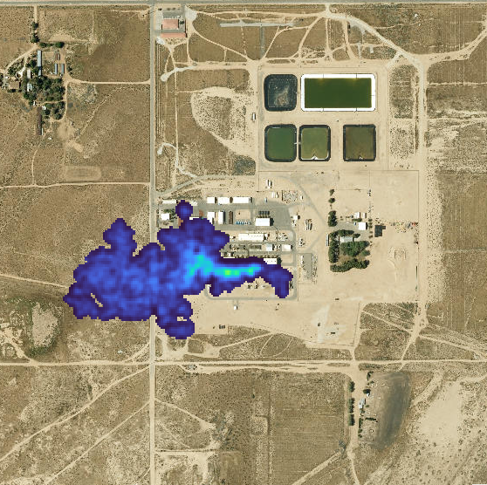
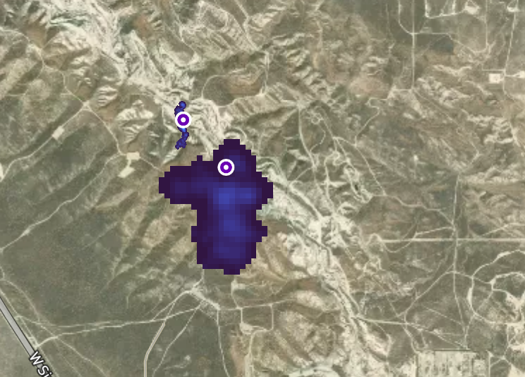
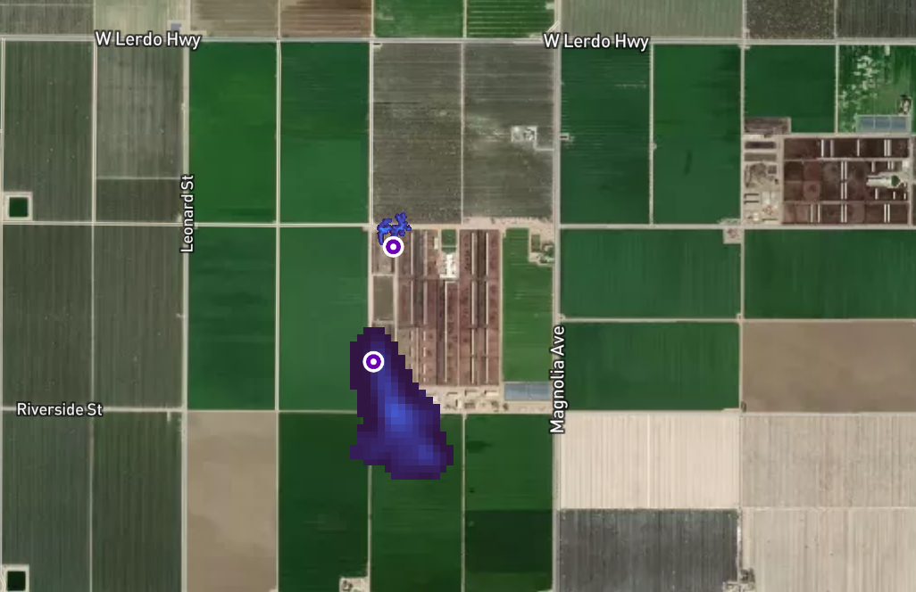
Example Plumes
Compressor station 2016
Most plumes are found in places where there are very few people
Oil and Gas – June 2025
Dairy Farm – June 2025

Slide 4
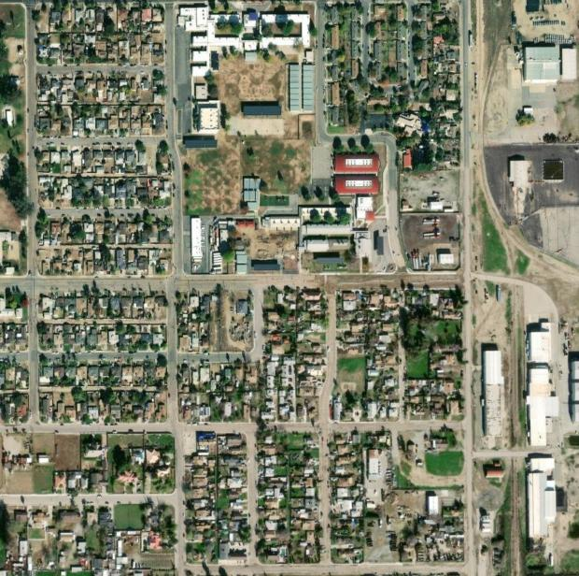
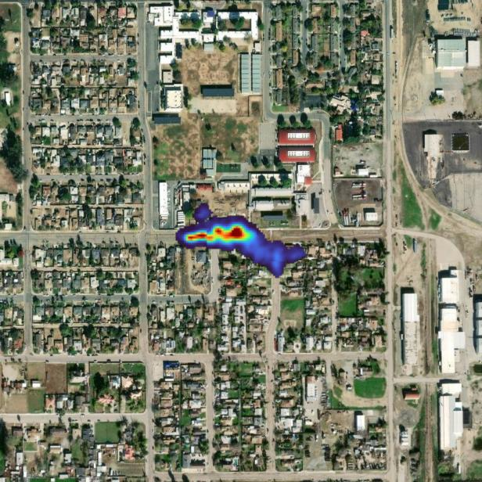
Example Plume – Residential Pipeline Leak
Residential gas leak at gas service line (Arvin; PG&E)
Unintentional leak caused by damage caused by landscaper
Gas company was made aware by the landscaper and fixed it
Flyover following day found no plumes
Approximate Origin
Plume Image
Plumes found in communities, that overlap residential areas, will be designated as High Priority Emissions Plumes (HPEPs), and receive special immediate attention
Notes:
Unintentional: previously unknown emission that can be mitigated
Incidence 56
Operator performed on-the-ground inspection
Found fugitive emissions leak
Leak came from pipeline
Leak was discovered and repaired

Slide 5
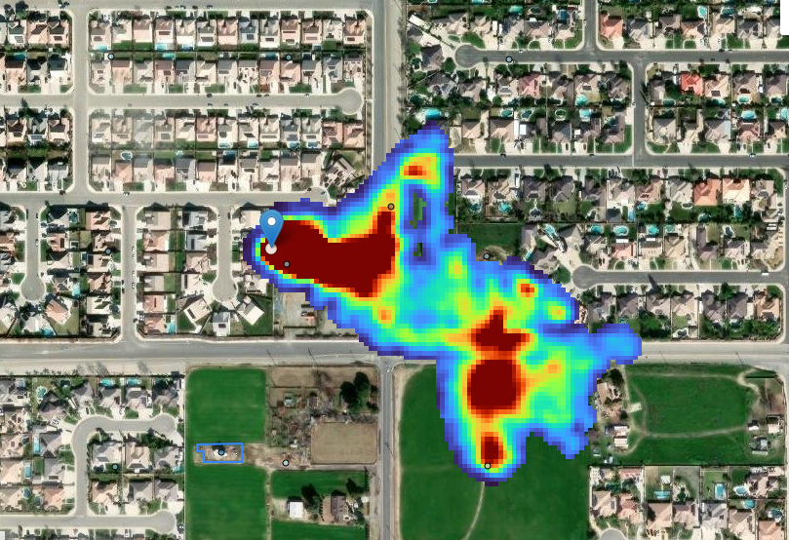
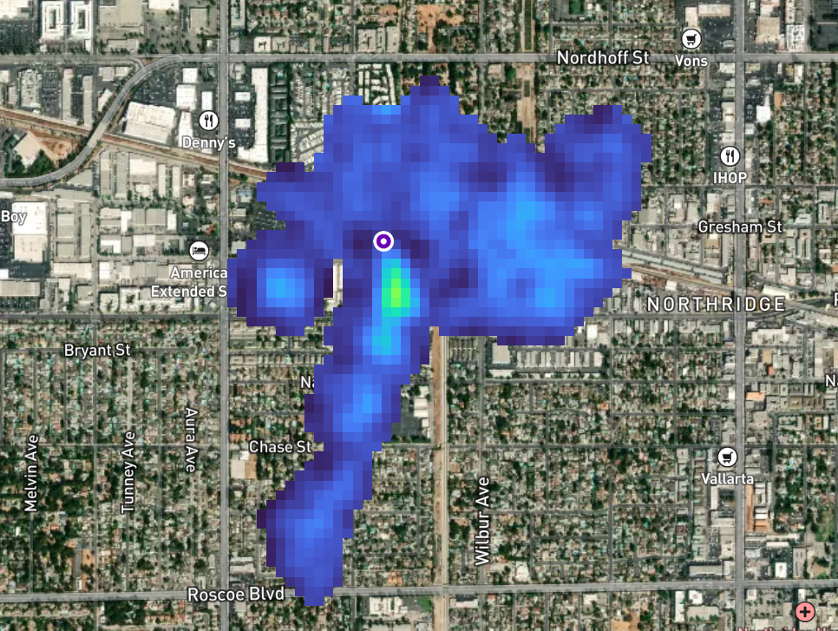
High Priority Emissions Plumes
HPEP’s are very rare, <1% of plumes found to date
Need immediate attention
Work with local air districts to get inspectors out
Working with communities on getting the word out
Will notify emergency responders as appropriate who can send out ‘spill’ reports

