Slide 1
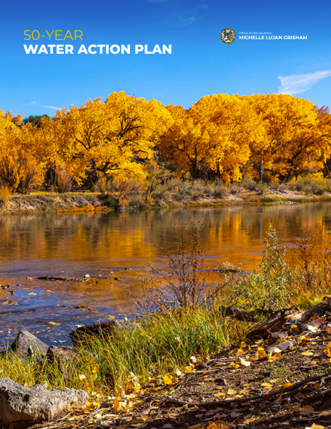

50 Year Water Action Plan
NMED is the lead agency on six of 11 priority actions in the Action Plan.
50 Year Water Action Plan
Reduce
Leaks
(A3)
Strategic Water Supply (B1)
Water Reuse Rules
(B2)
Cleanup Groundwater (C1)
Surface Water Permitting (C2)
Aging Water Infrastructure
(C3)
1
Notes:
A3 = Asterra
B1 = SWS; grant application form and RFP going out on 8/25
B2 = WATR Alliance petition to WQCC is pending
C1 = SB21 and neglected contaminated sites fund/funding; 25+ sites set for cleanup
C2 = SB21 and draft rules going out late August or early September for a petition to WQCC in December
C3 = NMED funding programs; just executed $150M loan with City of Santa Fe to address Clean Water Act violations; in FY25, invested $70M in water infrastructure and initiated 148 new projects

Slide 2
50 Year Water Action Plan
50 Year Water Action Plan
Reduce
Leaks
(A3)
Strategic Water Supply (B1)
Water Reuse Rules
(B2)
Cleanup Groundwater (C1)
Surface Water Permitting (C2)
Aging Water Infrastructure
(C3)
Spotlight: Water Reuse Rules
Develop and implement comprehensive water reuse rules for potable and non-potable reuse of treated wastewater, including produced water
Develop rigorous science-based standards and permitting requirements to protect the environment and public health
Ensure the necessary regulatory frameworks are in place by 2026 to maximize new water supplies
2
Notes:
A3 = Asterra
B1 = SWS; grant application form and RFP going out on 8/25
B2 = WATR Alliance petition to WQCC is pending
C1 = SB21 and neglected contaminated sites fund/funding; 25+ sites set for cleanup
C2 = SB21 and draft rules going out late August or early September for a petition to WQCC in December
C3 = NMED funding programs; just executed $150M loan with City of Santa Fe to address Clean Water Act violations; in FY25, invested $70M in water infrastructure and initiated 148 new projects

