Slide 1
MethaneSAT and What’s Next
Jon Goldstein
Associate Vice President
Environmental Defense Fund
Sept. 3, 2025

Slide 2
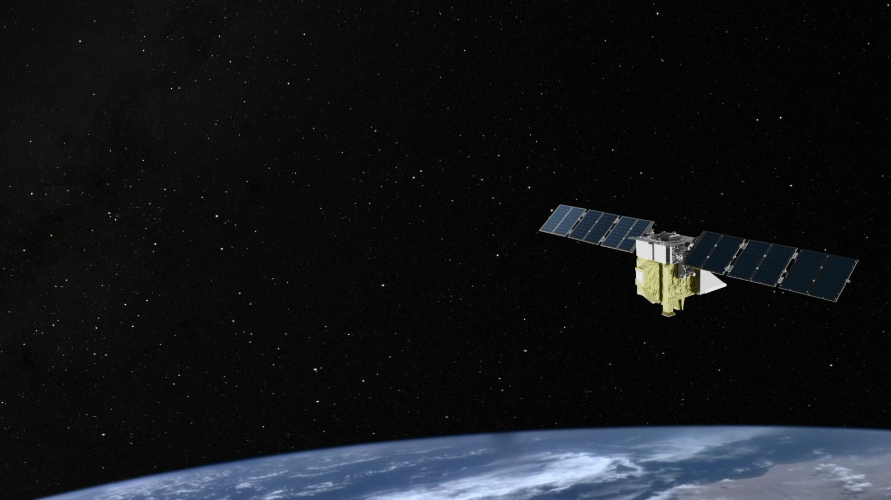
Where do we go from here?
On June 20th, MethaneSAT Mission Operations lost contact with MethaneSAT
We have several months worth of data that will be processed and published to the MethaneSAT portal and Google Earth Engine
We will be working with partners around the world to
leverage algorithms and software.
There are other satellites that provide complementary data
to MethaneSAT and there is a robust set of options to consider.

Slide 3

MethaneSAT was a critical complement to, not a substitute for, other satellites.
MethaneSAT
100 m x 400 m pixels
200 km swath
TROPOMI
7,000m x 5,500m pixels
2,600 km swath
GHGSat
30m x 30m pixels
10 km swath
GOSAT-GW
Focus mode: 1km x 1km or 3km x 3km pixels
90 km swath
Wide mode: 10km x 10km pixels
911km swath
Carbon Mapper
30m x 30m pixels
18 km swath

Slide 4
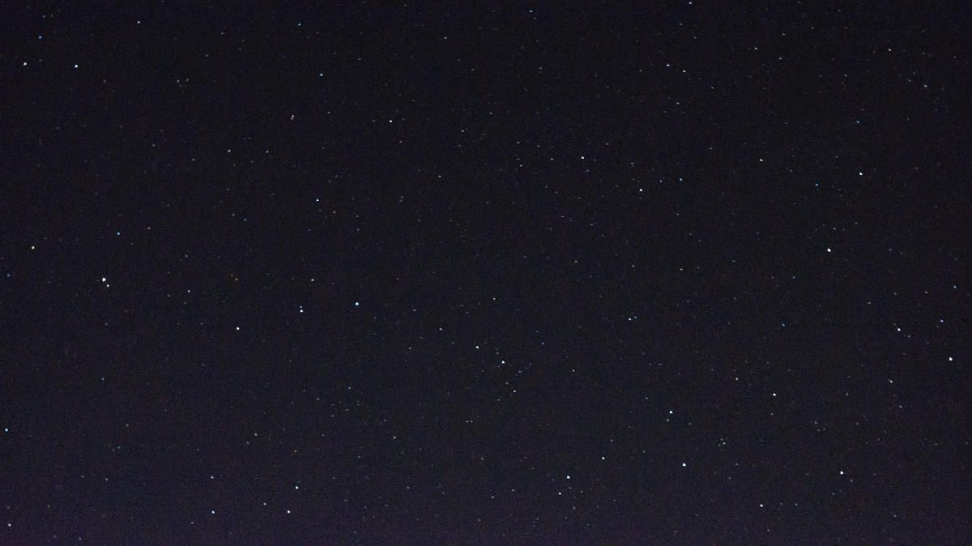
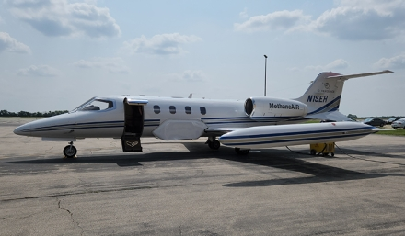
MethaneAIR
Technical specification | MethaneAIR
Size of Target Area | ~100 km x ~100 km
Target Frequency | ~4 targets per week
Time to Observe a Target | 2.7 hrs
Daily Coverage | 20,000 km²
Access | Continental North America
Angular Field of View | 23.7°
Altitude | 40,000 ft
Swath Width | 5 km
Native Pixel Size | 5m x 25m
Point source detection threshold | 150-200 kg/hr
Area sources detection threshold | 5 kg/hr/km2

Slide 5
