Slide 1

Workforce Solutions and
Budget Woes

Slide 2
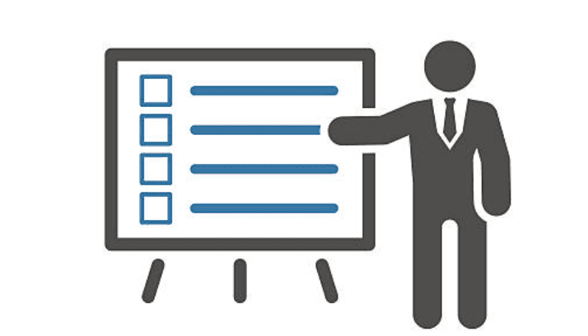
Problem Statement
States have received unprecedented federal funding for water infrastructure work and need to deploy it to maximum effect, despite the following:
  Dramatic scaling (first up and soon down) in federal funding for water infrastructure
    ARPA; IIJA; IRA
  Level federal funding for delegated state programs
  Limited appetite/capacity for increased fees to support the work
  Workforce/hiring challenges

Slide 3
What Strategies Have You Used to Overcome These Barriers?
Hiring
  Limited-service positions
  Senior Environmental Employment or SEE Program, funded through EPA
  Virtual job fairs
  Targeted recruitment of federal employees
  Other?

Slide 4
What Strategies Have You Used to Overcome These Barriers?
Continuing to accelerate infrastructure investments
  Resilience (revolving) loan programs
  Leveraging SRFs
  VT CHIP
    Allows municipalities to utilize future local property tax revenue growth to fund projects and repay the costs over time
  Others?

