Slide 1
North Carolina Flood Resiliency Blueprint
REID WILSON
SECREATARY, NCDEQ
September 4, 2025
Notes:
NC has the 3rd highest frequency of flooding events - LA, FL
Matthew, Florence – 2 1,000 year storms in 2 years; Michael Helene catastrophic
Response: Create NC Flood Resiliency Blueprint
Multi-agency, bottom up - local government planners, flood plain managers
NCGA 2021 - $20M plan and create
$96M – specific projects
Staff of 7 plus consultants
I’m told we are the first state to create such a tool- experiment in progress
1 of numerous resiliency programs underway at DEQ, will briefly mention a couple later.
Just hired Asst Sec for Resilience

Slide 2
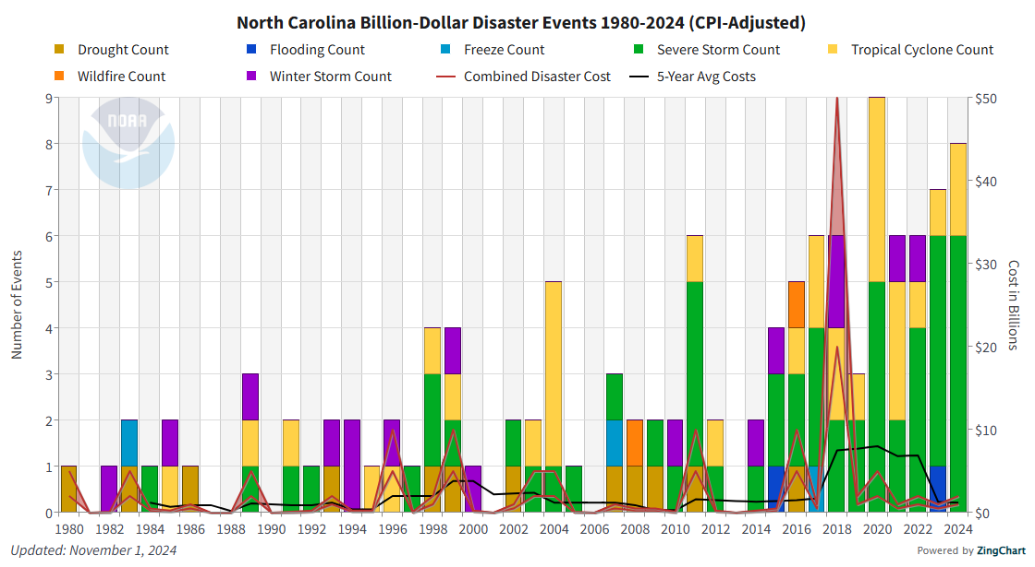
Billion-Dollar Disaster Events
Hurricane
Isaias (2020)
Hurricanes Michael and Florence (2018)
Hurricane Helene (2024)
Hurricane Matthew (2016)
Tropical Storm Fred (2021)
Hurricane
Dorian (2019)
Notes:
This is a graph of billion dollar disasters in NC since 1982
– The Yellows, Greens and blues are all flooding related. Simply put – North Carolina is seeing more frequent, more severe, and more costly storms

Slide 3
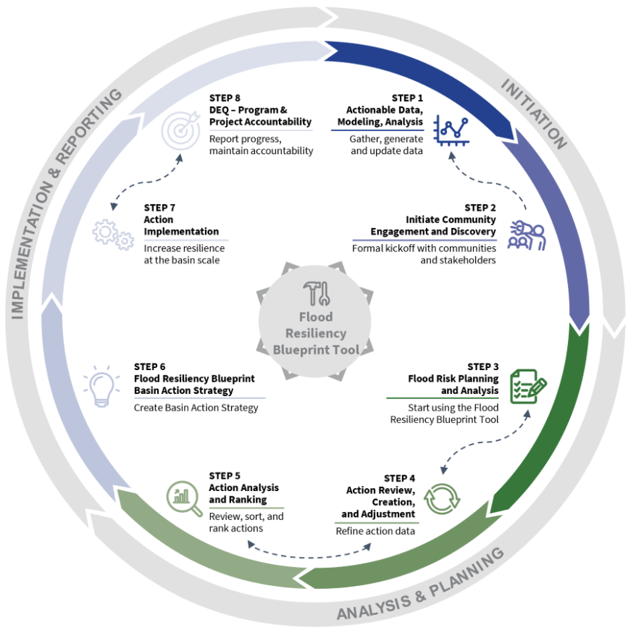
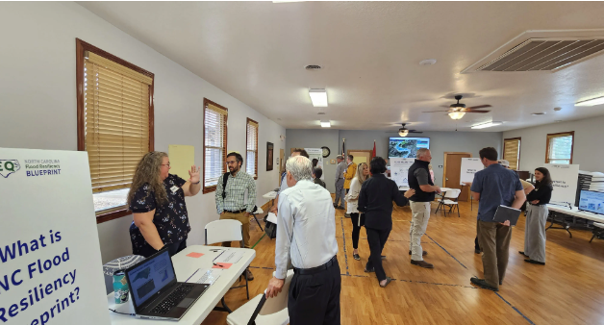
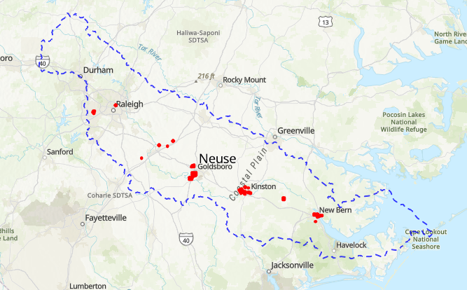
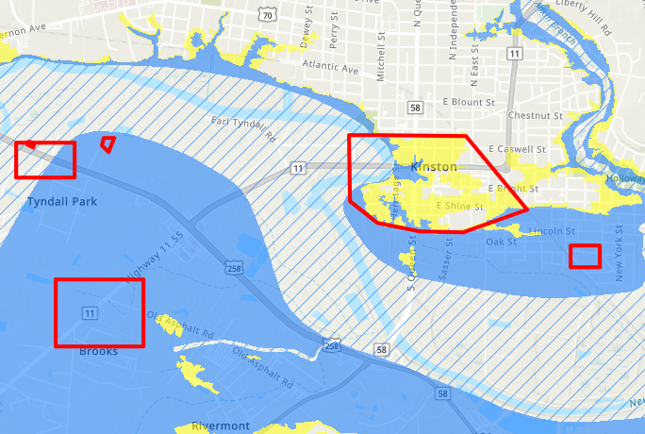
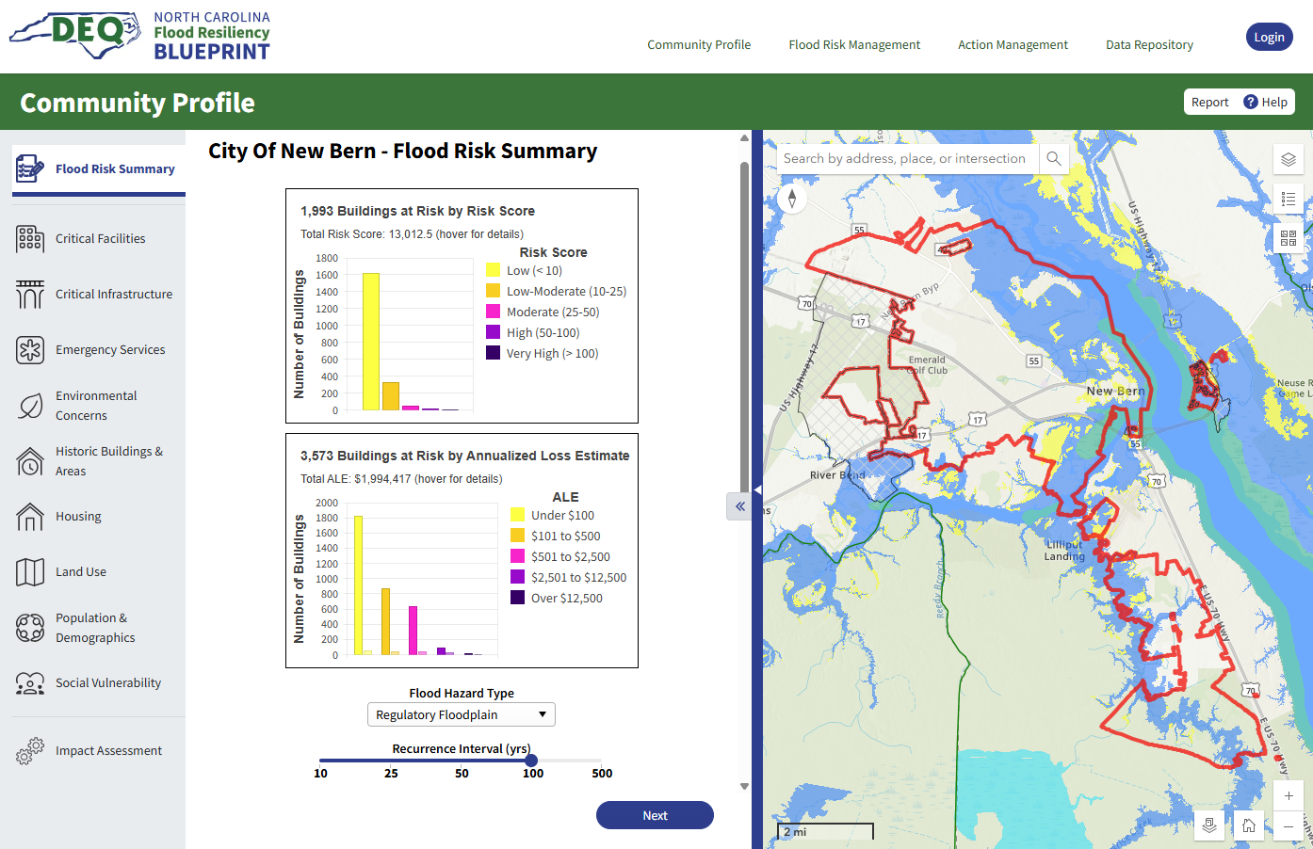
North Carolina Flood Resiliency Blueprint
Goal: Make North Carolina more resilient to flooding.
Implement more and more effective flood resilience actions (projects and policies)
Blueprint – The process, data, tools, and capacity to answer the question:
How can local governments, the state, and their partners best invest to mitigate future flood risk and reduce the cost and disruption from future flood events?
Department of Environmental Quality
Notes:
FRB - The goal is simply to make North Carolina more resilient to flooding—to reduce the loss of life, loss of property, the cost rom future flood events.
The Blueprint is the framework for how we get there. It is the process, data, and tools and the capacity to answer the question: how can local governments, the state, and their partners best invest to mitigate future flood risk and reduce the cost and disruption from future flood events
We are developing the data and tools to empower local governments do data-driven resilience planning and implement prioritized actions.

Slide 4
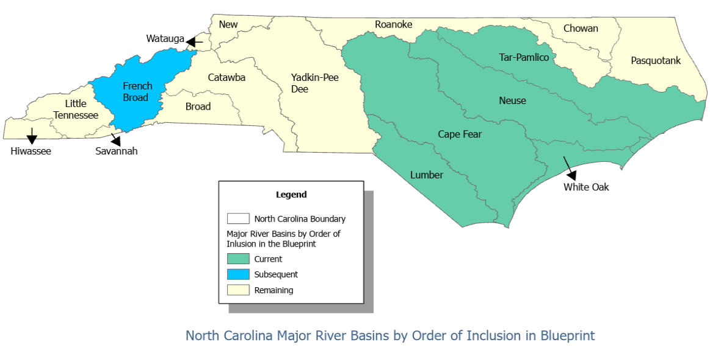
North Carolina Flood Resiliency Blueprint
Goals:
Increase community resilience to flooding
Serve as the backbone of State flood planning
Reduce the cost and complexity for local governments in the planning and implementation of flood risk reduction projects
“...A successful blueprint should ultimately lead to a prioritized set of projects and funding strategies that the State can implement.”
Targeted River Basins: Neuse, Cape Fear, Lumber, Tar-Pamlico, White Oak, and French Broad (added 2024)
Department of Environmental Quality
Notes:
The law instructed us to start with 6 basins – worst flooding
Reduce the cost and complexity for local governments to identify and implement solutions.
Actionable set of projects and funding strategies that the State can implement.

Slide 5
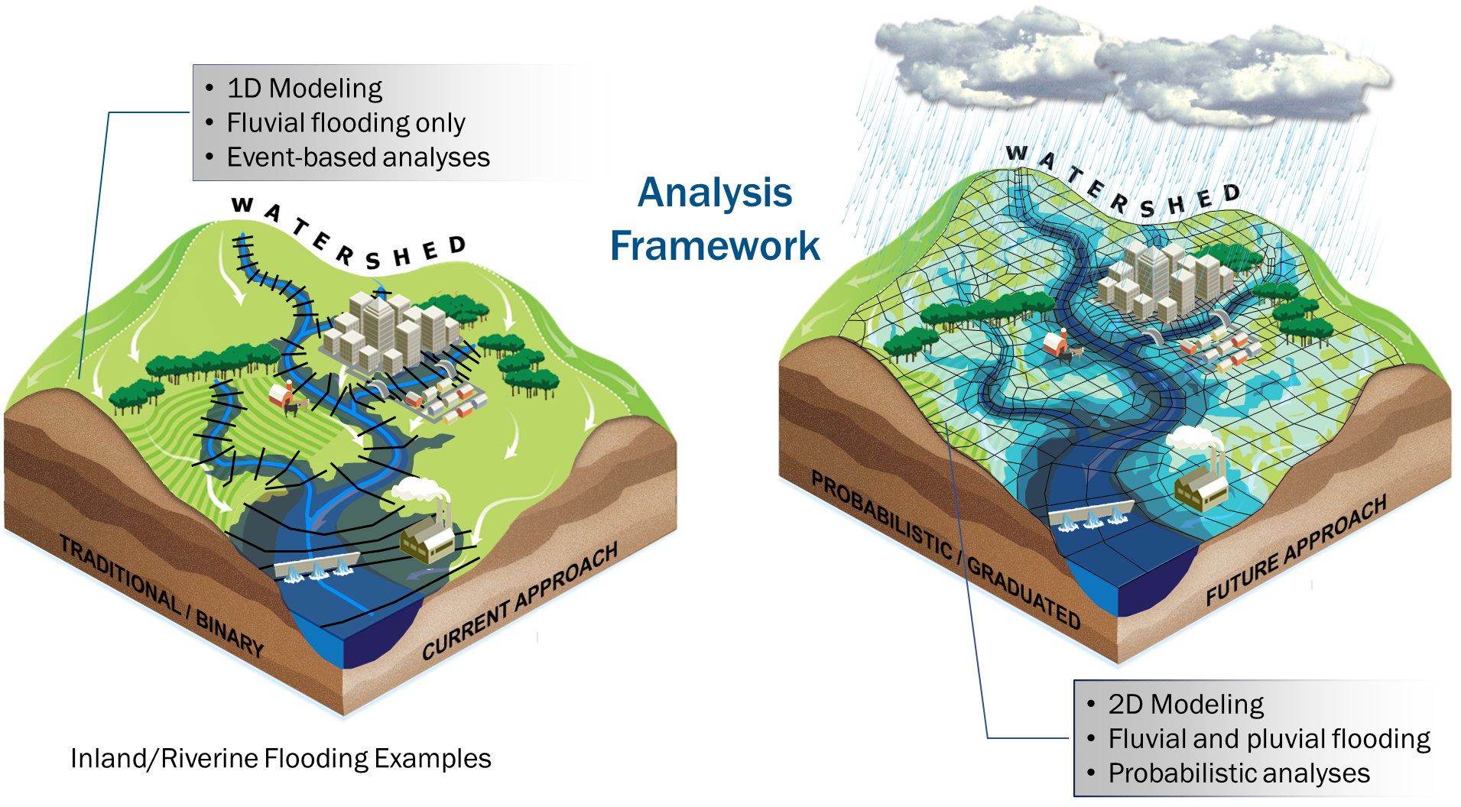
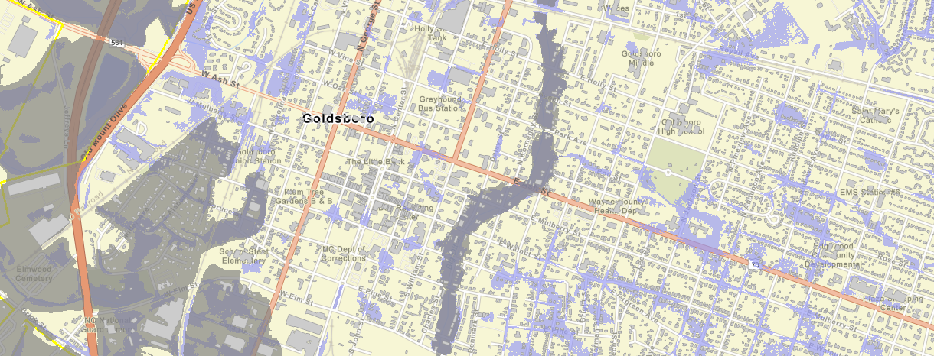
Blueprint Overview – Data and Tools
Improved Models
Better define flood extent and depths
  Current Conditions
  Capture future flooding
    Changes in precipitation patterns
    Sea level rise
    Increased impervious surfaces
Department of Environmental Quality
Notes:
We're moving from the 1D regulatory models to 2D Rain-on-grid models. This will not only give us a better understanding of our current exposure to flooding, but we will also model future conditions including changes in precipitation, sea level rise, and continued development.
This is important because existing maps are frequently already outdated or insufficient

Slide 6
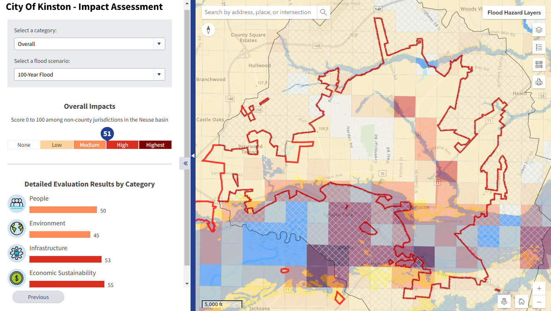
Blueprint Tool – Understand Your Vulnerability
Provide users with accurate, data-driven flood risk and vulnerability assessments
Flood risk to structures
Impacts on:
  People
  Environment
  Infrastructure
  Economic Sustainability
Department of Environmental Quality
Notes:
Will provide data-driven risk and vulnerability assessments.
Impacts on people, environment, infrastructure, local economies
Kinston

Slide 7
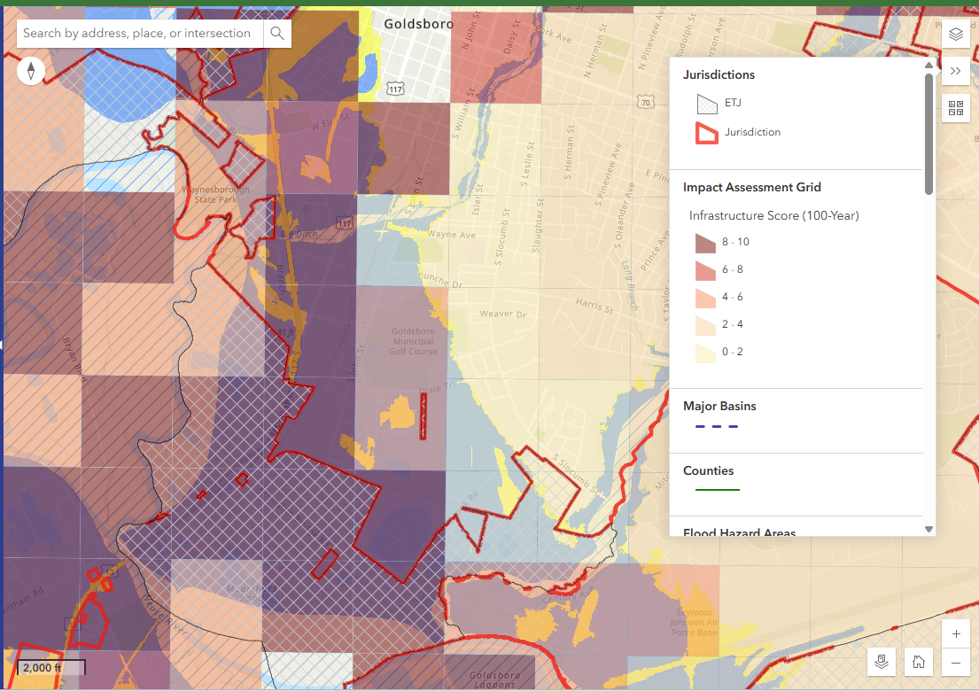
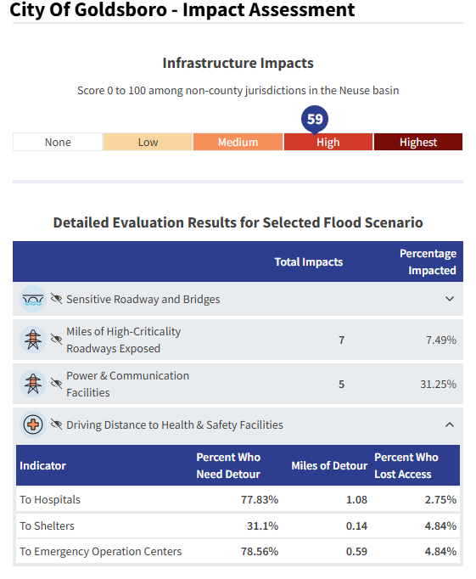
Phase II – Decision Support Tool
(Blueprint Tool)
Goals:
Be a resource for communities, local governments, and other partners for the planning and implementation of resilience actions
  Provide users with accurate, data-driven flood risk and vulnerability assessments
  Allow users to explore, develop, and define flood resilience actions
  Help users to evaluate and prioritize effective flood resilience actions
Notes:
We have traditional metrics for flood exposure and damage to buildings and infrastructure but also developing analyses on how flooding affects people, the economy, critical infrastructure, …
The example here is looking at drive times to hospitals, shelters, emergency operation centers during flood events. Goldsboro, NC

Slide 8
Phase II – Decision Support Tool
(Blueprint Tool)
Goals:
Be a resource for communities, local governments, and other partners for the planning and implementation of resilience actions
  Provide users with accurate, data-driven flood risk and vulnerability assessments
  Allow users to explore, develop, and define flood resilience actions
  Help users to evaluate and prioritize effective flood resilience actions
Building Level Mitigation
Channel Modifications
Nature Based Solutions
Infrastructure and Control Structures
Policy and Planning
Relocation, Utility Elevation, Structural Elevation, Reconstruction, Wet Floodproofing, Dry Floodproofing, Acquisition/Demolition
Water Farming, Afforestation, Flood Storage Wetlands, Floodplain Restoration, Riparian Buffers, Floodplain Preservation
Levee/Dike/Berm, Dams, Roadway Elevation/Road Crossing Modification, Storm Water Management Activities
Enhanced Zoning, Land Use/Impervious Area Restrictions, Multi-use Floodplains, Stormwater, Water Quality, Floodplain Regulations
Debris Removal, Channel Dredging, Widening, Diversion
Notes:
Data will influence the actions that local governments prioritize.
A wide range of actions –
building level mitigation,
channel modifications,
nature based solutions,
infrastructure and control structures,
policy & planning

Slide 9
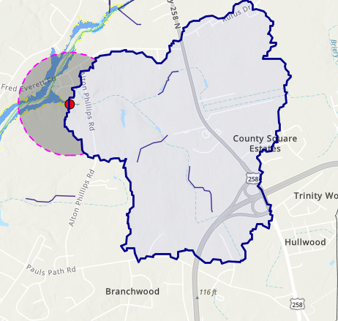
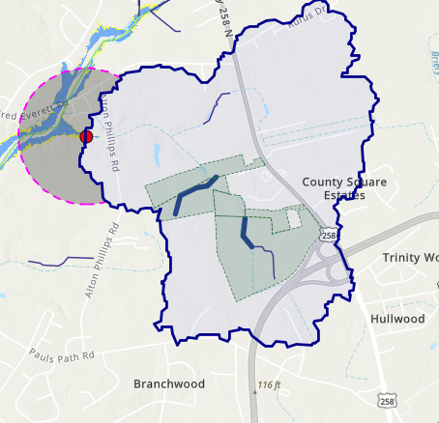
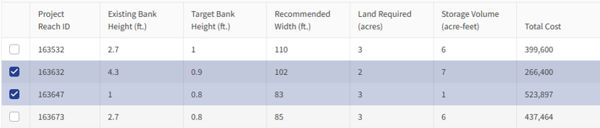
Phase II – Decision Support Tool
(Blueprint Tool)
Allow users to explore, develop, and define flood resilience actions
Floodplain Restoration Example
  Identify area of interest
  Define catchment
  Tool identifies opportunities for floodplain restoration based on stream and landuse characteristics
  4. User selects project areas.
  5. Tool estimates costs and flood storage volume.
  6. Outputs and user-provided information used to estimate risk and resilience impacts
Notes:
A simplified example of how a user might explore/define a flood resilience action, This example is a floodplain restoration action.
The user can identify an area of interest where there is known or expected flood hazards (red dot)
from this the tool defines the catchment--where a retention or runoff reduction project could potentially help.
[CLICK]
The tool identifies opportunities for floodplain restoration based on stream and land use characteristics
The user selects the stream segments where they want to explore floodplain restoration.
[CLICK]
5. The tool estimates project costs and flood storage volume.
6. Outputs and user-provided information used to estimate risk and resilience impacts
7. Helps local governments prioritize actions among thousands of options/decisions.

Slide 10
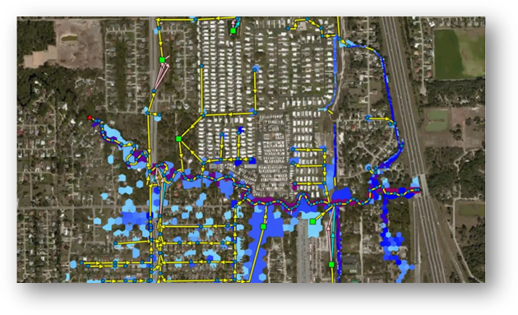
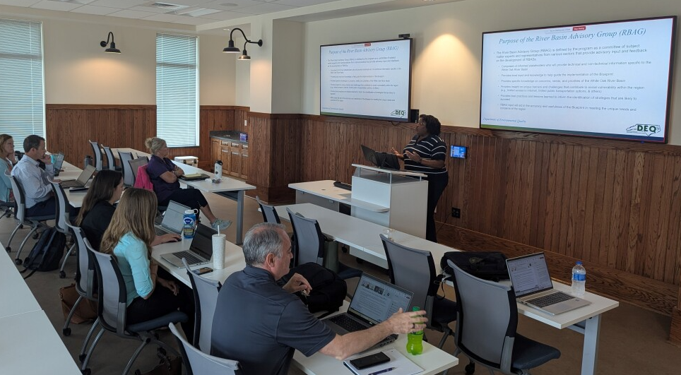
Blueprint Overview - Phase III
Phase III (2024 - 2026) - Ongoing
  Develop River Basin Action Strategies for 6 priority basins
River Basin Action Strategy
  Data Collection, Modeling, and Analysis
    Vulnerability Assessment
    Capacity Assessment
  Community Engagement and Discovery
  Flood Risk Planning and Analysis
  Resiliency Action Review and Adjustment
  Basin-Wide Action Analysis and Ranking
Department of Environmental Quality
Notes:
River Basin Action Strategies
Not simply local governments doing their own thing in a vacuum.
Pull together basin entities to be more efficient and effective. Build synergy, create funding opportunities
Near final draft done for Neuse
Other 5 in progress, ‘26-’27 completion
For other 11 basins, Blueprint data and tool available, but not at same level as first 6

Slide 11
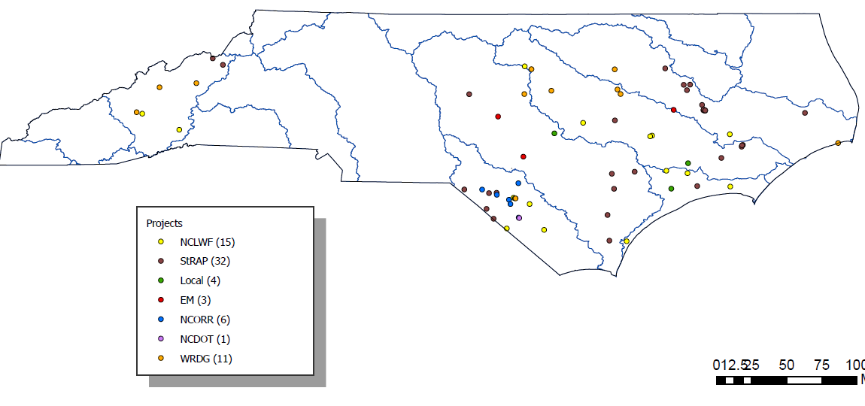
Implementation – Projects Under Contract
Project Partner
Notes:
We have funded 68 resilience projects for ~$32M (will be 72 projects very soon.)
They range from green infrastructure, to innovative stormwater projects, to fortifying critical infrastructure, to relocating public housing out of a flood zone,

Slide 12
Implementation – Funding Partnerships
Implementation Opportunity - Partner | Total Committed With Partners | Under Contract | In process
StRAP 2023 - Department of Agriculture Consumer Services |  | $4,387,666.00
Land Water Fund - DNCR |  | $9,047,404.00 | $1,139,351.00
Disaster Relief and Mitigation Grants - NCEM |  | $3,910,000.00
RISE Priority Projects - Direct Funding Local Governments |  | $120,000.00 | $3,559,476.00
Lumberton Recovery and Infrastructure Resilience - NCORR |  | $8,000,000.00
Water Resources Development Grants - DEQ |  | $5,858,513.00 | $5,000,000.00
Agricultural Pond Flood Storage - DACS | $9,000,000.00
Natural Infrastructure Flood Mitigation Program – DEQ-DMS |  |  | $5,000,000.00
Resilient Transportation - NC DOT | $2,730,000.00 | $270,000.00
French Broad Resilient Recovery Opportunities – Direct Funding Local Governments | $9,000,000.00
Funds for Actions Prioritized RBAS process | $11,240,090.00
Total | $31,970,090.00 | $32,473,583.00 | $9,698,827.00
 |  |  | $76,142,500.00
Notes:
Examples: $11.2M specific River Basin Action Strategy (RBAS) actions
Ag Dept –Streamflow Rehabilitation Assistance Program (StRAP)
Lumberton infrastructure
Also, $42M allocated in progress, not yet under contract
What’s Next?
Expanded outreach to local governments to make them aware of this tool
NCGA push and pull
$20M of $98M removed; staffing concerns
RBAS – Finishing first 6, moving on to next 11
MORE STORMS

Slide 13
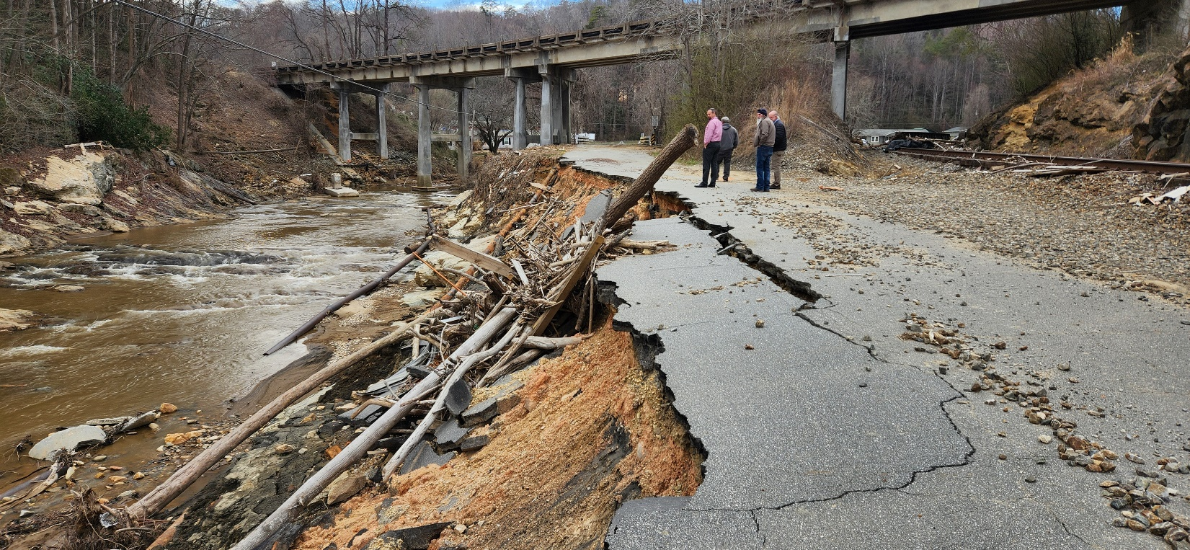
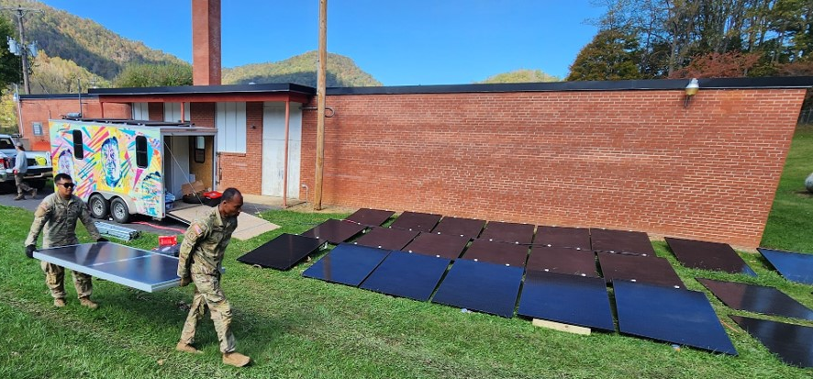
Two Additional Resilience Programs, Post-Helene
Photo Credit: NCDEQ
Photo Credit: Land of Sky Regional Council
Notes:
Picture 1: Hurricane Helene damage to Old Fort water system
$685M federal Helene recovery bill – thank you, EPA region 4!
Worked with local governments, pre-applications, applications – 16 projects from 11 communities, SWIA mtg 9/17 to begin allocations
Rolling quarterly approvals for next year
Picture 2: 25 mobile microgrid being set up in Pensacola NC after Helene.
$5M BIL microgrids for Helene communities – hubs for communications, power
24 permanent in 4 counties – though COG, plus 2 mobile

Slide 14
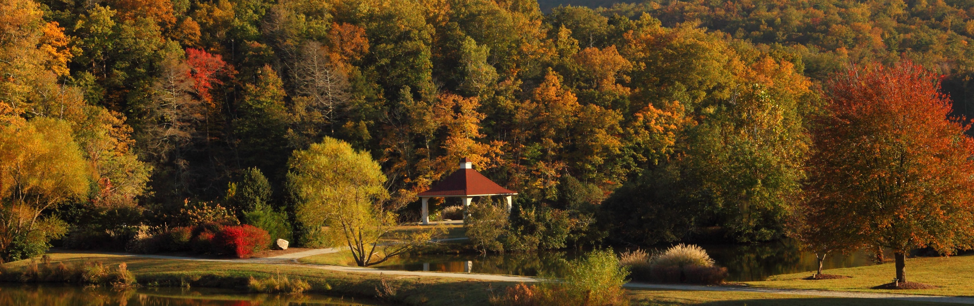
Thank You!
Contacts:
Stuart Brown
NC Flood Resiliency Blueprint Manager
stuart.brown@deq.nc.gov
Department of Environmental Quality

