Slide 1
Resilient Communities & Infrastructure Projects
ECOS Climate & Energy Workgroup –
Strategies in Resilience and Adaptation
Phetmano Phannavong, PE, PMP, CFM

Slide 2
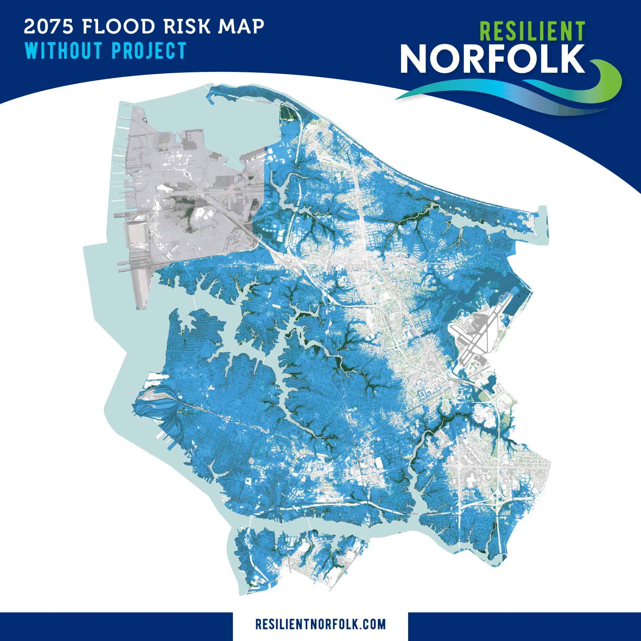
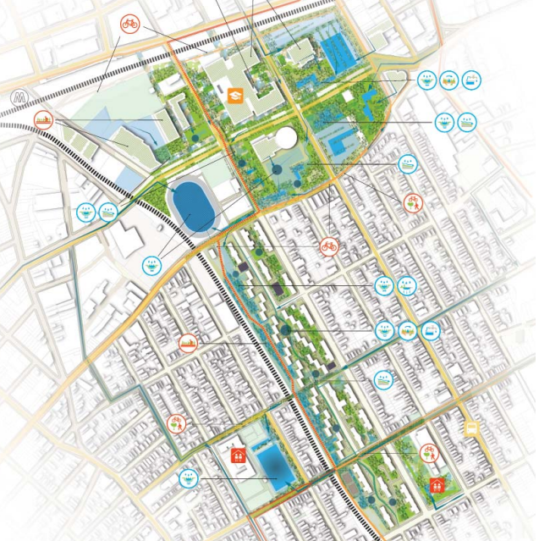
Two Approaches in Resilience and Adaptation
Coastal Storm Risk Management
Cloudburst Management
City of Norfolk, VA
New York City, NY

Slide 3
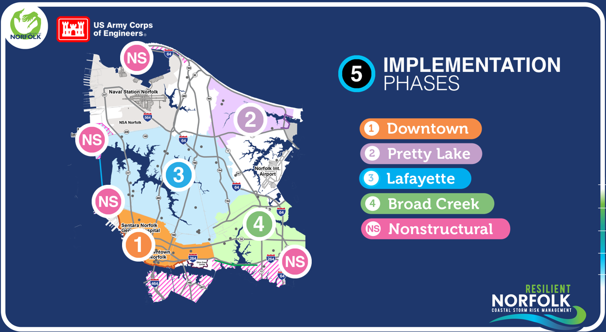
Coastal Storm Risk Management (CSRM) Project, Norfolk, Virginia

Slide 4
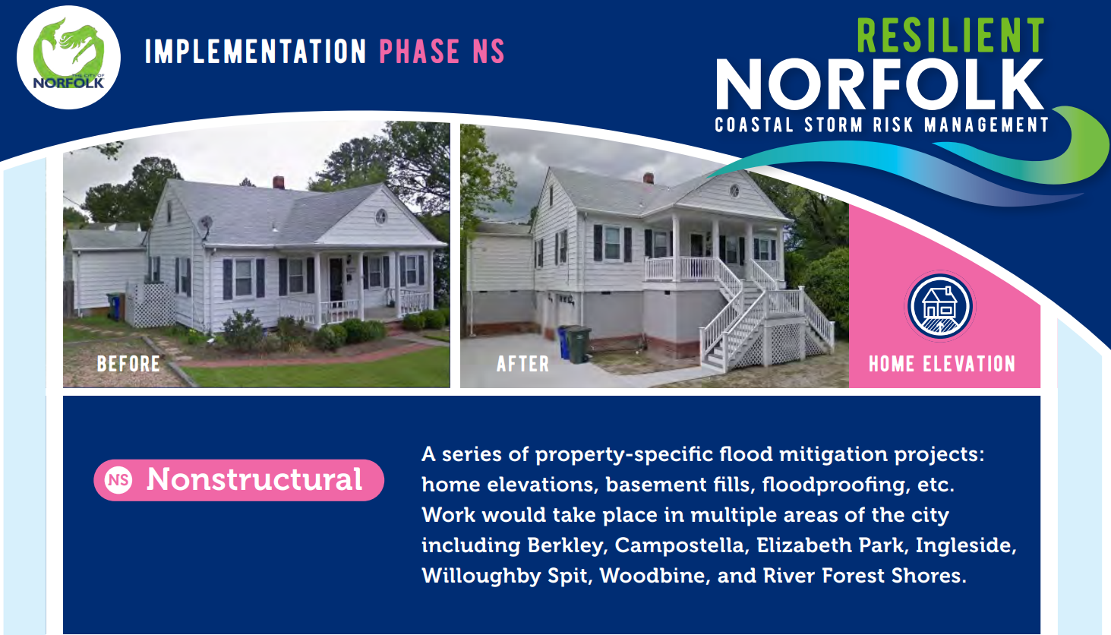
Norfolk CSRM Nonstructural Program, Norfolk, Virginia

Slide 5
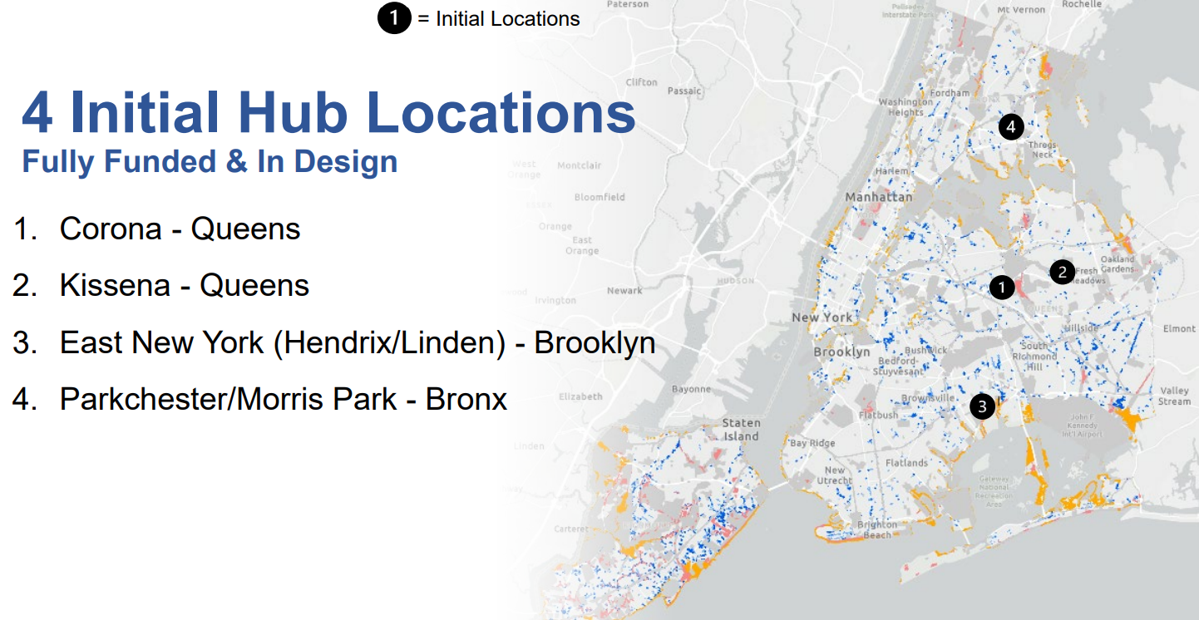
Cloudburst Management Project, New York City, New York

Slide 6
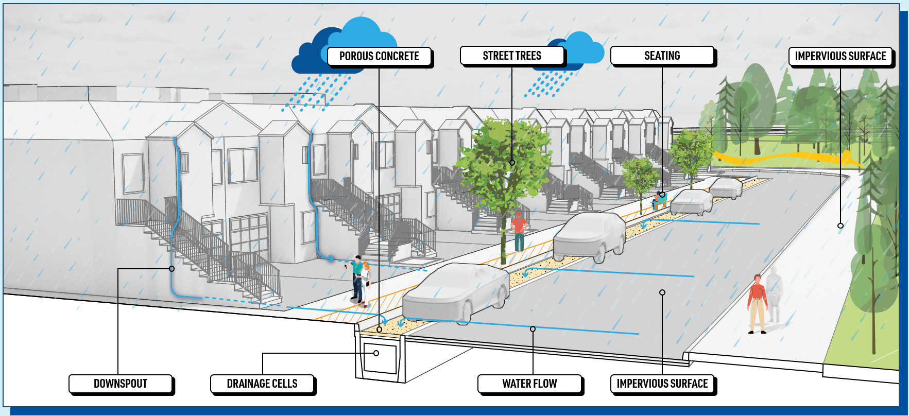
Kissena Cloudburst Hub, New York City, New York

Slide 7
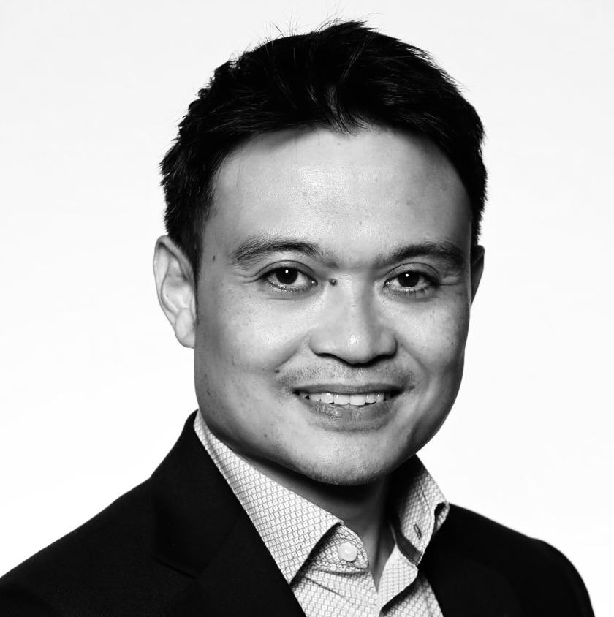

Phetmano Phannavong, PE, PMP, CFM
Senior Advisor, Water
(703) 599-0055
phetmano.phannavong@aecom.com

