Slide 1
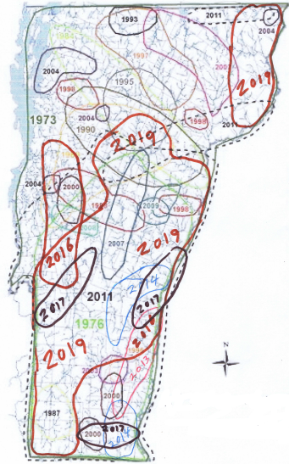
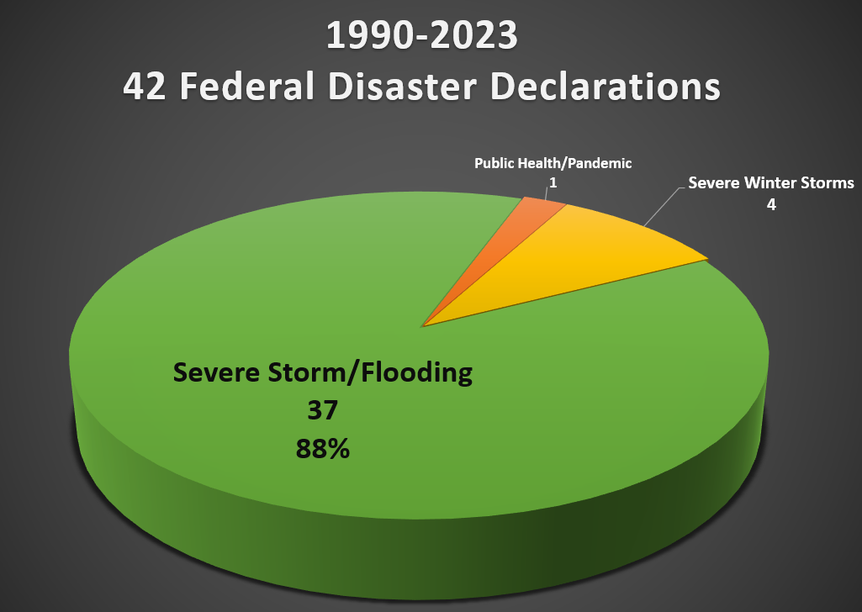
Vermont Disasters, by the Numbers
Notes:
Average a federal flood declaration every year 1990..
No wonder that our State Hazard Mitigation Plan list flooding and flood related erosion has our top natural hazards of concern…

Slide 2
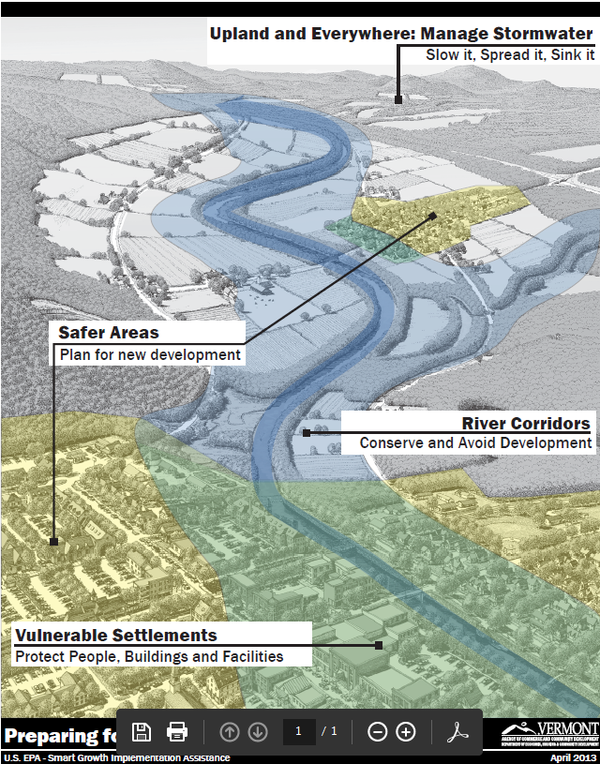
Importance of Resilience
Fast, effective response and early recovery
  Emergency authorities
  VT WARN
  Local liaisons program
Long-term adaptation
  Avoiding the unmanageable
    Hazard mitigation
    Land use planning and regulation
    Nature-based solutions
  Managing the unavoidable
    Floodproofing and hardening existing assets
    Designing and maintaining reliable infrastructure

Slide 3





Resilience Implementation Strategy
Government Systems
Community-Centric Approach
Early Warning Systems & Emergency Response
Economic & Environmental Sustainability
Infrastructure Design & Reinforcement
Nature-Based Solutions
Notes:
Presenter: Evan
The vision is built on these six core components, which guide the entire strategy.
These were refined from the initial release, and we made one addition: Government Systems. We added this because it’s the foundational framework that connects and supports all the other components. It’s how we integrate climate resilience across all state agencies, empower our communities—especially the most vulnerable—and build the trust needed for a unified response to climate change.
This vision doesn't start from scratch. It's grounded in work already happening across the state. We conducted an assessment of more than 20 existing reports and plans that have extensive public engagement to identify themes within these core areas. That analysis allowed us to refine our focus based on what Vermonters were looking for. For example, we broke down a broad topic like 'Nature-Based Solutions' into smaller parts, including land conservation, sustainable land practices, and water quality.
With this refined vision written, our next step was to identify the opportunities for action, which we did through a comprehensive inventory of existing state work and a hands-on workshop.

