Slide 1

EPA Form 4700-4 Audit
Rachel Zander
Civil Rights Coordinator
DNR Legal Services Bureau
rachel.zander@dnr.iowa.gov
515-305-0324

Slide 2
Iowa Department of Natural Resources
Environmental protection and natural resources
840 full time employees
Federal funding relationships with:
Environmental Protection Agency
Dept. of Interior (Fish & Wildlife Service* and National Park Service)
Dept. of Defense (US Army Corps of Engineers)
Dept. of Homeland Security* (US Coast Guard & FEMA)
Department of Transportation
Housing & Urban Development, occasional (Community Development Block Grants)
US Geological Survey, occasional
*Routine civil rights audits

Slide 3
Iowa DNR’s
civil rights
program
01
August 2021
Created External Civil Rights & EJ Coordinator position
02
Published Nondiscrimination Statements, Disability Nondiscrimination Plan, Grievance Procedure, and Language Access Plan
October 2021
03
November 2021
EPA technical assistance meeting with DNR on LEP meaningful access
04
February 2022+
Focus on language implementation
05
August 2022
EPA published NPG containing audit goals
06
April 2023-January 2024
(not many developments - Coordinator temporarily reassigned)
Routinely audited by USFWS & DHS
Notes:
I came onboard in December 2021 first in an acting capacity and then permanent.

Slide 4
EPA’s Focus on Audits

Slide 5
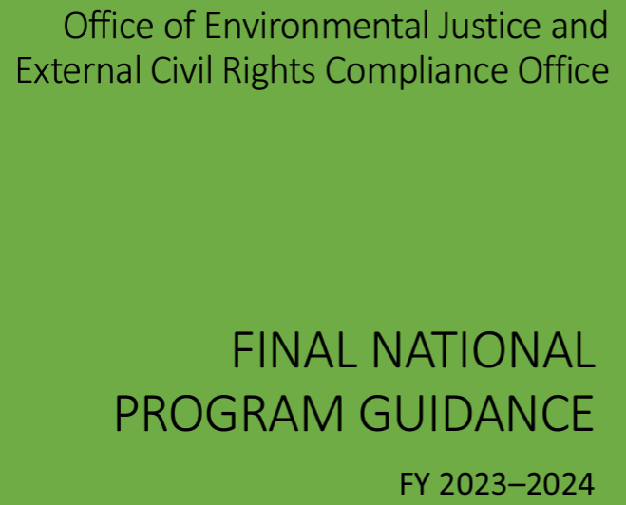
Long-Term Performance Goal: By September 30, 2026, complete 305 audits to ensure EPA financial assistance recipients are complying with nondiscrimination program procedural requirements.
FY25-26 Draft NPG contains commitment to audits and has a placeholder for the final number.

Slide 6
ECRCO Update
National EJ Community Engagement Call
7/16/24
Post-Award Audits Initiated: 14, with another 10 pending
Post-Award Audits Completed: 9

Slide 7
EPA’s Audit of Iowa DNR’s
Form 4700-4

Slide 8
Initiation Email
February 21, 2024
Email from: V’Hesspa Glenn, Case Manager, OEJECR
Initiation letter attached
CC:
OEJECR
Contractor
Region 7
Region
Anhthu Hoang
Kurt Temple
Lilian Dorka
Environmental Engineer, Eastern Research Group, Inc.
Division Director, Environmental Justice, Community Engagement, & Env. Review Dvi.
Acting Regional Counsel
Assistant Regional Counsel (CR coordinator)
Office of Public Affairs staff

Slide 9
Audit Initiation Letter: Focus
“The audit will confirm whether an EPA recipient, whose Form is selected for audit, fulfills the nondiscrimination regulation requirements as indicated on the specified Form that was reviewed by EPA at the time of application for EPA financial assistance.”
Specific form identified in the letter subject line and attached
Letter identified which Form 4700-4 questions would be the focus of the audit

Slide 10
Audit Initiation Letter: Next Steps
“The audit will encompass information related to your organization’s responses submitted to EPA on the specified Form 4700-4 and may include initial and follow-up requests for information and data which supports your organization’s responses, including for example, electronic and hard-copy documents, website links and information, and other supporting material.”

Slide 11
Audit Initiation Letter: Next Steps
“Within 5 business days of the date of this correspondence, please contact [contractor], to acknowledge receipt and to schedule a conversation to discuss the audit and its process.”

Slide 12
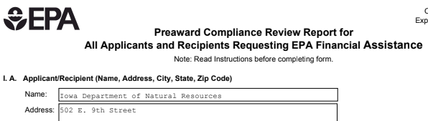
Audit Initiation Letter: Attachment
4700-4

Slide 13
Form 4700-4: summary of requirements
III. all pending civil rights lawsuits and administrative complaints
IV. all civil rights lawsuits and administrative complaints decided against the applicant/recipient within the last year
V. all civil rights compliance reviews of the applicant/recipient
VI. accessibility of new construction
VII. notice of nondiscrimination: accessible, posted, and naming coordinator
VIII. demographic data
IX. language access / LEP policy
X. designated coordinator
XI. grievance procedure

Slide 14
Form 4700-4: summary of requirements
III. all pending civil rights lawsuits and administrative complaints
IV. all civil rights lawsuits and administrative complaints decided against the applicant/recipient within the last year
V. all civil rights compliance reviews of the applicant/recipient
VI. accessibility of new construction
VII. notice of nondiscrimination: accessible, posted, and naming coordinator
VIII. demographic data
IX. language access / LEP policy
X. designated coordinator
XI. grievance procedure
April 2023 form for Brownfields funding

Slide 15
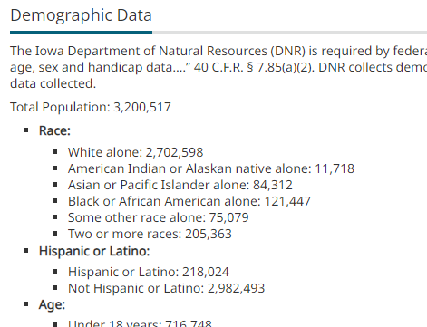
DNR’s immediate actions
Created Data Collection SOP
Retrieved statewide demographic data from the U.S. Census Bureau and posted to website consistent with 40 C.F.R. 7.85(a).
Posted to DNR website

Slide 16
Audit initiation meeting
February 29, 2024 (+8 days from receipt of email/letter)
Attendees:
  Rachel Zander (Iowa DNR)
  V’Hesspa Glenn (OEJECR)
  Kurt Temple (ECRCO)
  Contractor

Slide 17
Audit initiation meeting
EPA:
  A little behind on the commitment to 305 audits
  Recipients selected for audit randomly
  Request for information process
  Opportunity to provide technical assistance
  Goal: resolution through voluntary compliance; agreement if needed
DNR question:
  Respond to RFI with current information or info at time April 2024 form was submitted? Current

Slide 18
EPA’s request for information
Received March 6, 2024 (+6 days from meeting)
14 day turnaround
Content:
  Listed each specific Form 4700-4 item
  Identified DNR’s original response
  Specified what information to submit

Slide 19
RFI
III. Pending Civil Rights Lawsuits and Administrative Complaints.
For each identified lawsuit and complaint, please indicate the case name, the case number, and the status of the civil rights lawsuit or administrative complaint (e.g., John Doe Advocacy Group v. State DEQ, 12R-2022, casein final review). If there are no pending civil rights lawsuits or administrative complaints responsive to the request, please note that in your response.

Slide 20
Response
III. Pending Civil Rights Lawsuits and Administrative Complaints.
There are no pending civil rights lawsuits or administrative complaints responsive to the request.

Slide 21
RFI
IV. Decided Civil Rights Lawsuits and Administrative Complaints
For each identified lawsuit and complaint decided within the last year, please indicate the case name, the case number, and the date that the civil rights lawsuit or administrative complaint was decided (e.g., John Doe Advocacy Group v. State DEQ, 12R-2022, Decision: January 3, 2023). Enclose a copy of all decisions and describe all corrective actions taken by your organization pursuant to those decisions. If there are no civil rights lawsuits or administrative complaints responsive to therequest, please note that in your response.

Slide 22
Response
IV. Decided Civil Rights Lawsuits and Administrative Complaints
Not applicable as there were no civil rights lawsuits or administrative complaints responsive to the request.

Slide 23
RFI
V. Civil Rights Compliance Reviews.
For each identified compliance review conducted within the last two years, please indicate the name of the federal agency, the case name (or name of the involved parties), the case/reference number, the date of the civil rights compliance review’s initiation, and the date that the civil rights compliance review was closed (or indicate if a compliance review is still pending) (e.g., US Agency Compliance Review of State DEQ, 12R-2022, Initiated: November 9, 2022, Closed: January 3, 2023). Enclose a copy of the review(s) and any decisions, orders, or agreements based on the review. Please describe any corrective action taken by your organization in response to the review(s). If there are no civil rights compliance reviews responsive to the request, please note that in your response.

Slide 24
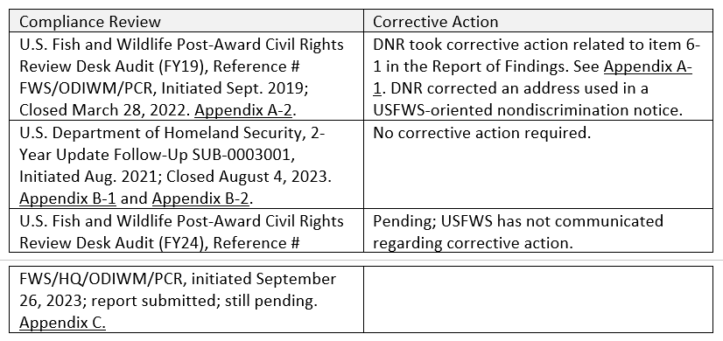
Response
V. Civil Rights Compliance Reviews.

Slide 25
RFI
VI. Assistance for New Construction
[Respond only if Box VI is Checked on the Audit Initiation Letter].
If your organization requested EPA assistance for new construction, please respond“yes” or “no” whether all new facilities or alterations to existing facilities will be designed and constructed to be readily accessible to and usable by persons with disabilities. If your response is “no”, please explain how a regulatory exception (40 C.F.R. 7.70) applies.

Slide 26
Response
VI. Assistance for New Construction
Not applicable (Box VI not checked on Audit Initiation Letter)

Slide 27
RFI
VII. Notice of Nondiscrimination
Your organization responded to questions VII, VII(a), VII(b), and VII(c) that your organization provides notice that it does not discriminate on the basis of race,color, national origin, sex, age, or disability. Please provide a copy of the notice that supports your organization’s responses.
In addition, please provide information about where the notice is located and whether it is publicly available. Publicly available information may include electronic and hard-copy documents, website links and information, and other supporting material.

Slide 28
Response
VII. Notice of Nondiscrimination
DNR’s Notice of Nondiscrimination English and Spanish versions are attached as Appendix D and Appendix E. This notice is publicly available in hardcopy and digital format. DNR posts paper versions of this notice in its central office and regional field offices. A digital version of this notice is available at the top of DNR’s Civil Rights and Environmental Justice website, https://www.iowadnr.gov/About-DNR/Civil-Rights-and-Environmental-Justice.
…

Slide 29
Response
VII. Notice of Nondiscrimination
… DNR also includes the notice in materials for education programs and activities and periodicals. For example, DNR’s drinking water and wastewater operator program involves educational components. The homepage for its training system includes the nondiscrimination statement, as does the PDF application for the Operator Certification Exam. See https://programs.iowadnr.gov/opcertweb/pages/opmenu.aspx and https:/
/www.iowadnr.gov/Portals/idnr/uploads/forms/5423118.pdf. DNR is occasionally required to harmonize nondiscrimination notice requirements from more than one federal agency, and a slightly different notice is used. For example, please see the 2023-24 Iowa Hunting, Trapping & Migratory Game Bird Regulations, page 54, https://www.iowadnr.gov/portals/idnr/uploads/hunting/
huntingregs.pdf.

Slide 30
RFI
VIII. Demographic Data
Your organization responded to question VIII that it maintains demographic data on the race, color, national origin, sex, age, or disability status of the population it serves. Please provide a copy of your organization’s policy, procedure, or other information to support your organization’s response.
In addition, please provide information about where the demographic data is maintained and whether it is publicly available. Publicly available information may include electronic and hard-copy documents, website links and information, and other supporting material.

Slide 31
RFI Response
VIII. Demographic Data
DNR’s Data Collection Standard Operating Procedure is included as Appendix F. The demographic data is collected by DNR’s Civil Rights Coordinator and is maintained on DNR’s Civil Rights and Environmental Justice webpage, https://www.iowadnr.gov/About-DNR/Civil-Rights-and-Environmental-Justice.

Slide 32
RFI
IX. LEP Policy/Procedure
Your organization responded to question IX that it has policy/procedure for providing meaningful access to services for persons with limited English proficiency. Please provide a copy of your organization’s policy, procedure, or other information to support your organization’s response.
In addition, please provide information about where policy, procedure, or other information is maintained and whether it is publicly available. Publicly available information may include electronic and hard-copy documents, website links and information, and other supporting material.

Slide 33
RFI Response
IX. LEP Policy/Procedure
Iowa DNR’s Limited English Proficiency Plan, English and Spanish versions, are included as Appendix G and Appendix H. Both versions of the plan are available on DNR’s Civil Rights and Environmental Justice webpage, https://www.iowadnr.gov/About-DNR/Civil-Rights-and-Environmental-Justice.

Slide 34
RFI
X. Nondiscrimination Coordinator
If your organization responded to question X by leaving the space blank, or with an “N/A”, or “not applicable”, please confirm whether your organization is an education program or activity and provide information identifying the number of employees in your organization.
If your organization responded to question X with information about the name and other requested identifying information about your organization’s coordinator, please provide information about where the coordinator’s information is maintained and whether it is publicly available. Publicly available information may include electronic and hard-copy documents, website links and information, and other supporting material.

Slide 35
RFI Response
X. Nondiscrimination Coordinator
Iowa DNR’s Nondiscrimination Coordinators name and contact information are publicly available. The coordinators are identified on DNR’s Civil Rights and Environmental Justice webpage, https://www.iowadnr.gov/About-DNR/Civil-Rights-and-Environmental-Justice. A coordinator is also named in the Notices of Nondiscrimination, Appendix D and Appendix E.

Slide 36
RFI
XI. Grievance Procedures
If your organization responded to question XI by leaving the space blank,or with an “N/A”, or “not applicable”, please confirm whether your organization is an education program or activity and provide information identifying the number of employees in your organization.
If your organization responded “yes” to question XI, please provide information about where the grievance procedures are located and whether they are publicly available. Publicly available information may include electronic and hard-copy documents, website links and information,and other supporting material.

Slide 37
RFI Response
XI. Grievance Procedures
Iowa DNR’s grievance procedure, titled the Discrimination Complaint Procedure, is publicly available in English and Spanish. Appendix I and Appendix J. Both are accessible on DNR’s Civil Rights and Environmental Justice webpage, https://www.iowadnr.gov/About-DNR/Civil-Rights-and-Environmental-Justice.

Slide 38
Audit review letter / audit conclusion
Received June 28, 2024 (+47 days since RFI response submitted)
OECRC has reviewed IDNR’s responses to the RFI,including the corresponding links IDNR provided on March 19, 2024, and determined that the responses generally fulfill the requirements for the questions on Form 4700-4. Accordingly, there is no further action required by IDNR at this time.

Slide 39
EPA
reviewed:
USFWS FY19 Report of Findings
USFWS FY19 Closure Letter
USDHS Civil Rights Evaluation
USDHS Closure Email
USFWS FY24 Initiation Letter
DNR Notice of Nondiscrimination – English
DNR Notice of Nondiscrimination – Spanish
DNR Data Collection SOP
DNR Limited English Proficiency Plan – English
DNR Limited English Proficiency Plan – Spanish
DNR Discrimination Complaint Procedure – English
DNR Discrimination Complaint Procedure - Spanish

Slide 40
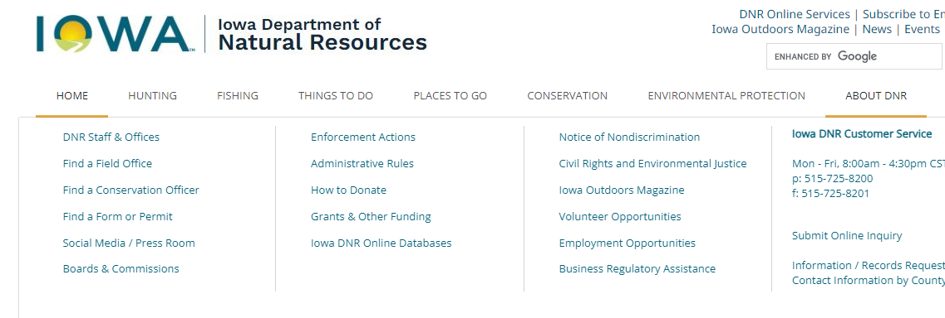
By way of technical assistance, IDNR may wish to consider hyperlinking IDNR’s Civil Rights and Environmental Justice page on IDNR’s homepage instead of under the “About” tab to ensure prominent placement as required by 40 C.F.R. Sect. 7.95

Slide 41
Alternative next steps…
Additional RFIs; technical assistance
Voluntary compliance agreement to correct deficiencies within 6 months

Slide 42
Audit Timeline
February 21 | DNR receives EPA email/letter initiating audit
February 29 | Audit initiation meeting
March 6 | DNR receives EPA’s request for information
March 19 | DNR submits response to request for information
June 28 | DNR receives EPA’s audit review letter concluding the audit

Slide 43
Questions?
Rachel Zander
Iowa Department of Natural Resources
Civil Rights Coordinator & Attorney
rachel.zander@dnr.iowa.gov
515-305-0324

