Slide 1
National Recycling Strategy and Goals Kimberly Cochran, Ph.D. Office of Resource Conservation and Recovery U.S. Environmental Protection Agency ECOS Fall Meeting September 23, 2020

Slide 2
Recycling Challenges
Promoting Education and Outreach
Enhancing Materials Management Infrastructure
Strengthening Secondary Materials Markets
Enhancing Measurement

Slide 3
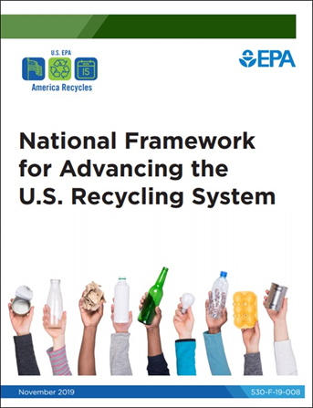
Developing the Draft National Recycling Strategy
SMM Strategic Plan for 2017-2022
National Framework for Advancing the U.S. Recycling System
National Recycling Strategy
National Recycling Goals
Roadmap

Slide 4
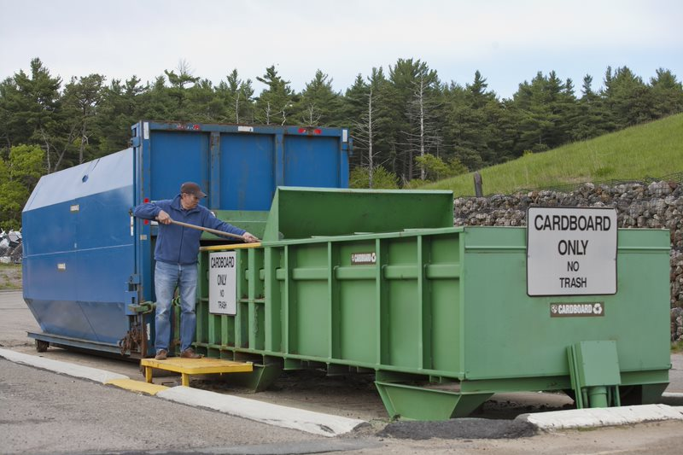
National Recycling Strategy Objectives
Objective 1: Reduce Contamination
Objective 2: Increase Processing Efficiency
Objective 3: Improve Markets

Slide 5
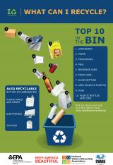
Objective 1: Reduce Contamination in the Recycling Stream
Enhance education and outreach
Increase information on recycling programs and policies

Slide 6
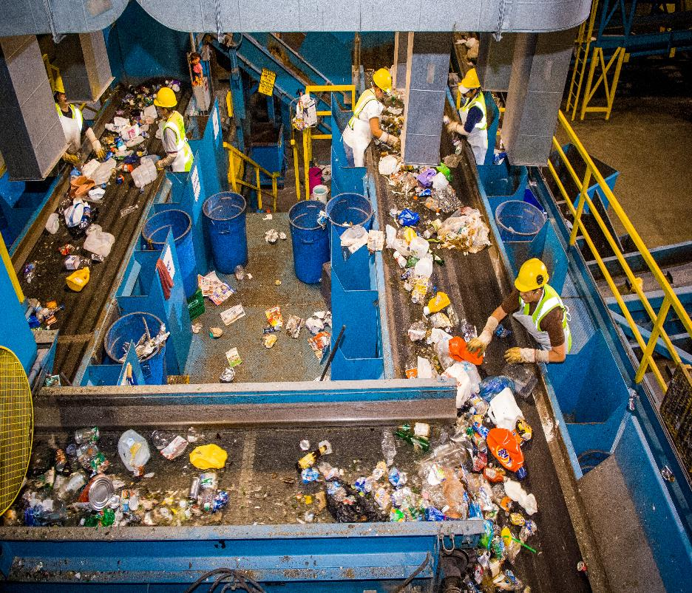
Objective 2: Increase Processing Efficiency
Understand infrastructure needs
Identify available funding
Support R&D
Design products for recycling
National definitions, measures, targets, and performance indicators

Slide 7
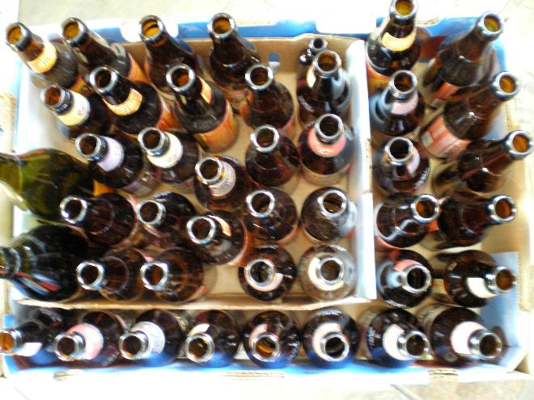
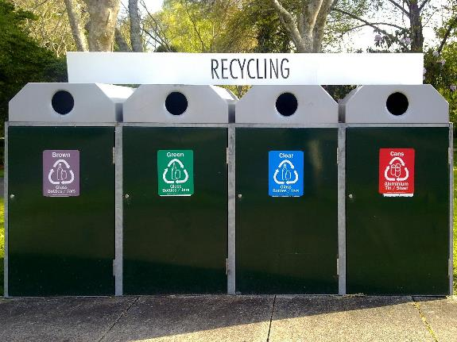
Objective 3: Improve Markets
Market development workshops
Analyze end markets
Generate data on materials and markets
Use materials where they are generated
Increase demand

Slide 8
Opportunity for Comment
Which actions are the most important?
In general?
For the federal government?
What are the key steps to successfully implement these actions?
Are we missing any actions?
Are you willing to lead and collaborate with others to implement the actions?
Additional information or recommendations?

Slide 9
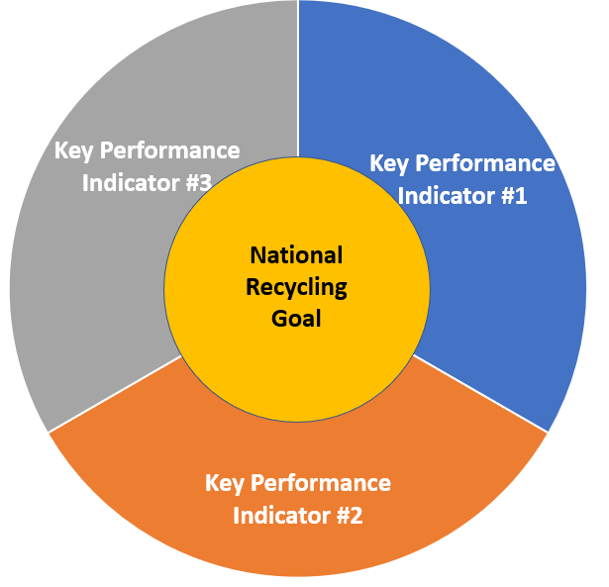
Developing National Recycling Goals
America Recycles Objectives
Measurement Approach
Strengthen U.S. Recycling System

Slide 10
Next Steps
National Recycling Goals are out for comment
Release draft Strategy for comment
Highlight Strategy and Announce Recycling Goals during America Recycles Week 2020
Summit and Innovation Fair Nov 16-17
Finalize Strategy in early 2021
Develop roadmap
epa.gov/AmericaRecycles

Slide 11
Questions
Kim Cochran
Chief of the Sustainable Materials Branch
Office of Resource Conservation and Recovery
Cochran.Kimberly@epa.gov
www.epa.gov/americarecycles

