Slide 1
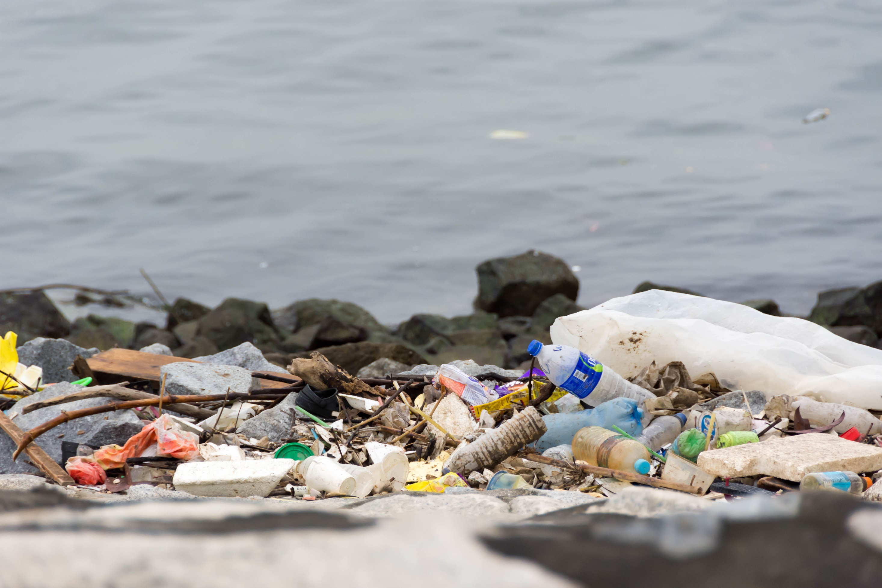

Toward Plastics Reduction, Recycling, & Reuse
23 September 2020
Wendy Worley
NC DEQ Recycling Program
Notes:
LONG-STANDING PROGRAM AT STATE LEVEL TO PROVIDE TECHNICAL ASSISTANCE TO LOCAL GOVERNMENTS & RECYCLING BUSINESSES
GOAL – Transform the state’s economy from a linear disposal economy to a sustainable circular economy
Technical ass’t to local governments & recycling businesses
SOURCES OF PLASTIC POLLUTION
Litter -- Intentional and Unintentional
Domestic & International

Slide 2
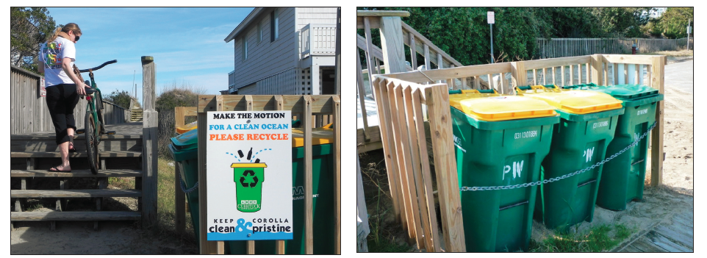
Solutions
Reduce Your Single Use
Offer Adequate Trash & Recycling Services
Stop System Leakage
Education & Enforcement
Notes:
Reduce Your Single Use
Offer Adequate Trash & Recycling Services
Stop System Leakage
Appropriate containers (esp. away from home)
Trained collectors and collection vehicles that minimize loss
Operational plans for material facilities to reduce debris / system leakage
Education & Enforcement
Increase Domestic Markets for Recyclable Materials

Slide 3

Notes:
Tools for local implementation to provide clear, consistent messaging about what can and can’t be recycled.
Set of Informational and Education Tools for Local Implementation
225+ Local Governments Participated in the Campaign
DEACS Social Media Platforms:
Reached ~1 million people

Slide 4
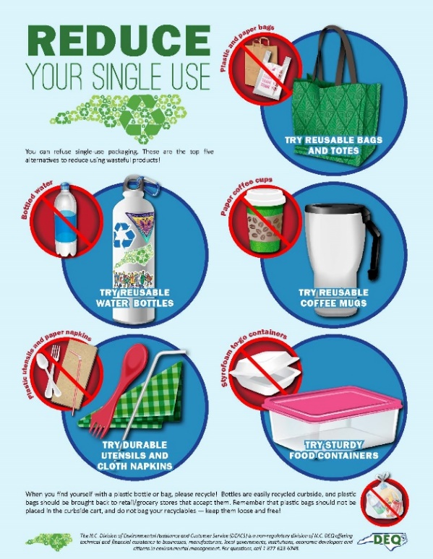
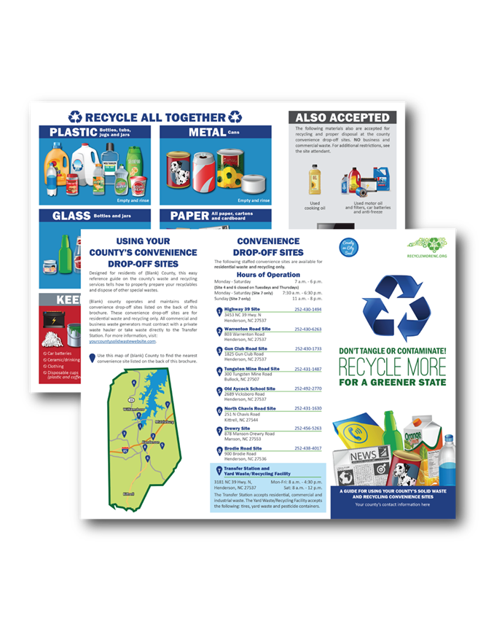
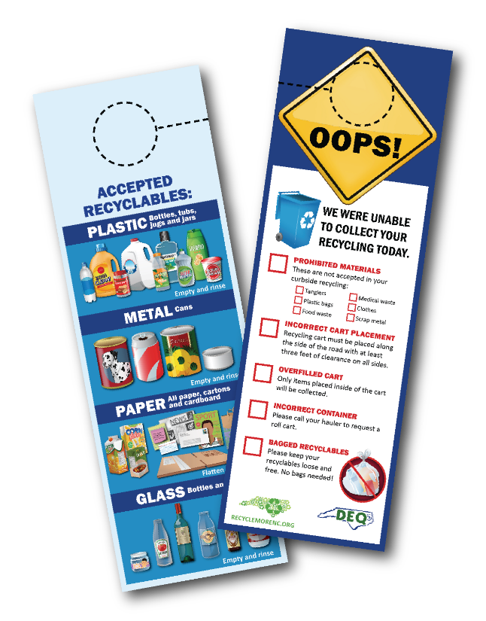
Education and Enforcement Customized Local Outreach Design

Slide 5
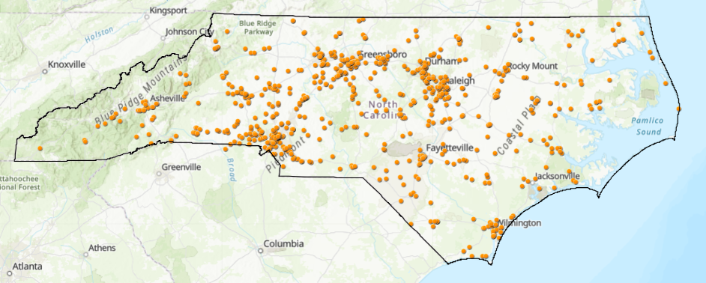
Increase Domestic Markets for Recyclable Materials
Notes:
Increase Domestic Markets for Recyclable Materials

Slide 6
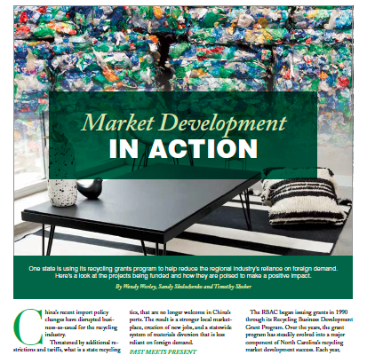
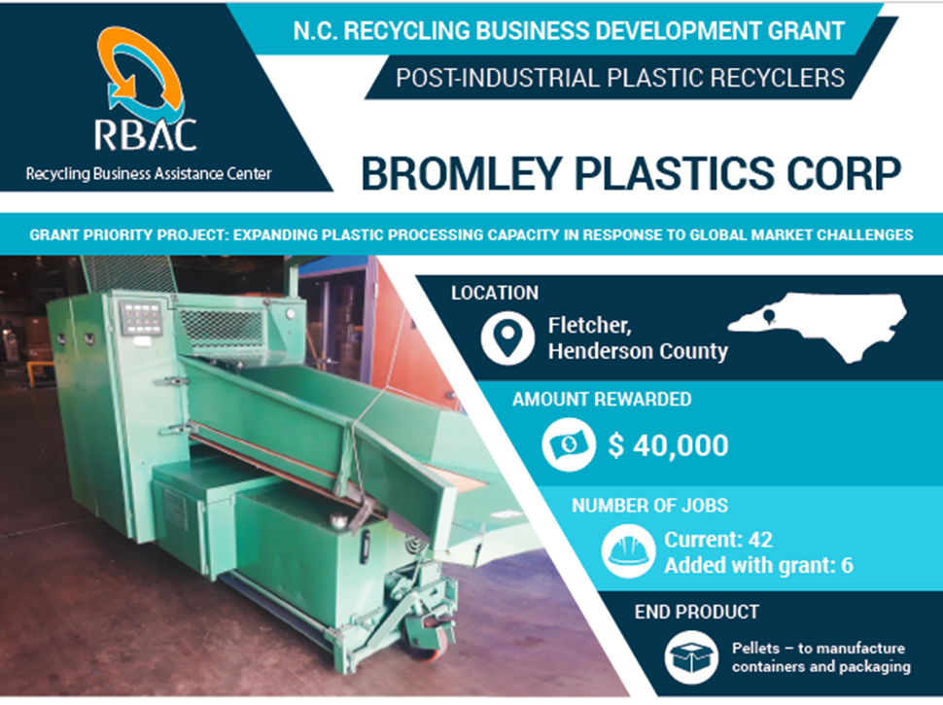
Targeted Grant Making
Notes:
Increase Domestic Markets for Recyclable Materials

Slide 7
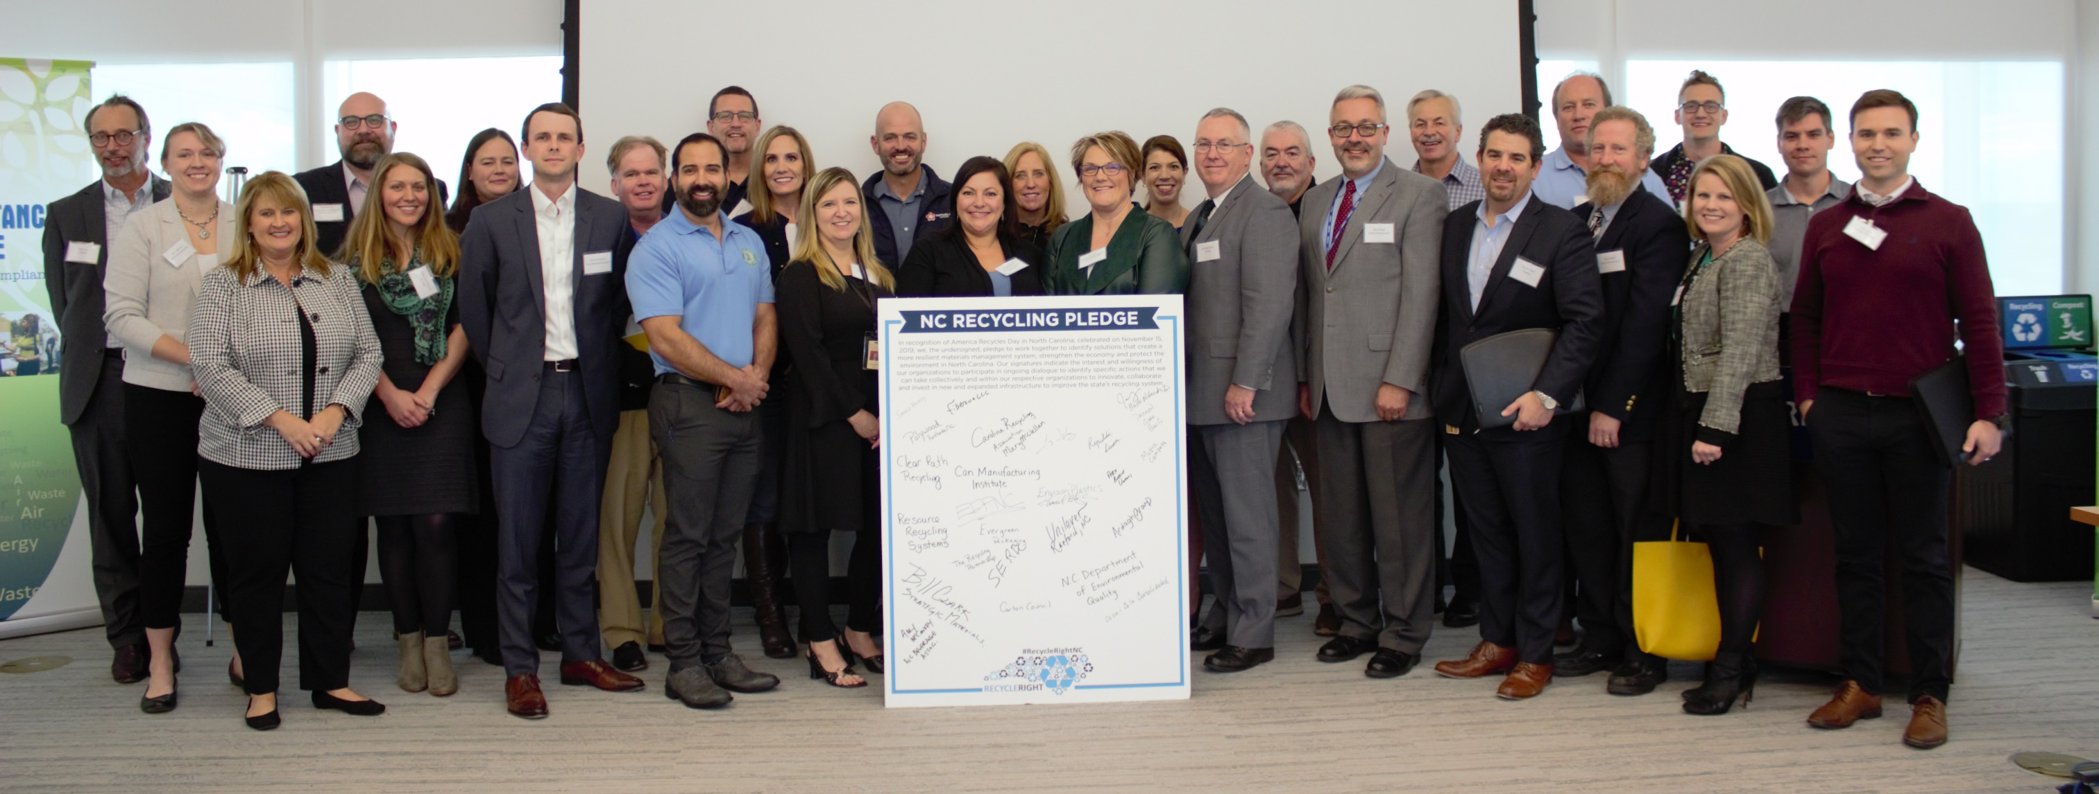
NC Recycling Market
Development Roundtable
Notes:
Increase Domestic Markets for Recyclable Materials

Slide 8
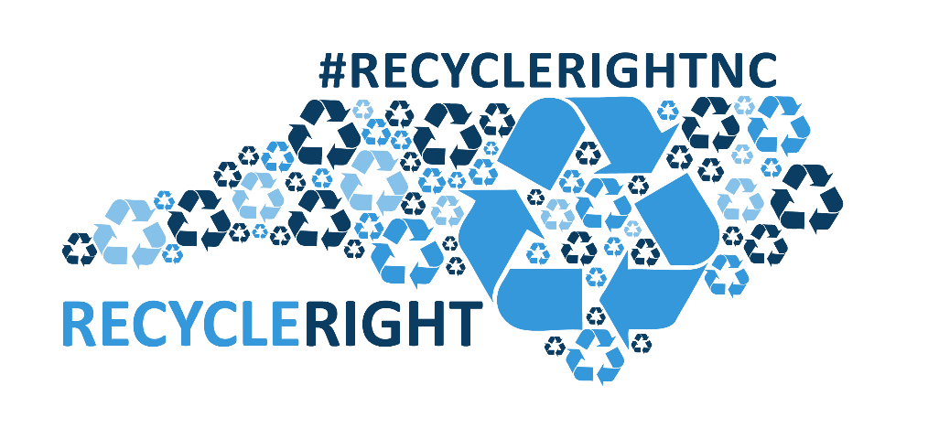


Thank you!
Wendy Worley
Recycling and Materials Management Section
Division of Environmental Assistance and Customer Service
NC Department of Environmental Quality
919-707-8136
wendy.worley@ncdenr.gov
www.recyclenc.org

