Slide 1
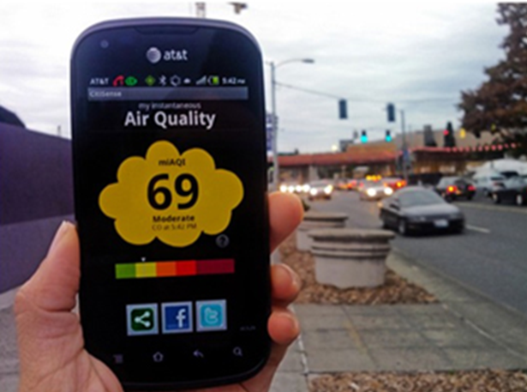
E-Enterprise Community Science:
Approaches and Opportunities
    Environmental Council of the States
    Fall Meeting, September 23, 2020
    Patrick McDonnell
    ECOS Vice President
    Co-Chair, E-Enterprise for the Environment Leadership Council
    Secretary, Pennsylvania Department of Environmental Protection
    Jay Benforado
    Chief Innovation Officer, U.S. EPA Office of Research & Development

Slide 2
Community Science Polling Questions
1. In what areas has your state used community science to contribute to the work of state environmental programs?
(May select more than one)
  A. Water quality monitoring
  B. Air pollution monitoring
  C. Drinking water and ground water
  D. Environmental observations – e.g., HABs, fish kills, pesticides applications, invasive species, etc.)
  E. Biology and Conservation
  F. Information/awareness raising
  G. Other
  H. Unsure
2. Do you see potential for movement in your state towards increased use of community science?
  A. No
  B. Yes
  C. Not sure
3. What are likely to be the biggest barriers to state use of citizen science data? (May select more than one)
  A. Data quality (documentation of quality assurance)
  B. Limited available funding and technical support from state agencies
  C. Uncertainty about technology (e.g., performance of pollution sensors)
  D. Limited scientific support available from other organizations
  E. Other
4. What opportunities offer the most potential to strengthen the EPA/State/Tribal partnership on community science?
(May select more than one)
  A. Shared vision on using citizen science in environmental programs
  B. Additional projects at the state level that demonstrate good practices
  C. Focus on data management issues through E-Enterprise
  D. Guidance on how data can be used (i.e., data that does not come from federally approved regulatory-quality methods -- which is most CS data)
  E. Other

Slide 3
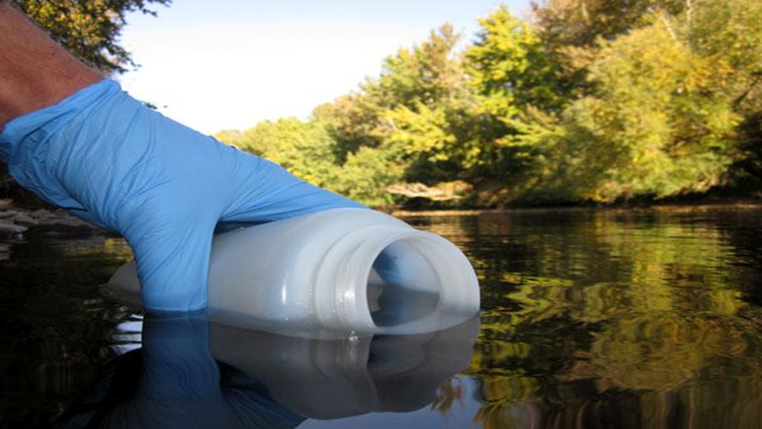

Slide 4
Community Science Alignment with the E-Enterprise Digital Strategy
Community Science
Digital Strategy
Community Science actions advance the
Digital Strategy
Make Open Data Content and Web APIs the New Default
Improve Data Infrastructure
Elevate Standards and Methods
Shared Platforms
Promote Data Accessibility and Transparency
Move to Cloud and Shared Hosting

Slide 5
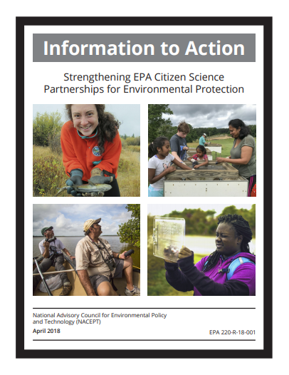
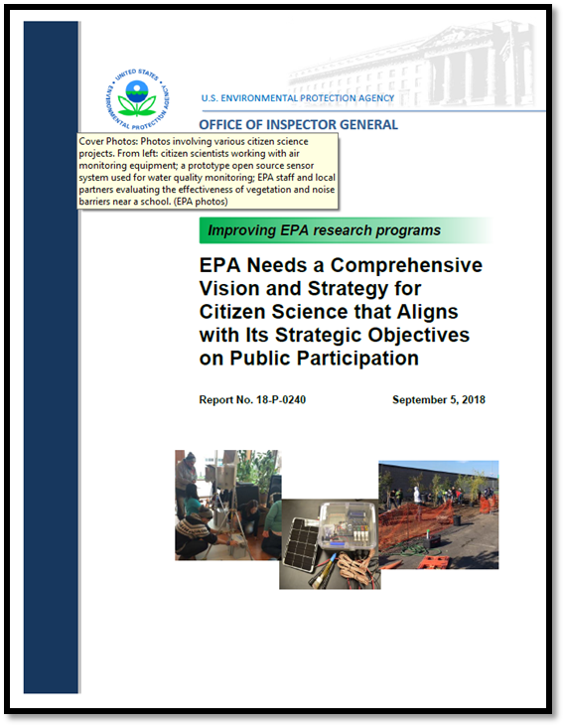
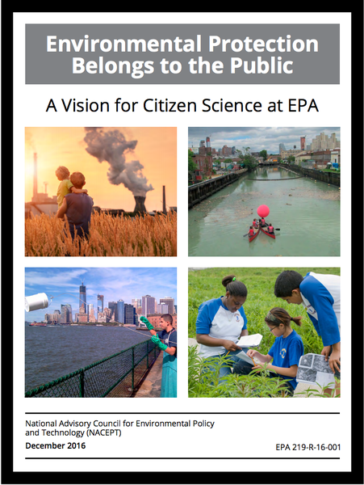
2018
EPA
2016
2018

Slide 6
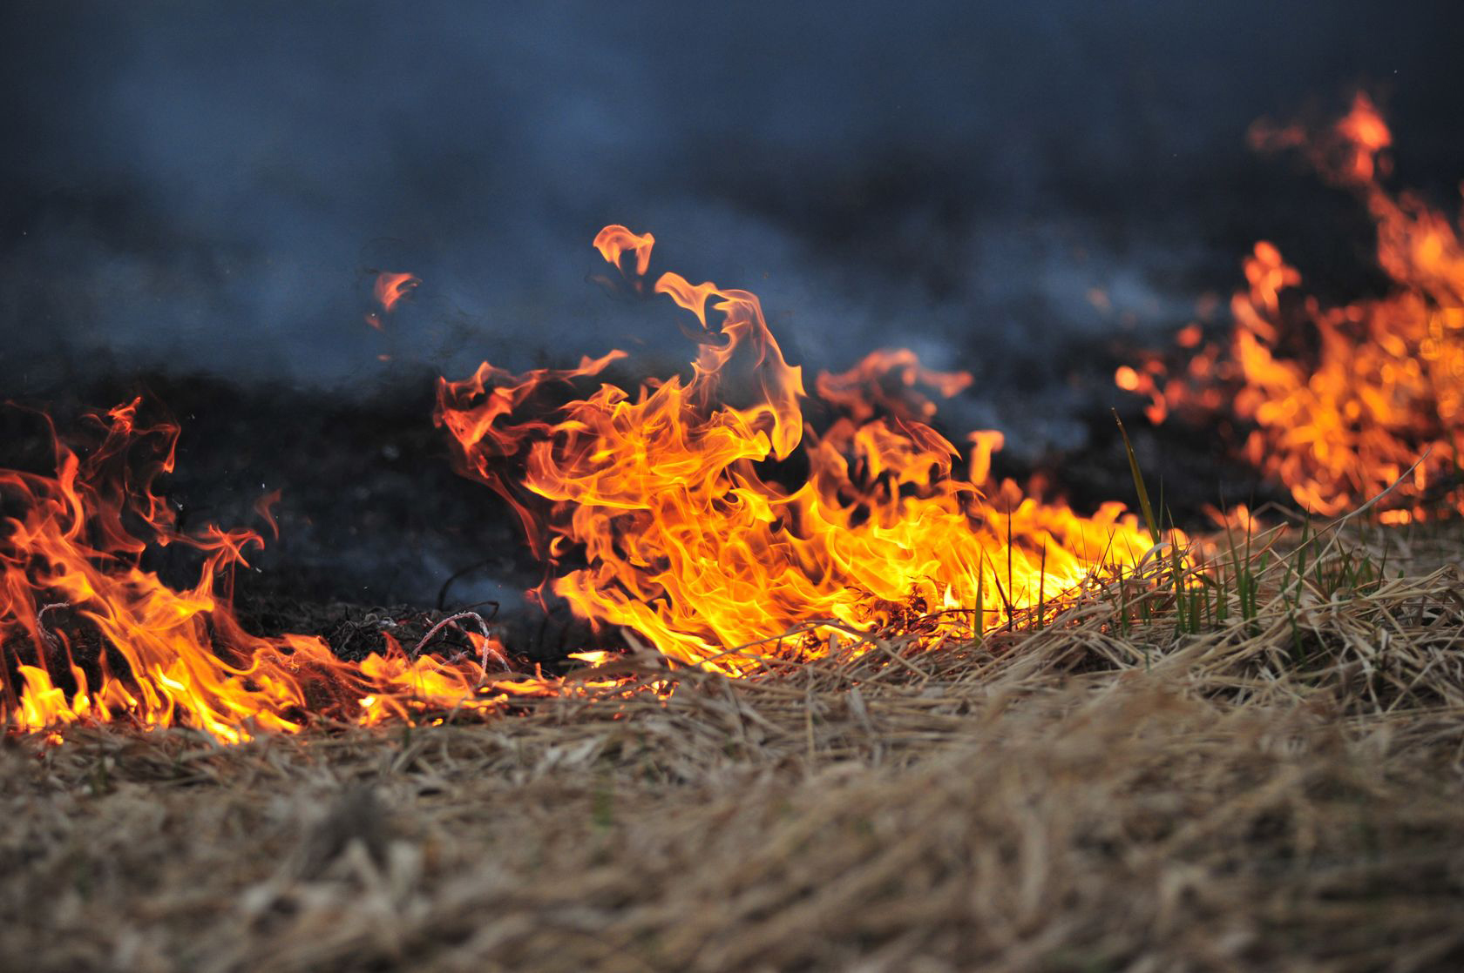
Smoke Sense
EPA mobile app to increase awareness of health effects from exposure to wildfire smoke and further advance scientific understanding of:
  Participants’ perspectives on wildfire smoke and public health
  How people protect their health during smoke exposure
  Communication strategies for health risks from smoke exposure
Notes:
Smoke Sense Citizen Science Project:
Aims to increase awareness about the health risks of breathing wildfire smoke and actions individuals can take to reduce the volume of smoke they breathe in.
The Smoke Sense mobile app is free to download and available on both iOS and Android phones. More than 34,000 individuals have downloaded the Smoke Sense app and each year thousands provide reports of smoke exposures, receive health risk communication messaging, and explore information about wildfires, smoke and air quality.
The Smoke Sense project also supports state and local strategies to protect and improve health through a two-way communication framework.

Slide 7
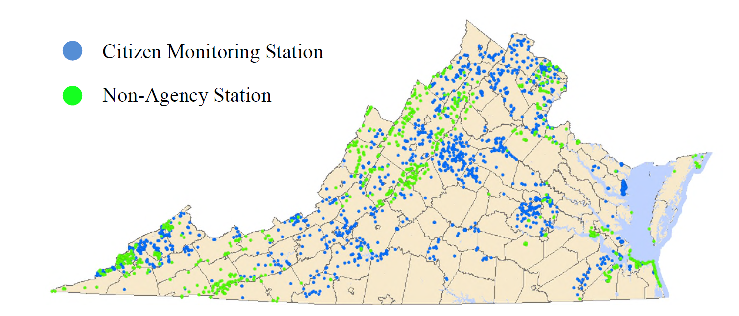
Virginia Water Quality Monitoring
Virginia DEQ began working with water quality data from volunteer monitoring organizations in 2004.
State Law authorizes a Citizen Water Quality Monitoring Program
Data sent to EPA under sections 305(b) and 303(d) of the Clean Water Act
Citizen monitored areas in 2016
  3,800 stream miles
  90 square miles of estuaries
  15,000 acres of lakes and reservoirs
Growth in capacity of citizen monitoring
  2004: < 50 stations passed DEQ field or lab audit
  2016: > 1000 stations met the standard

Slide 8
Monetary Value of Volunteer Water Quality Monitoring in Virginia
Monetary Value
Volunteer Water Quality Monitoring in Virginia
2018 VA DEQ Survey
Over 140 monitoring groups -- contribute more than 81,000 hours annually
Small monitoring budgets (less than $5,000); rely on grants or endowments
Operating costs for the state --$1.2 million per year
Estimated value of volunteer monitoring – more than $3.2 million per year

Slide 9
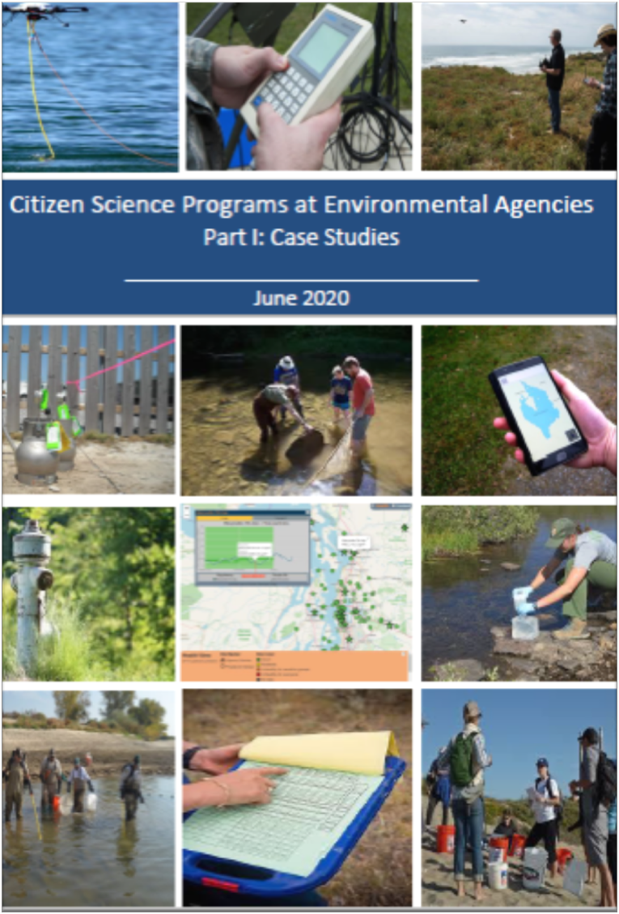
Understanding the Use of Citizen Science in State, Tribal and Local Gov’t
Environmental Programs
Draft Assessment by the Environmental Law Institute
15 Case studies
Best practices report
Interactive webinars
Final report and recommendations

Slide 10
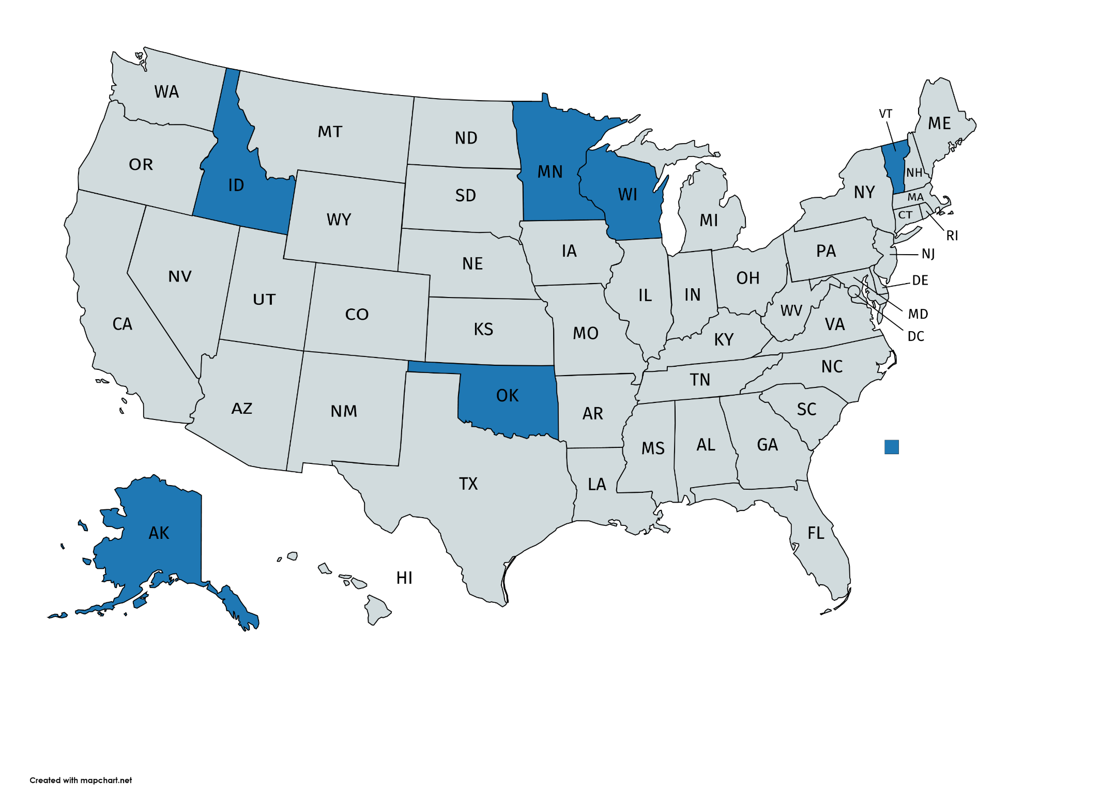
Water Quality Case Studies
Southwest Wisconsin Groundwater/Geology Study
Private well owners contribute water samples to help assess geographic extent of well contamination
Reporting Harmful Cyanobacteria Blooms in Idaho
Public can identify toxic blooms, which identifies problem areas and allows state staff to alert the public about risks
Evaluating Wetland Health in MN Volunteers collect data for use by local gov’t and watershed groups in management programs
Tracking Cyanobacteria in Lake Champlain
Volunteer monitoring data used to alert the public to risks and identify areas that are safe
Alaska-Yukon Indigenous Observation Network
Community-based monitoring tracks water quality across a vast area in Alaska & Canada
Oklahoma Fish Kill Response Management Program
A telephone hotline to report fish kills and respond to these events

Slide 11
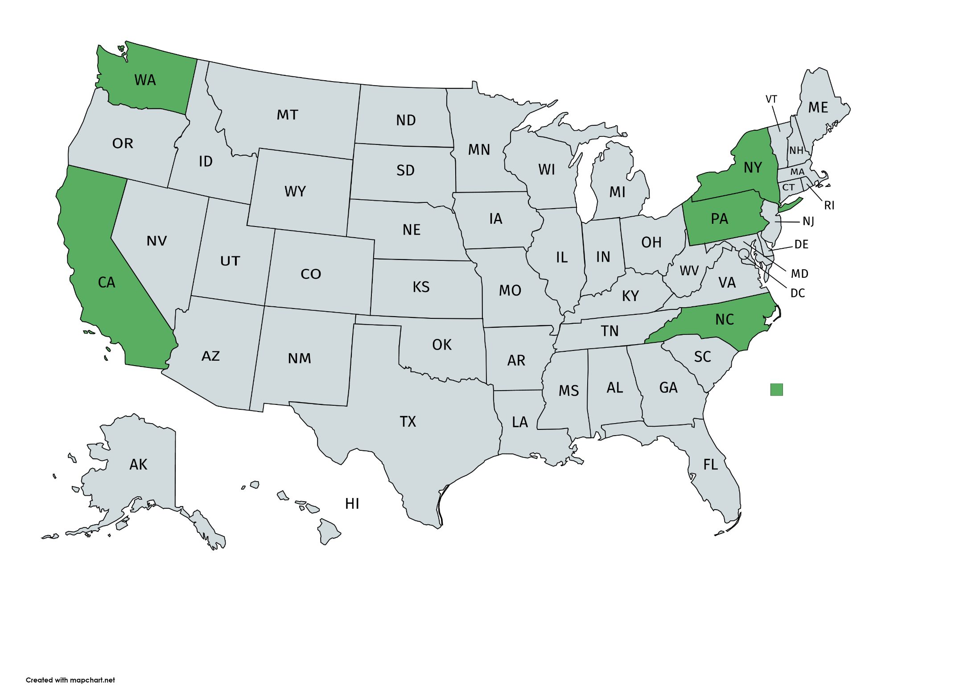
Air Quality Case Studies
New York State Community Air Screen Program
Community-based program in which volunteers can sample for toxic air pollutants
Puget Sound Air Quality Sensor Map
Complies data from local low-cost sensors and adjusts the data to the standard of agency monitors
West Oakland Community Action Plan
Collaboration with community activists helped create a long-term plan to reduce air pollution
Smell Pittsburgh Smartphone App crowdsources reports on offensive odors
Imperial County Community Air Monitoring Project
Community members help gather data in an air-monitoring network
Mecklenburg County Community Science Station
Allows the public to test accuracy of personal air sensors

Slide 12
Best Practices of Successful Programs
Demonstrate and Document
Success
(Outcomes/Impacts)
03
Generate
Valuable
Data
(Fill a key data gap)
01
Create
A Partnership
Network
(To leverage $’s)
02

Slide 13
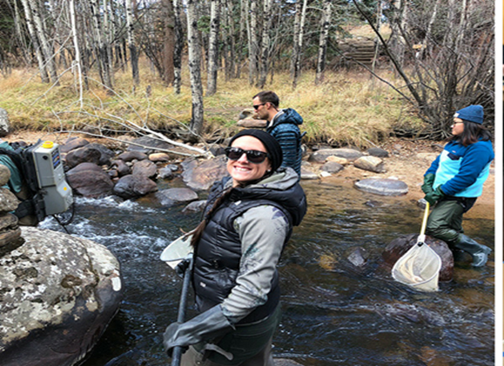
Future State Agency Opportunities for Community Science
Recognition of potential value of non-agency data
Value in environmental justice communities
Partnerships with external groups -- tools, training and assistance
Colorado River Watch

Slide 14
To Learn More . . .
Upcoming EE2020 Online Webinar Series
Improving the Management and Use of Community Science Data:
What Can We Learn from Current State and Tribal Programs?
October 8, 2020, 1 – 3 pm ET
Register at eenationalmeeting.net/october-2020

