Slide 1

the clean energy transition:
The value of “spreading our chips”
Karl Hausker, Ph.D. september 2020
Senior Fellow
khausker@wri.org

Slide 2
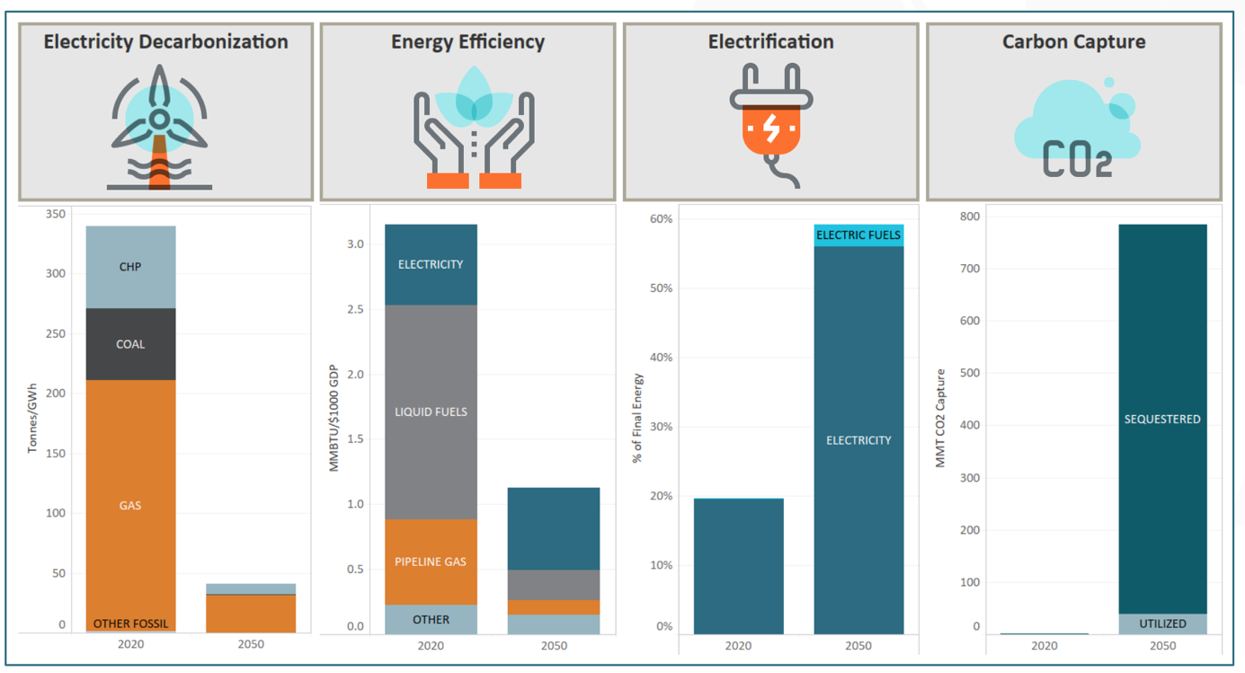
FOUR strategies for the clean energy transition getting to “net zero carbon” by 2050
2
https://www.evolved.energy/single-post/2019/05/08/350-ppm-Pathways-for-the-United-States

Slide 3
system costs increase with “all chips” on variable renewable sources
3
“Integration”
costs drive up system LCOE:
Transmission
Load shifting
Storage
  Daily
  Seasonal
  Weather
  flux
See also: Hausker (2019), https://kleinmanenergy.upenn.edu/paper/betting-climate-solutions
Frew et al (2016) , https://web.stanford.edu/group/efmh/jacobson/Articles/Others/16-Frew-Energy.pdf
Sepulveda, N., Jenkins, J.D., et al. (2018), “The role of firm low-carbon resources in deep decarbonization of electric power systems,” Joule
https://papers.ssrn.com/sol3/papers.cfm?abstract_id=3015424
Notes:
“For us, reaching 100% renewable energy purchasing on a global and annual basis is just the beginning. In addition to continuing to aggressively move forward with renewable energy technologies like wind and solar, we will work to achieve the much more challenging long-term goal of powering our operations on a region-specific, 24-7 basis with clean, zero-carbon energy”
“we’ll broaden the scope of energy sources to include technologies or services that enable 24-7 clean energy….To this end, in complement to our wind and solar purchasing, in the future we may pursue dispatchable, zero-carbon generation energy options for our portfolio. These options could include CCS and advanced nuclear power

Slide 4
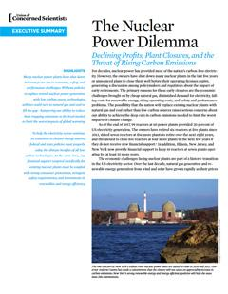
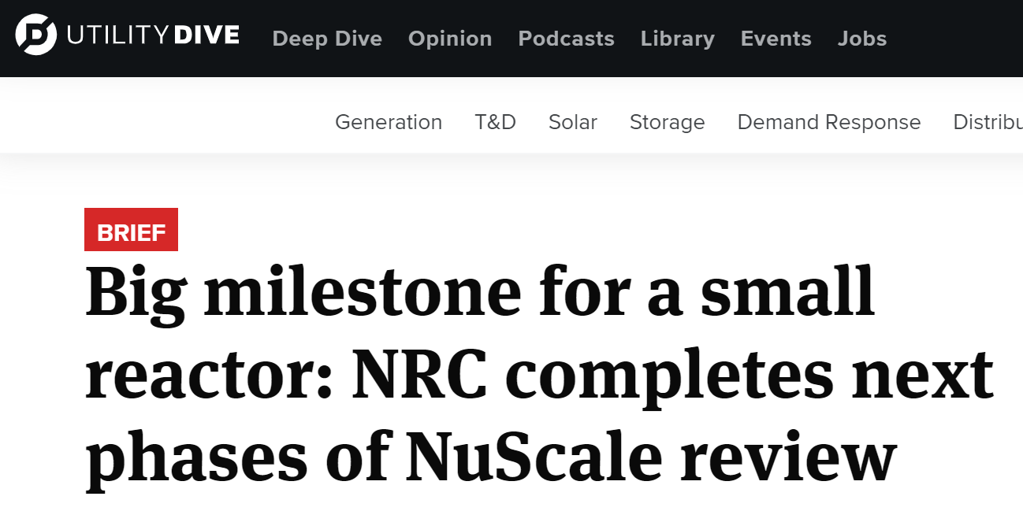
“Spread your chips”
UCS report cites value of existing nuclear plants
4
Without policies to replace retired nuclear
power generation with low-carbon energy
technologies, utilities could turn to natural
gas and coal to fill the gap
  could result in a 4 to 6 percent increase in
  US power sector emissions.
Small modular reactors
hold promise
https://www.ucsusa.org/sites/default/files/attach/2018/11/Nuclear-Power-Dilemma-executive-summary.pdf

Slide 5
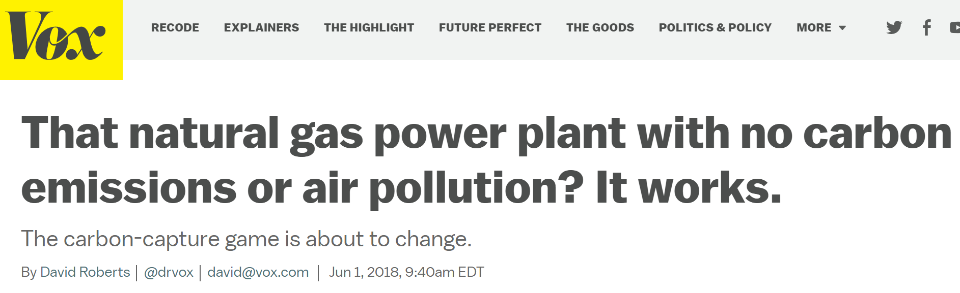

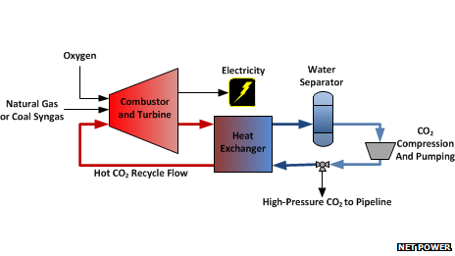
“Spread your chips”
Carbon capture and storage for power sector
https://www.vox.com/energy-and-environment/2018/6/1/17416444/net-power-natural-gas-carbon-air-pollution-allam-cycle

Slide 6
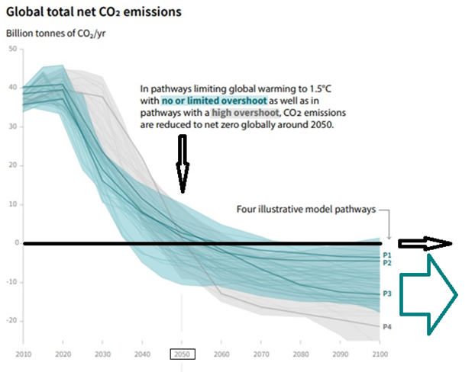
carbon capture must be fully commercialized critical for industry and for carbon dioxide removal
6
50
40
30
20
10
0
-10
-20
Net Zero Emissions
All pathways require Carbon Dioxide Removal
2030 2050 2070 2090
https://www.ipcc.ch/sr15/chapter/summary-for-policy-makers/
Notes:
In addition to large emissions cuts in the next decade, net CO2 emissions will on average need to be reduced to zero by mid-century. If the date of reaching net-zero emissions is brought forward one decade to 2040—fewer than 25 years away—the chance of limiting warming to 1.5˚C is considerably higher. The sooner emissions peak before 2030 and the lower the level at which they do so, the less daunting the challenges will be.
All pollutants leading to climate change must be addressed. The report notes the critical role of short-lived but highly potent climate pollutants, such as methane and hydrofluorocarbons (HFCs). While carbon dioxide dominates long-term warming, reduction of other pollutants can contribute to the 1.5˚C goal in the short term, with substantial co-benefits, such as reducing air pollution.
The report shows clearly that we will need to focus efforts not only on reducing emissions, but also removing and storing carbon from the atmosphere. Carbon removal is necessary for both moving to net-zero emissions and for producing net-negative emissions to compensate for any overshoot of 1.5˚C. The pathways studied in the report rely on different levels of carbon removal (ranging from 100-1,000 GtCO2 over the 21st century for scenarios with limited or no overshoot), but all rely on it to some extent. The report notes that carbon removal deployed at such a scale is unproven, and is a major risk to our ability to limit warming to 1.5˚C.The report also notes that feasibility and sustainability of carbon removal could be enhanced if a portfolio of carbon-removal approaches is pursued.

Slide 7
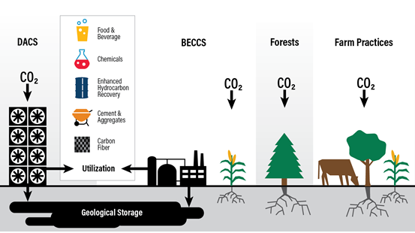
CARBON DIOXIDE REMOVAL techniqueS
7
Also at research stage: Enhanced weathering of rocks/minerals, and seawater capture
https://www.wri.org/publication-series/carbonshot-creating-options-carbon-removal-scale-united-states
Notes:
- Forests and farm practices – "AFOLU" - plants and soils
- Inherently limited
- BECCS – Bioenergy with Carbon Capture and Sequestration
- limited, and poses trade-offs with food production and biodiversity
- DACS – Direct Air Capture and Storage – need to develop, expensive
- research stage: enhance weathering of rocks & minerals, seawater capture

Slide 8
Karl Hausker, Ph.D.
Senior Fellow khausker@wri.org
THANK YOU

