Slide 1
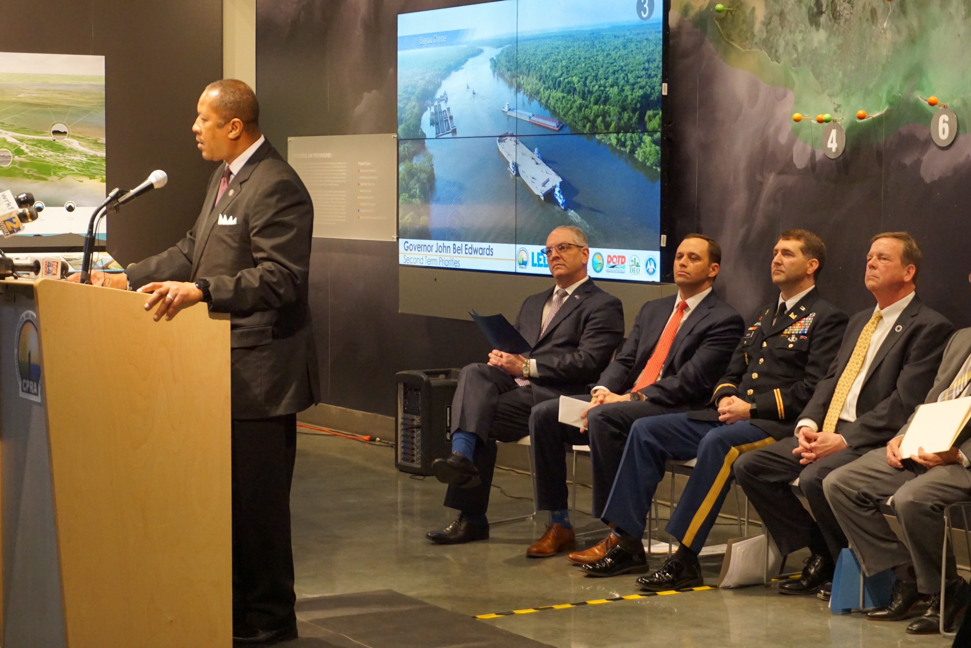
Climate Change Taskforce

Slide 2
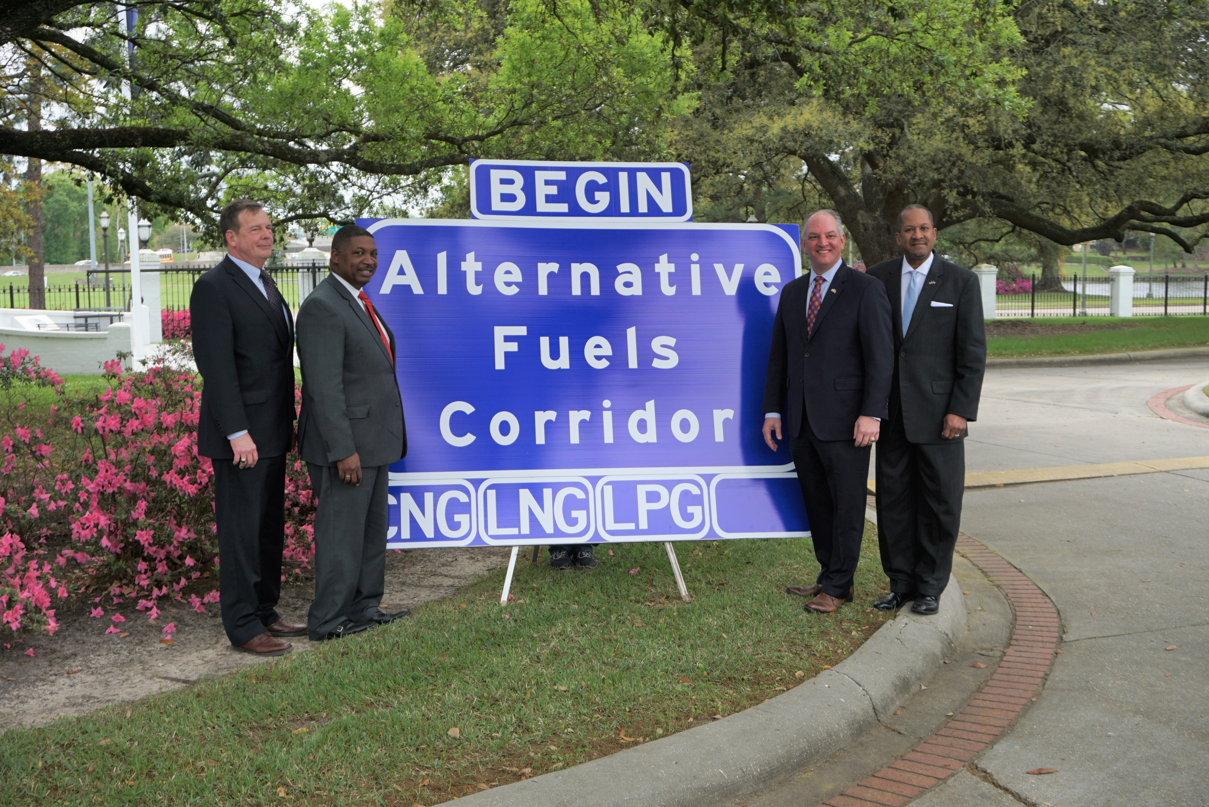
Alternative Fuels Corridor

Slide 3
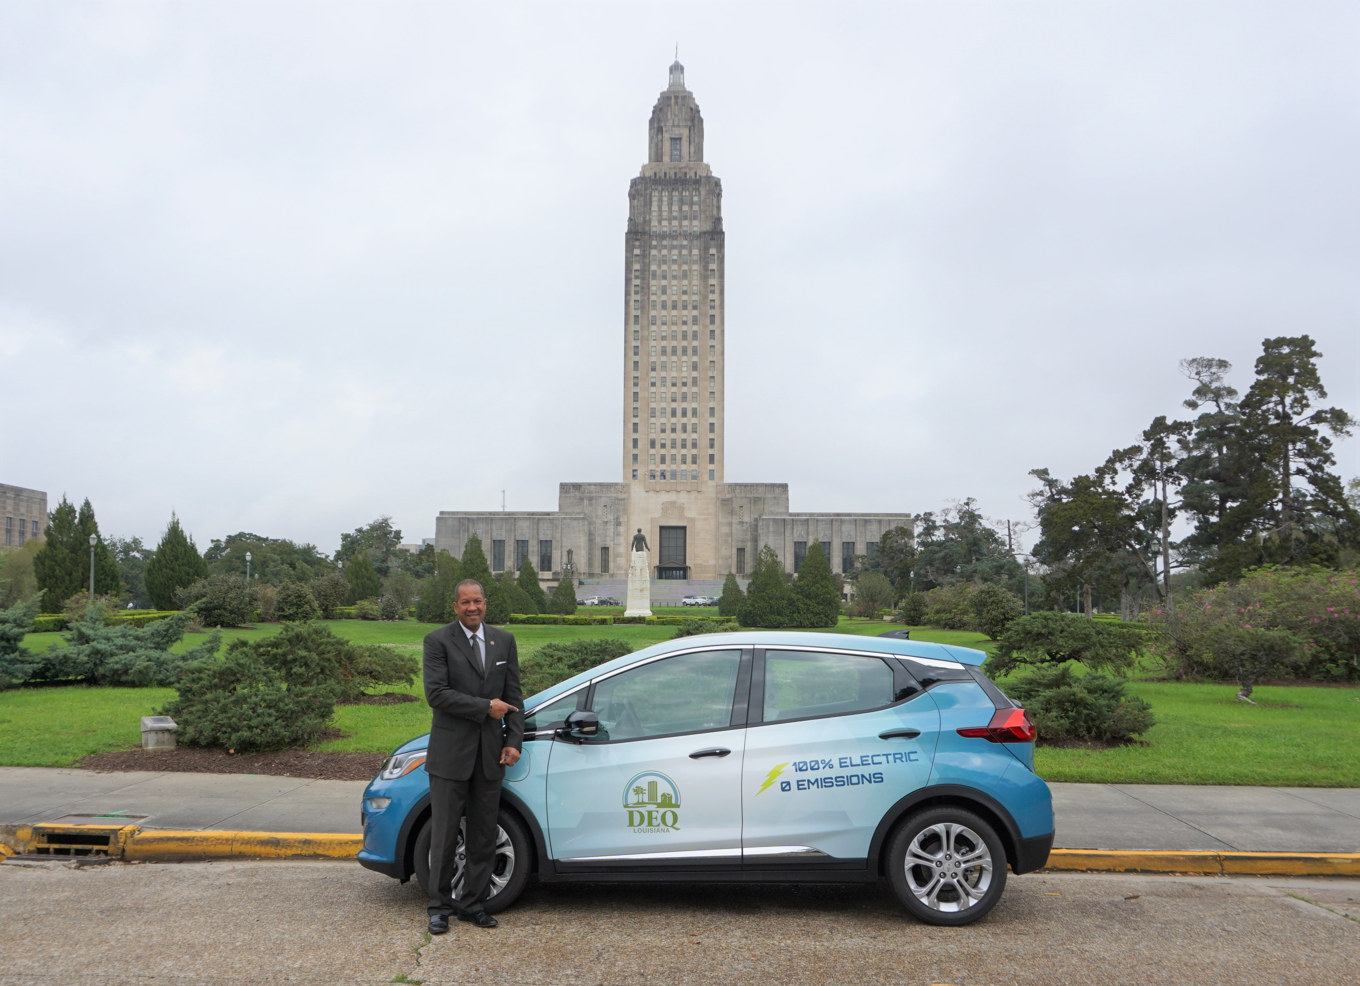
LDEQ Electric Vehicle Fleet

