Slide 1
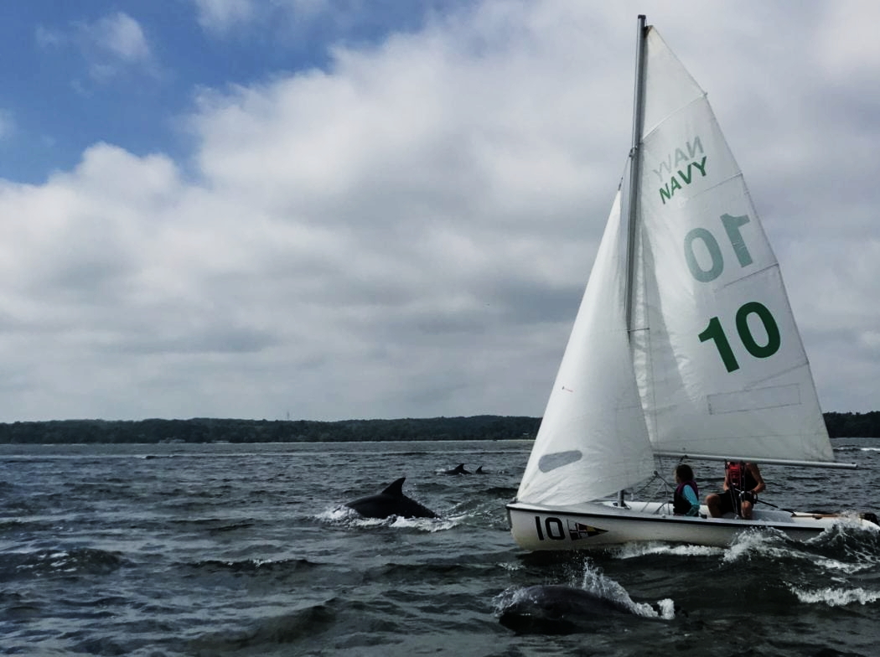



Reducing stormwater pollution via innovative technology public/private partnership
Mark Bryer, Chesapeake Bay Program Director, The Nature Conservancy
Matt Rea, Strategic Partnerships Manager, OptiRTC
Toni McCrory, Director, Walmart EH&S

Slide 2
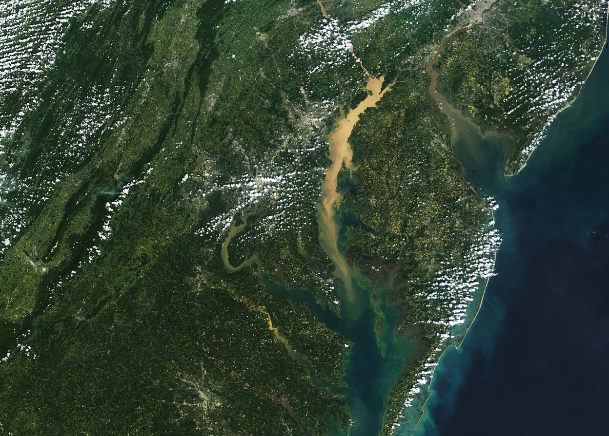
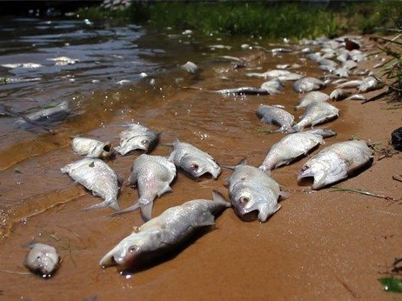

Slide 3
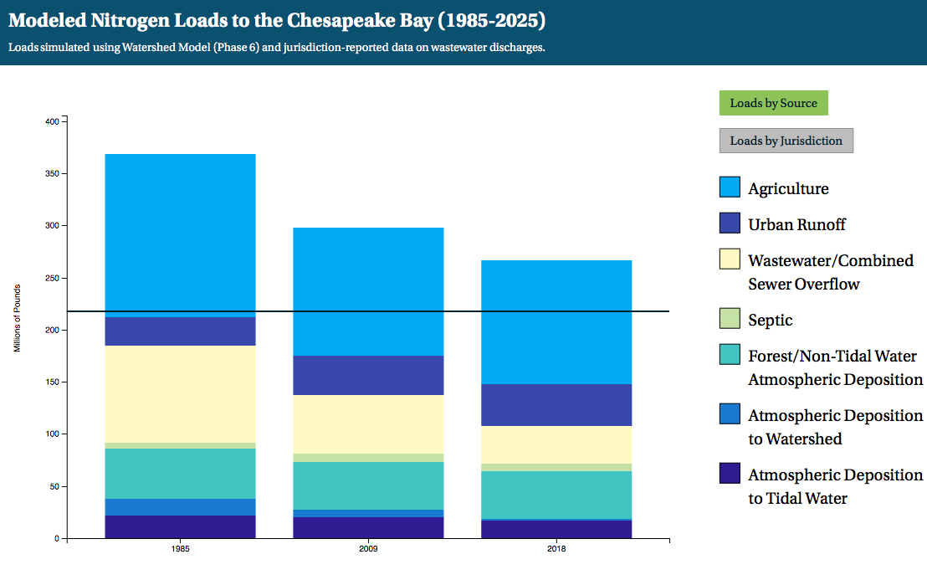
Source: Chesapeake Bay Program

Slide 4
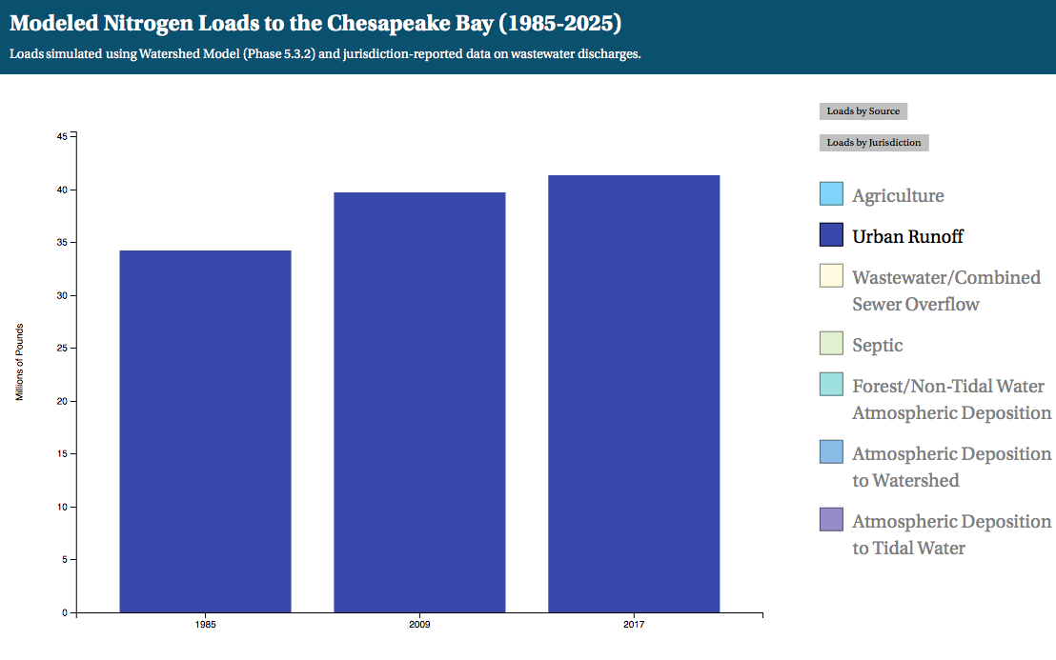
Source: Chesapeake Bay Program

Slide 5
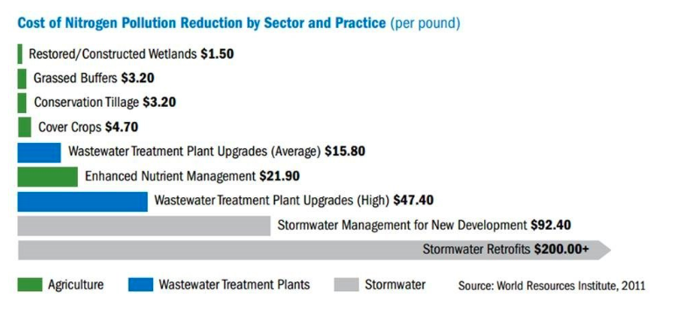

Slide 6
95%
Private Ownership of Land in
U.S. Urban/Suburban areas
Climate Resilience Relies on Partnerships
with Private Landowners
Source: https://fas.org/sgp/crs/misc/R42346.pdf

Slide 7
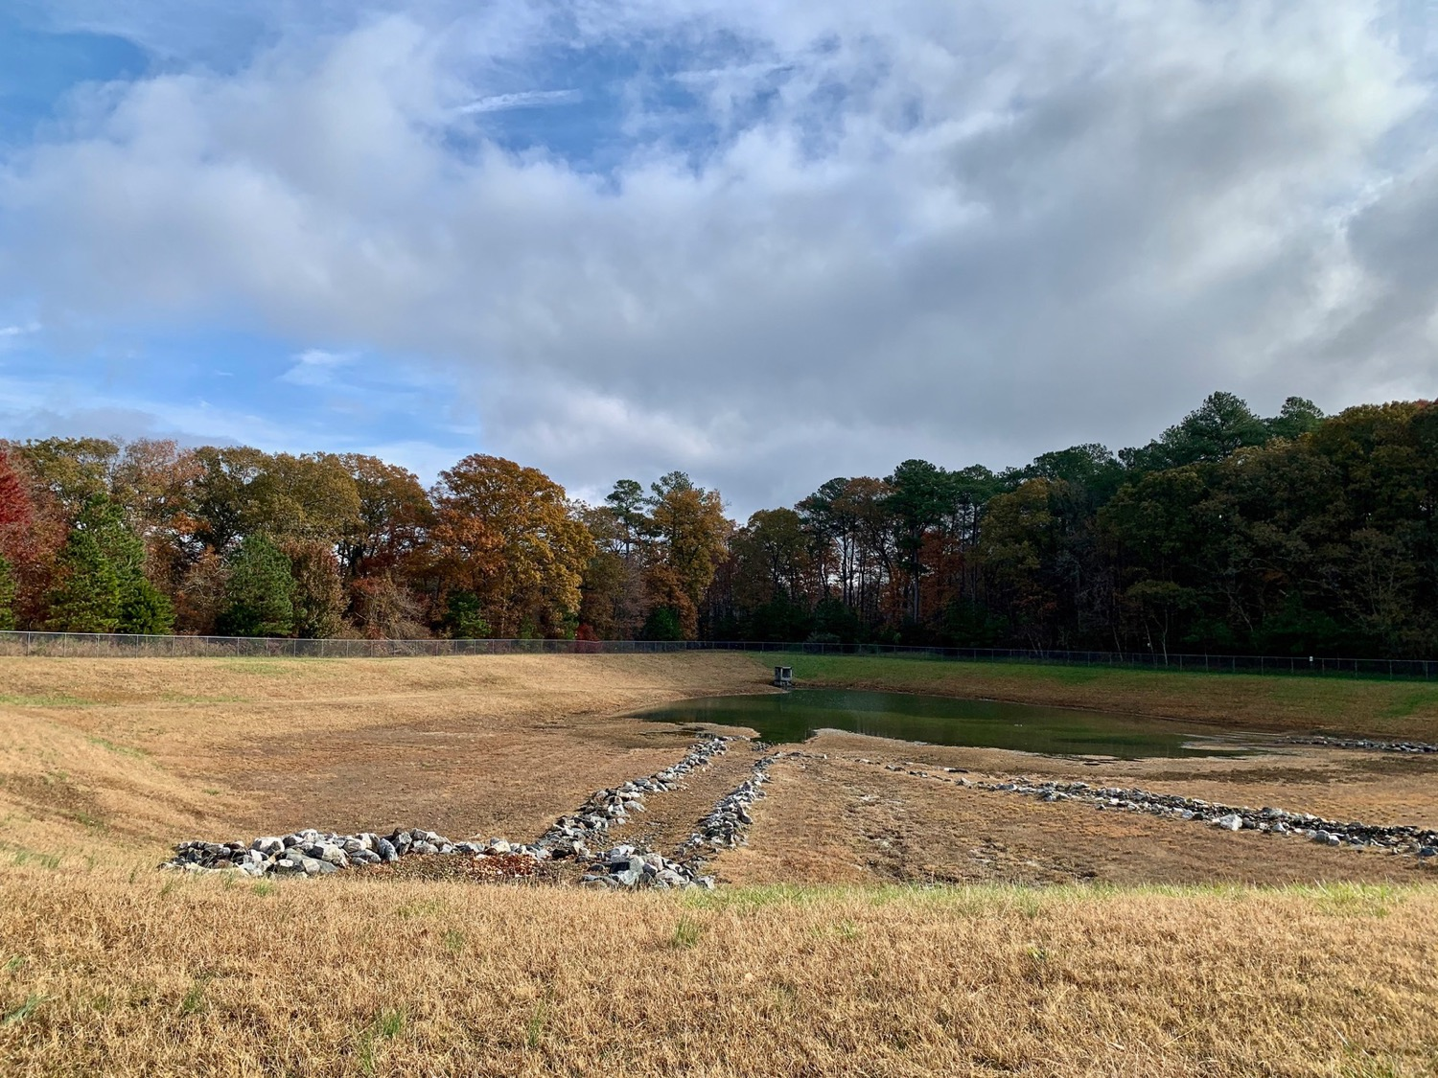

Slide 8
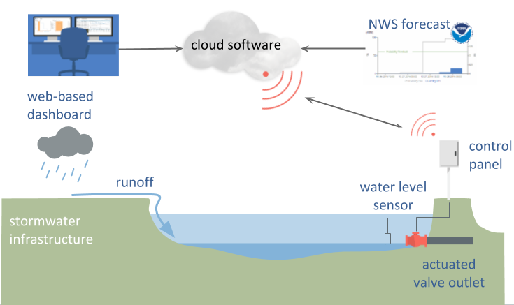
How Opti’s Technology Works

Slide 9
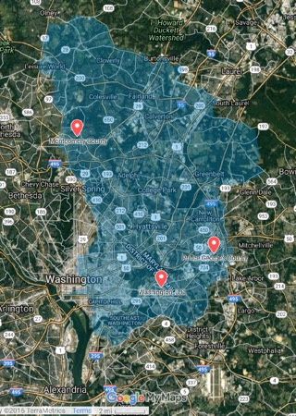

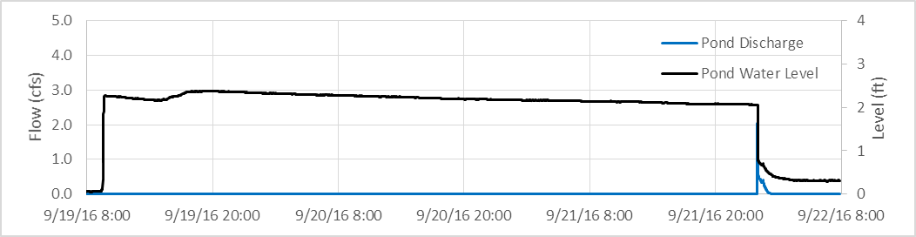

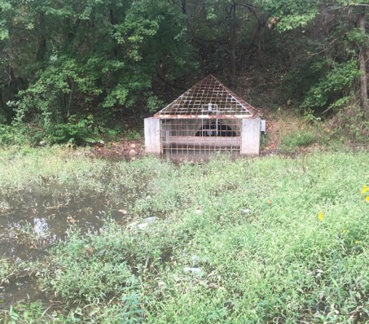
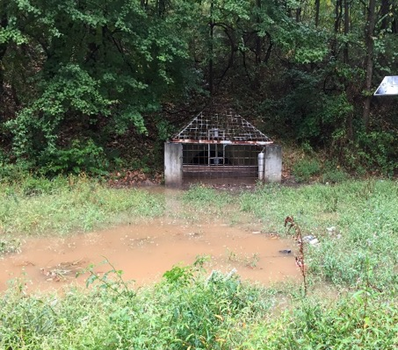


Increased Retention Time Improves Water Quality
Real-Time Monitoring
Water level
Rainfall
Temperature
Conductivity
pH
Turbidity
Nitrate
TSS

Slide 10
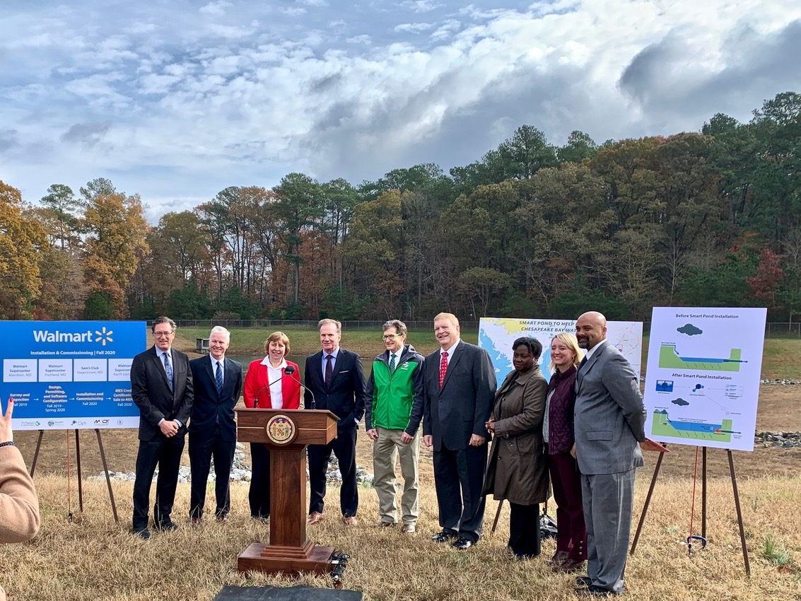

Slide 11
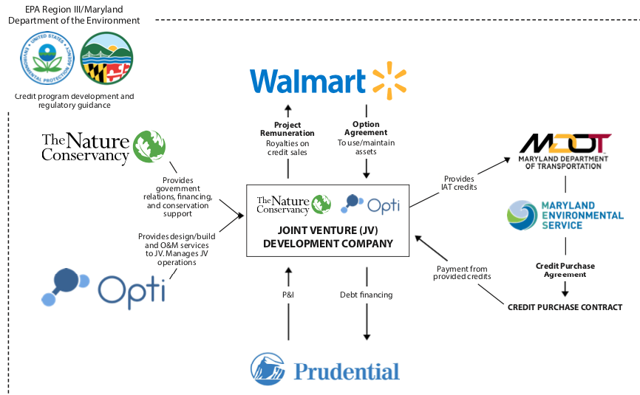
How it all works - Partnership Structure

