Slide 1

www.virginiaforever.org | www.facebook.com/ourlandourwater

Slide 2



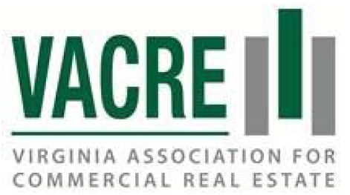







































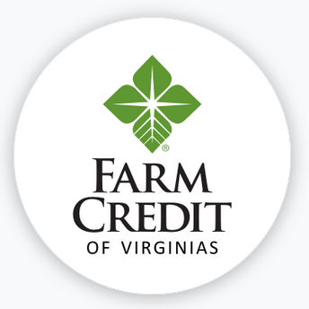




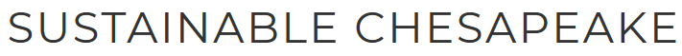

Slide 3
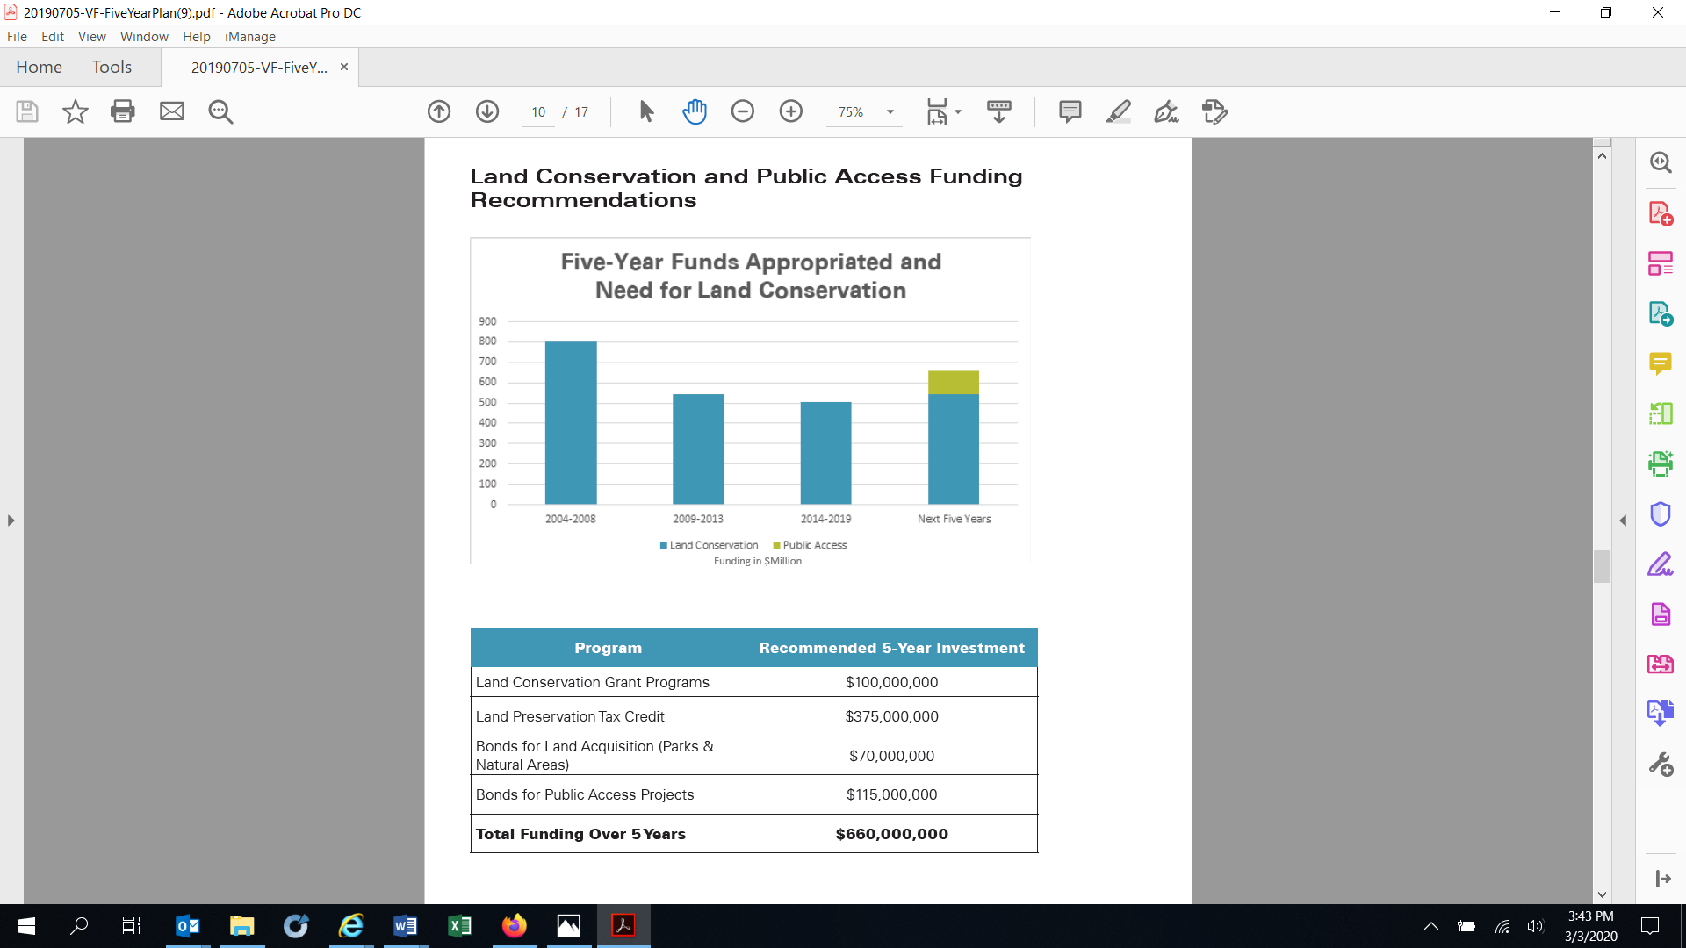
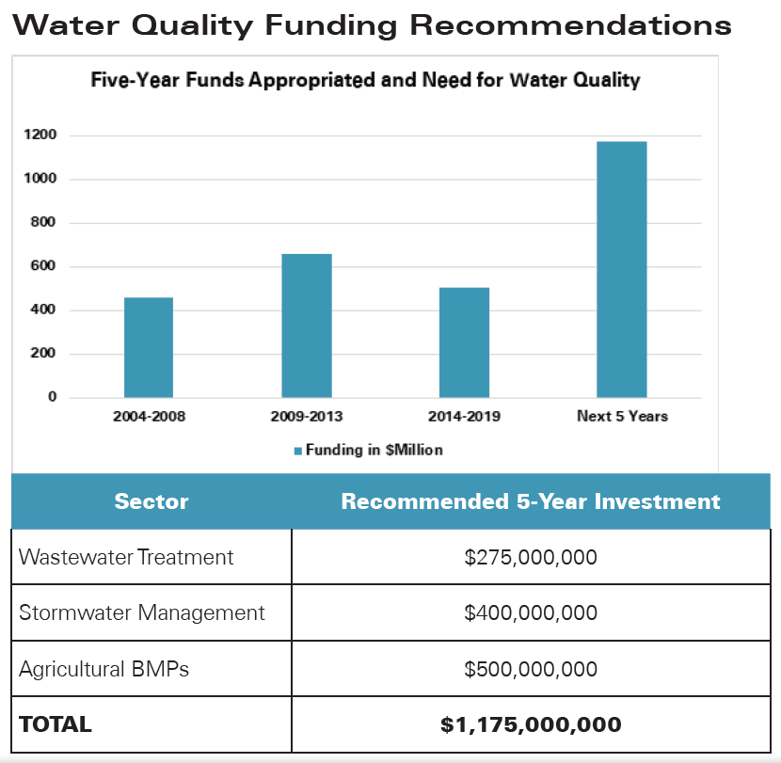
Natural Resources Funding Requests

Slide 4
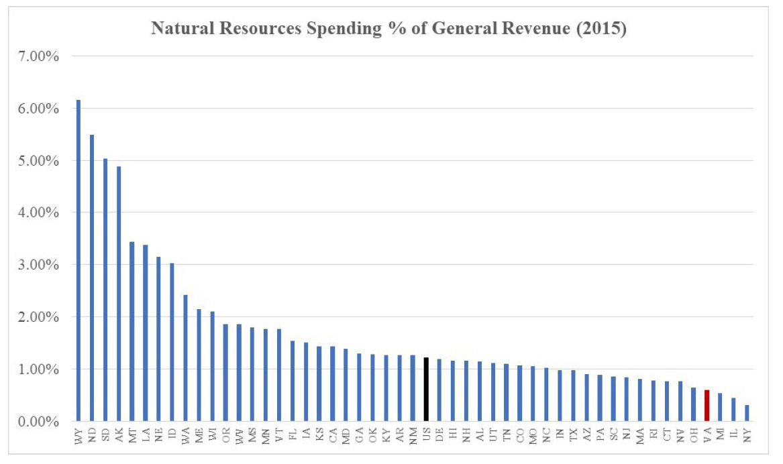
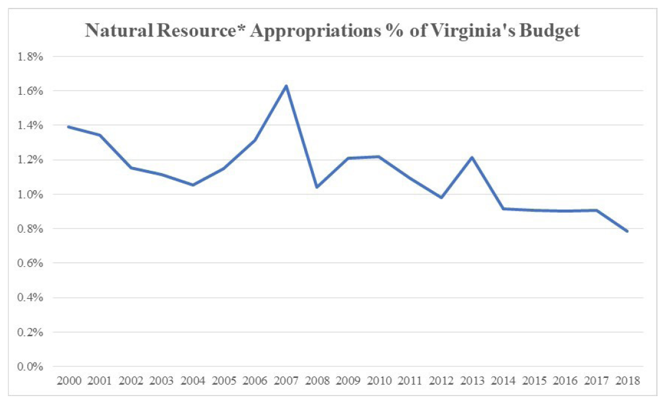

Slide 5
Questions about VIRGINIAforever?
Contact:
Ginny Boland, Vice President, McGuireWoods Consulting
804-775-1907 | gboland@mwcllc.com

