Slide 1
DEQ Teleworking

Slide 2
DEQ Challenges (at least some of them)
Retiring work force-over 30% currently qualified for retirement
Attracting and retaining new work force (Millennials)
Looking for mission driven work that allows flexibility
Budget Pressure-Never enough money, consistently asked to reduce reliance on General Fund
Perception of DEQ as the heavy hand of regulation vs. partner
Strategy: TELEWORKING

Slide 3
Teleworking Rollout
Pilot Project: November-Feb
Planned rollout for June 2020
Target adoption rate of 30% of eligible employees by end of 2020
Long term goal: get employees into rural/all parts of the state
Reduced travel times for inspectors
Improved relationships, staff perceived as “one of us in the community”

Slide 4
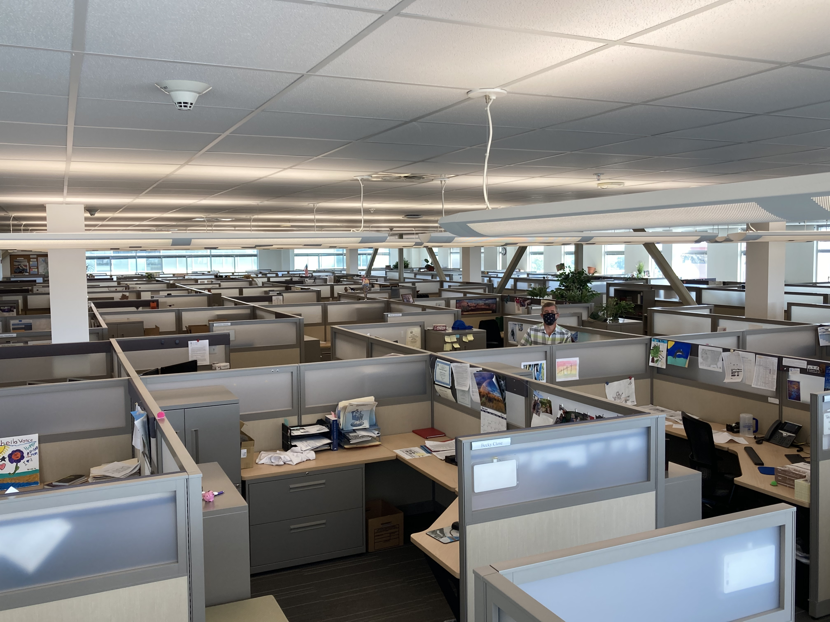
What We’re Seeing

Slide 5
What We’re Seeing
Not our people
Currently 95% of our employees are teleworking due to COVID
30% of all employees have signed permanent teleworking agreements
60 days to try and decide before office space is given up
Improved/deliberate management...managing by performance instead of presence
Increase in employee satisfaction
Reduced commute times and costs for employees
Work life balance
Greater flexibility
Increase in productivity

Slide 6
What We’re Seeing

Slide 7
Challenges with Teleworking
Keeping our culture alive and well
Connecting w/ people
Facilitating Collaboration
Purchasing:
Laptops
Webcams
Understanding the difference between situational teleworking (COVID) vs. permanent teleworking

Slide 8
Keys to Success and Strategies to Improve
Deliberate communication
Weekly team huddles
Weekly non-mandatory water cooler chats
Regular calls and zoom meetings from managers
Visual Management/Performance Measures have been very helpful
Photos/Videos
Video messages vs. emails
Virtual Tours of Workspaces (guess who’s space this is?)
Vacation Photos
Online Brown Bag Events
Creative ways to connect
Grubhub/food and division zoom meetings in place of annual picnic

