Slide 1
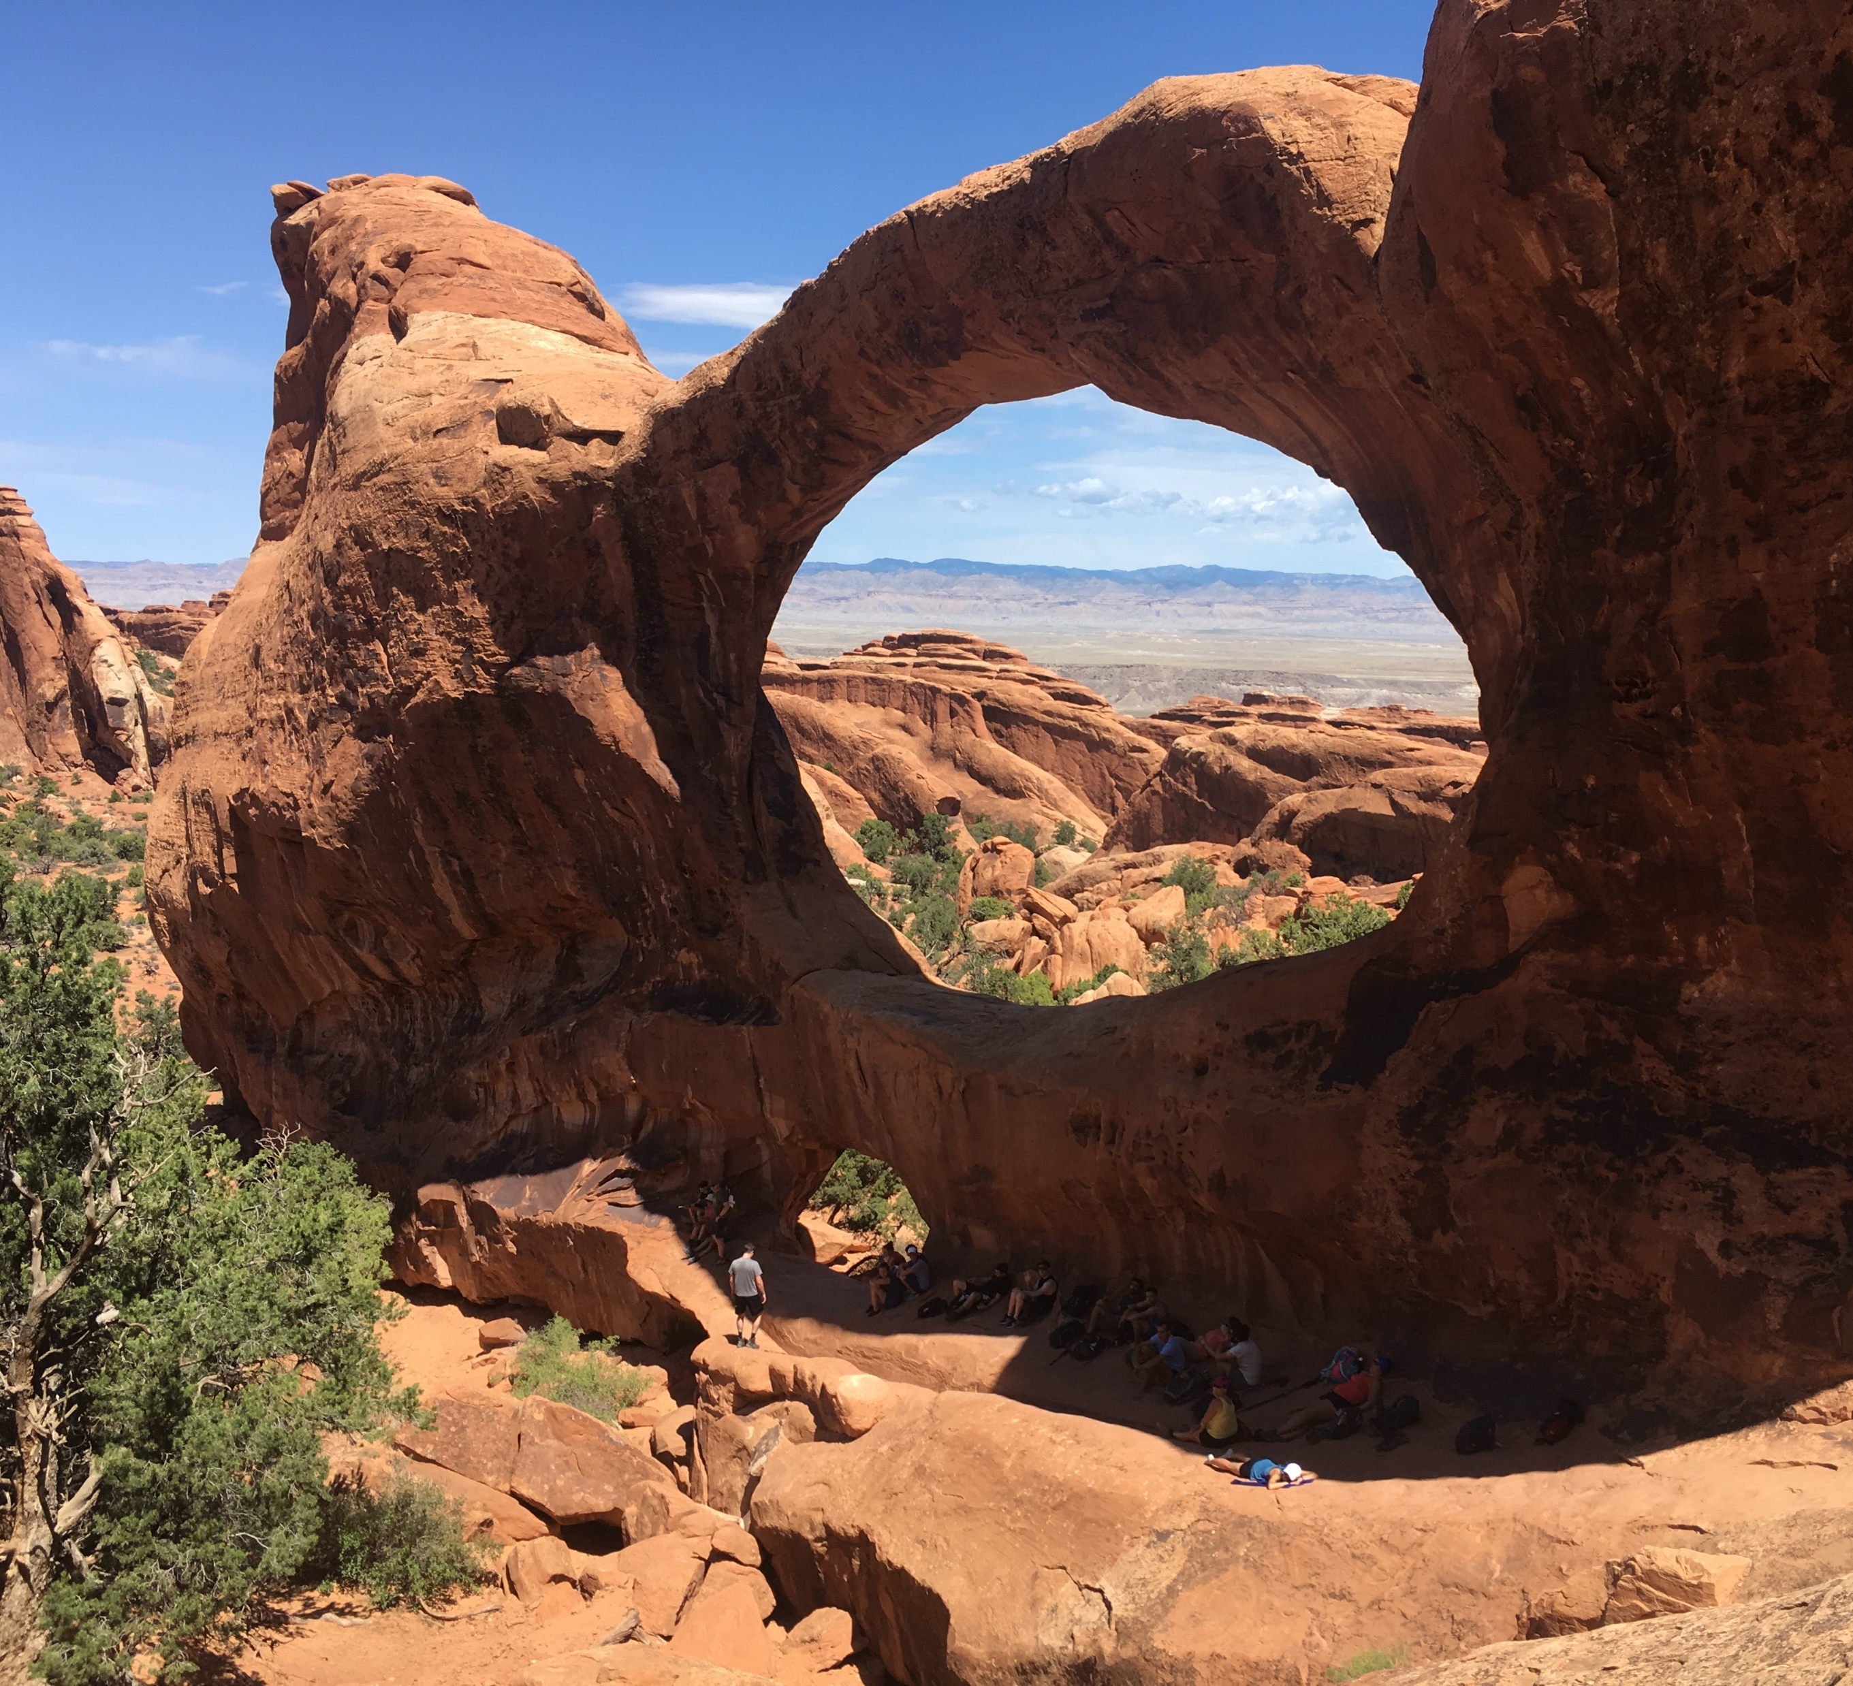
Water Data Integration
Dwane Young,
U.S. Environmental Protection Agency
Office of Water:
Water Data Integration Branch
Young.dwane@epa.gov
Brad Cooper,
Eastern Research Group, Inc.
Brad.cooper@erg.com

Slide 2
Water Data Integration
Outline
Big Picture: Telling a story about water
Open Water Data: Concepts – Internet of Water
Integrating across EPA systems (internal integration)
Pulling the Pieces Together: Telling the Water Story
WQX Web API – enabling new approaches for publishing water data

Slide 3
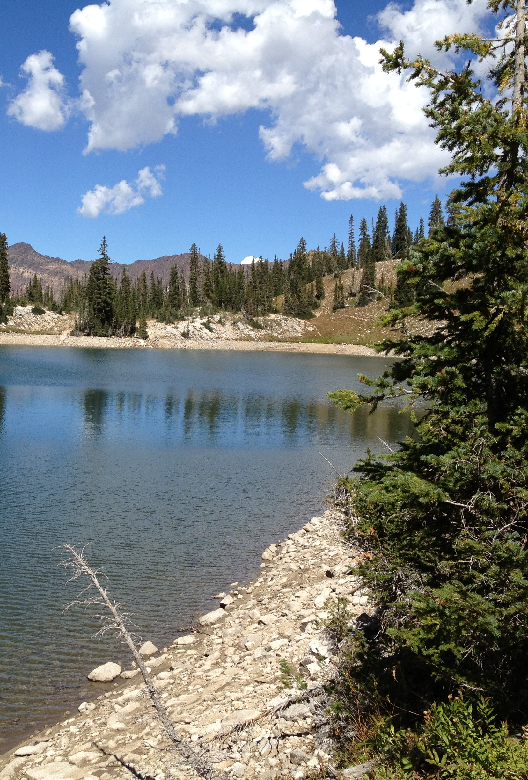
What can you tell me about my water?
Is it safe to drink?
Is there enough water?
Can I swim in it?
Is it polluted?
If it is polluted, what are you doing about it?
If it isn’t polluted, what are you doing to protect it?
What can I do to help?
Notes:
To answer these questions, I must interact with at least 6 different systems within EPA, and even that doesn’t tell the whole story. I need state data, other federal agency data, etc.
The public has an even harder time figuring all of this out. They don’t know our systems, and so don’t usually even know where to begin.

Slide 4

FOUR PILLARS OF OPEN WATER DATA
STANDARDS
METADATA
COMMON HYDROGRAPHY
DISCOVERABLE / SEARCHABLE
Notes:
These four concepts enable open water data:
Standards: Includes data standards, communication standards (how computers talk to each other), and common terminology
Metadata is often a piece of the data standard, but is important enough that it needs its own consideration. It provides the who, what, when, where, why, and how of data
Common Hydrography: Data should be linked to a common hydrography allow for data discovery using that hydrography (i.e. upstream/downstream searches or watershed searches)
Discoverable / Searchable: Data should be registered and summarized in data catalogs (or search indexes) to allow for easy discovery. Having huge data sets open and available is not enough. A user needs to be able to easily find the data that they’re interested in.
*** It is not enough to just post a file to a website. That does not make it ‘Open’, just ‘Available’.
***Open Water Data is about putting data together from multiple sources without requiring a lot of reformatting.

Slide 5

How Do We Get There: Building Blocks
Sampling Data
STANDARDS
METADATA
TIED TO HYDROGRAPHY
DISCOVERABLE
Real Time Data
STANDARDS
METADATA | GAP
TIED TO HYDROGRAPHY | SOME
DISCOVERABLE | SOME
Other Attributes
STANDARDS | VARIES
METADATA | VARIES
TIED TO HYDROGRAPHY | VARIES
DISCOVERABLE | VARIES
COMMON HYDROGRAPHY
Notes:
Sampling Data: The Water Quality Portal provides access to all of the components of Open Water Data, and is a good example starting point. The standard used is the Water Quality Exchange (WQX)
Real Time Data: Standards exist (OGC standards (WaterML 2, Sensor Observation Service, and NetCDF). Several good examples exist as well that use parts of the Open Data approach. USGS, NOAA, and Reclamation are all providing access to their data. CUAHSI also is a good example of possible approaches. EPA’s IWN tested out approaches for all components of Open Water Data, but is a demonstration project at this point.
Other Attributes: This broad category of data includes a number of secondary products that are developed using the raw data or are administrative decisions on the water (i.e. Is the water impaired? Permits; water allocations and use; land characteristics, etc.). These data need individual standards to accommodate each type of data. The Water Data Exchange (WaDE) led by the Western States Water Council is a good example of enabling open data for these type of data. They have achieved all of the pillars (except the hydrography pillar).

Slide 6
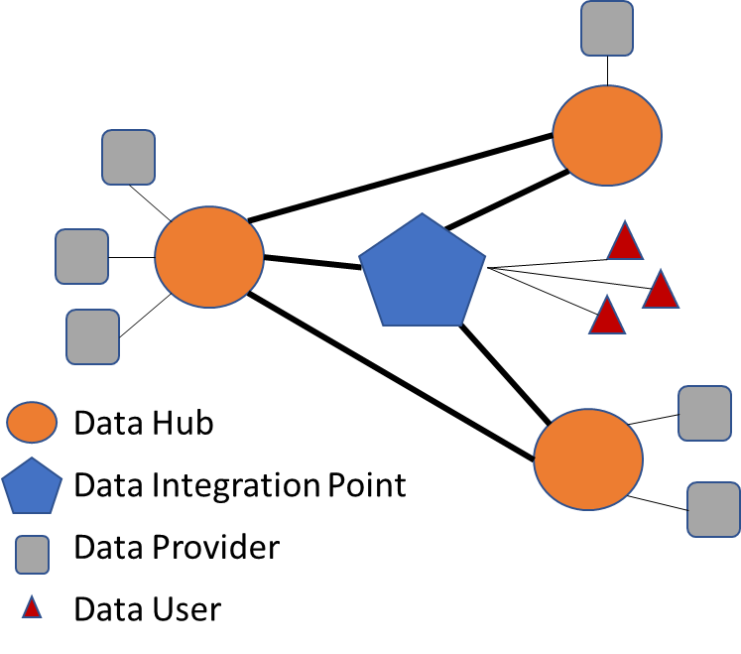
Internet of Water – Some History
IoW was the result of a series of dialogues led by the Aspen Institute
The dialogue included members from the federal, state, citizen, and private sectors
Goal of trying to connect water information together to be able to answer key questions
Built upon several prior efforts to integrate water information (including the Water Quality Framework)

Slide 7
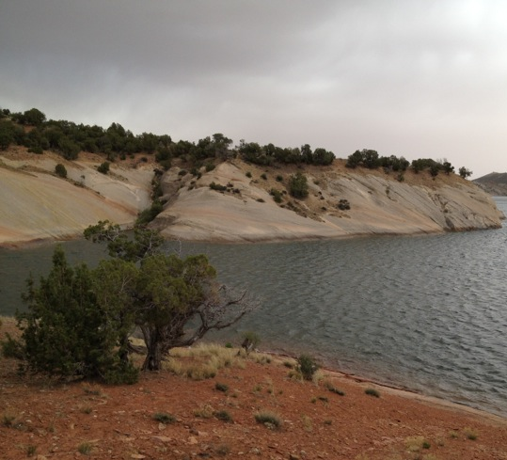
Principles of Integration
No direct database access. All interaction is through an API (this is true for the system owners as well)
Identify points of integration between systems to enable easy discovery and entry points across systems
Data indexes (catalogs) allow quick discovery of data
Data indexes can also facilitate common search functionality across systems
Data are all connected to a common Hydrography
Points of Integration:
Assessed Water ⬄ Monitoring Locations
Assessed Water ⬄ Permitted Facility
Assessed Water ⬄ Restoration Actions
Pollution Budgets ⬄ Permitted Facilities

Slide 8
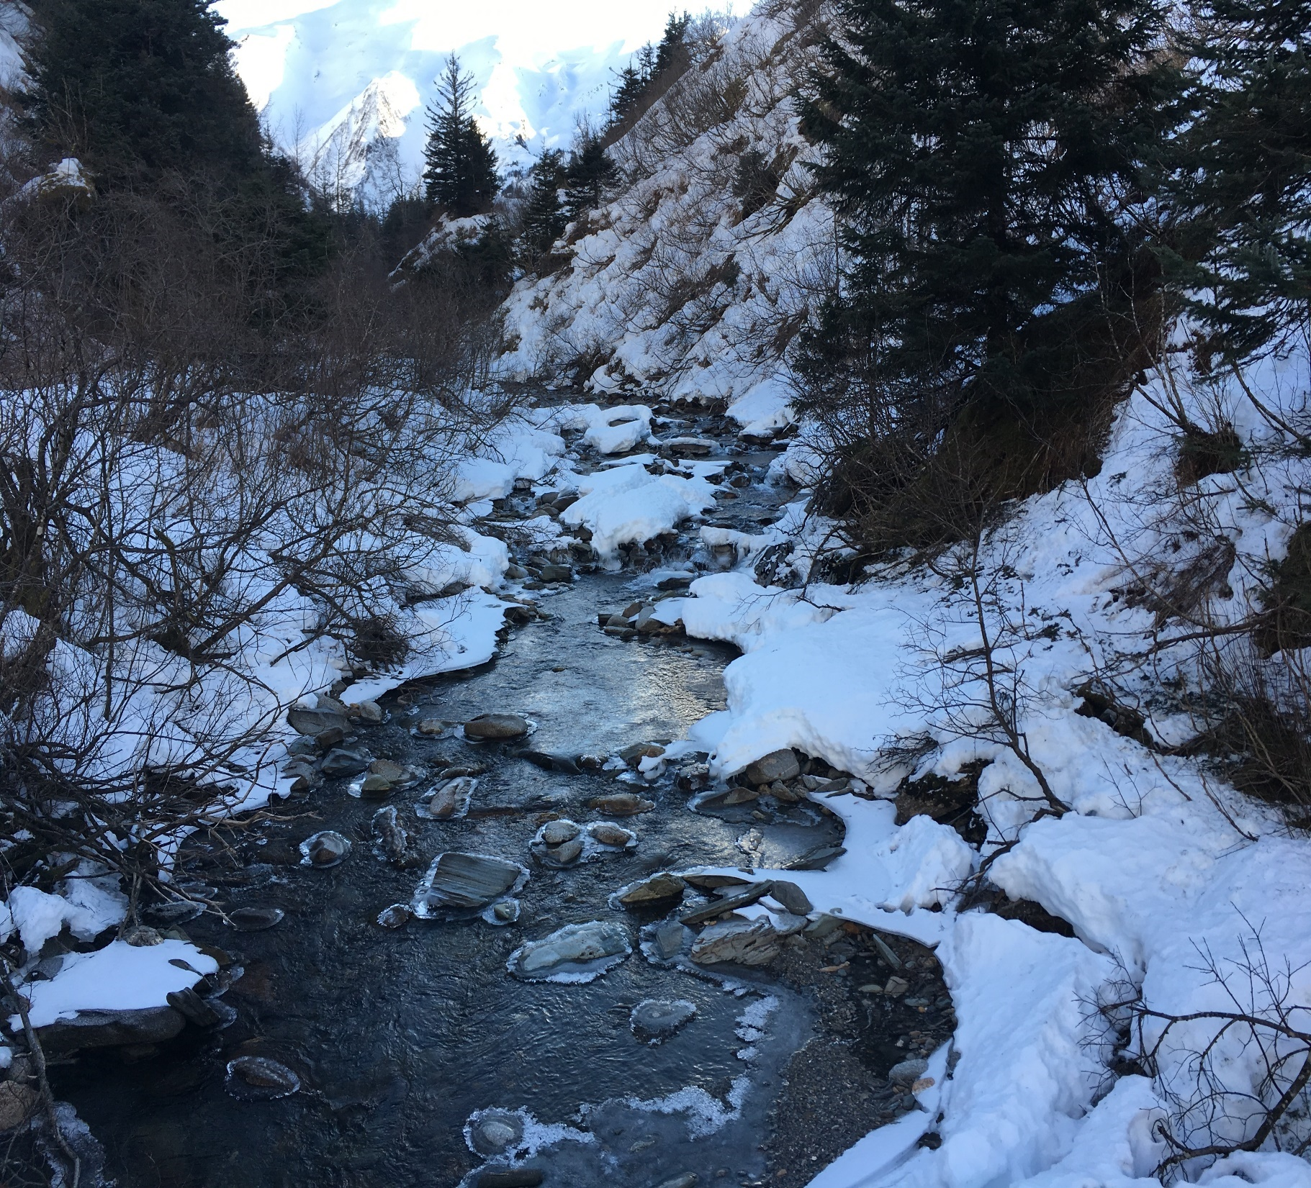
Pulling the Pieces Together: Telling the Water Story
Provide the public with usable, meaningful information
Communicate progress states, tribes, and EPA are making towards restoring or protecting water quality
Engage the public in understanding impacts on water and issues related to water

Slide 9
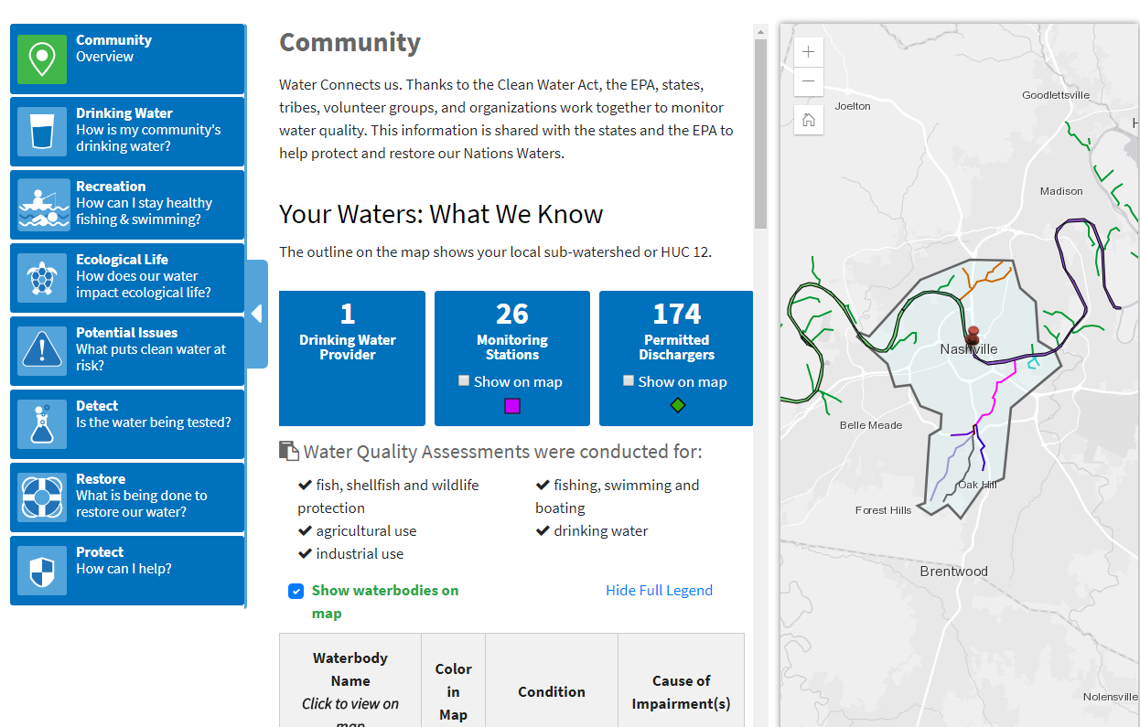
Design Concepts
All information is based on a service
Tell the story at multiple levels (National, State, County, Local)
Integrate data across systems
Allow for in-depth stories in addition to interactive content

Slide 10
DEMO

Slide 11
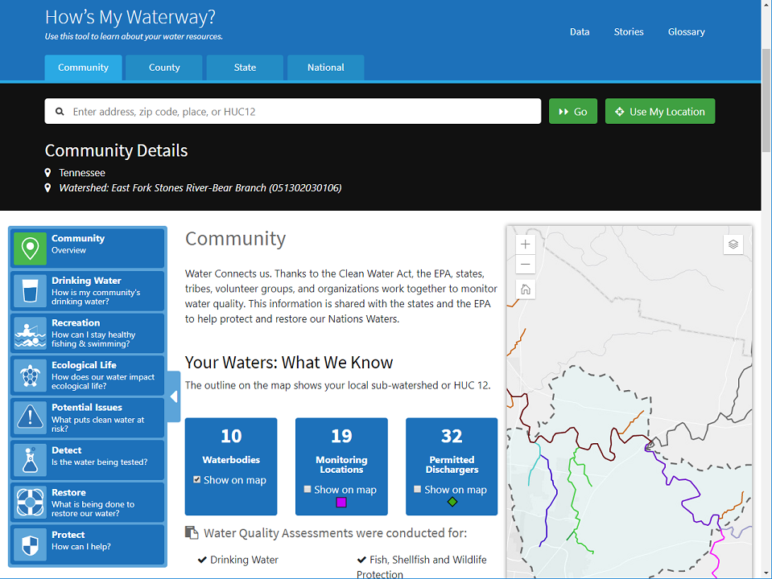


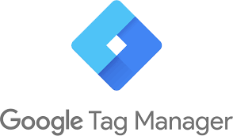
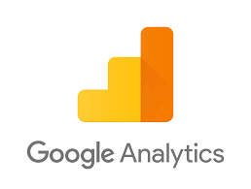


High-level Architecture
Web Browser
Application Code
Proxy Application
[Cross-Origin Resource Sharing
(CORS) enabled web service calls]
[For non-CORS enabled web service calls]

Slide 12
Web Services
ATTAINS Assessment Units
ATTAINS Assessments
ATTAINS State Use Summary
ATTAINS Actions
Grants Reporting and Tracking System (GRTS)
How’s My Waterway
Water Quality Portal (WQP)
Watershed Index Online (WSIO)
WATERS Watersheds
Enforcement and Compliance History Online (ECHO)

Slide 13
Potential Future Web Service
ATTAINS Assessment Units
ATTAINS Assessments
ATTAINS State Use Summary
Internet of Water (IoW)
Watershed Group Information
Sensor Data
SDWIS Fed Data
Warehouse (SFDW)
ATTAINS Actions
Grants Reporting and Tracking System (GRTS)
Water Stories
Upstream / Downstream
Search Capabilities
How’s My Waterway
State Revolving Fund
(DWSRF & CWSRF)
Water Quality Portal (WQP)
Watershed Index Online (WSIO)
Fish Advisories
National Aquatic Resource
Surveys (NARS)
Beaches
WATERS Watersheds
Enforcement and Compliance History Online (ECHO)

Slide 14


Technology and Tools
Technology
Tools
Bootstrap
Esri JavaScript API
Mapping widget
Geocoding
jQuery
RequireJS
Highcharts
Google Analytics and Tag Manager
Atom, Visual Studio Code
Github
Browsersync
Node.js / NPM
Docker
Jenkins
CircleCI
Prettier
WAVE Accessibility Tool
JAWS Screen Reader

Slide 15
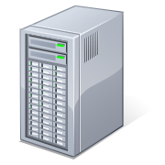

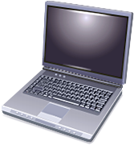
The role of WQX in Data Sharing
ARS
STEWARDS
Partner Data
Water Quality Portal
WQX
Exchange Network
EPA WQX
WQX
Web
USGS NWIS
For more information on the portal see: www.waterqualitydata.us
Notes:
The water quality data portal (an EPA/USGS partnership) provides access to over 260 million water quality results
These data are all available via web services which can be incorporated into any other third party application

