Slide 1

Massachusetts Department of Environmental Protection
Martin Suuberg, Commissioner
Enterprise-wide IT project
Energy and Environmental Information and Public Access System (EIPAS)
Newly launched in summer 2017: Energy and Environmental Affairs Data Portal

Slide 2
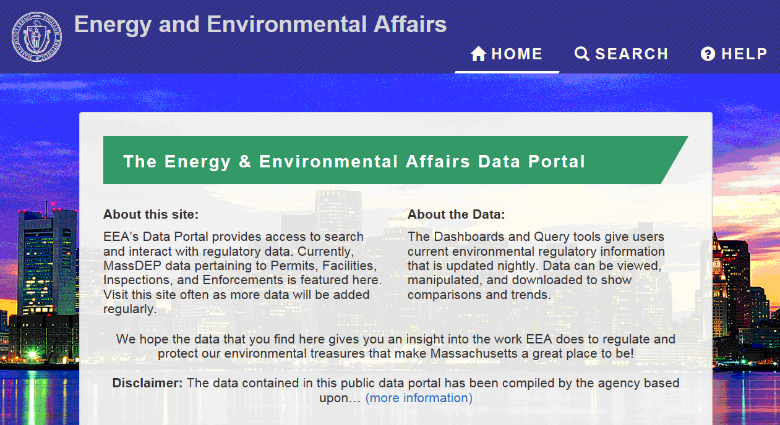
The Massachusetts Data Portal Illustrated http://eeaonline.eea.state.ma.us/portal#!/home
Notes:
With the launch of the EEA Data Portal, EIPAS is providing public online access to almost 20 years of MassDEP Permit, Inspection, and Enforcement data through both powerful analytic and search tools. The first release of the Data Portal provides access to core regulatory activity leveraging several of MassDEP’s legacy system data (not all MassDEP regulatory programs are included in this release of the portal). Data from across the EEA Secretariat will be added in subsequent releases.

Slide 3
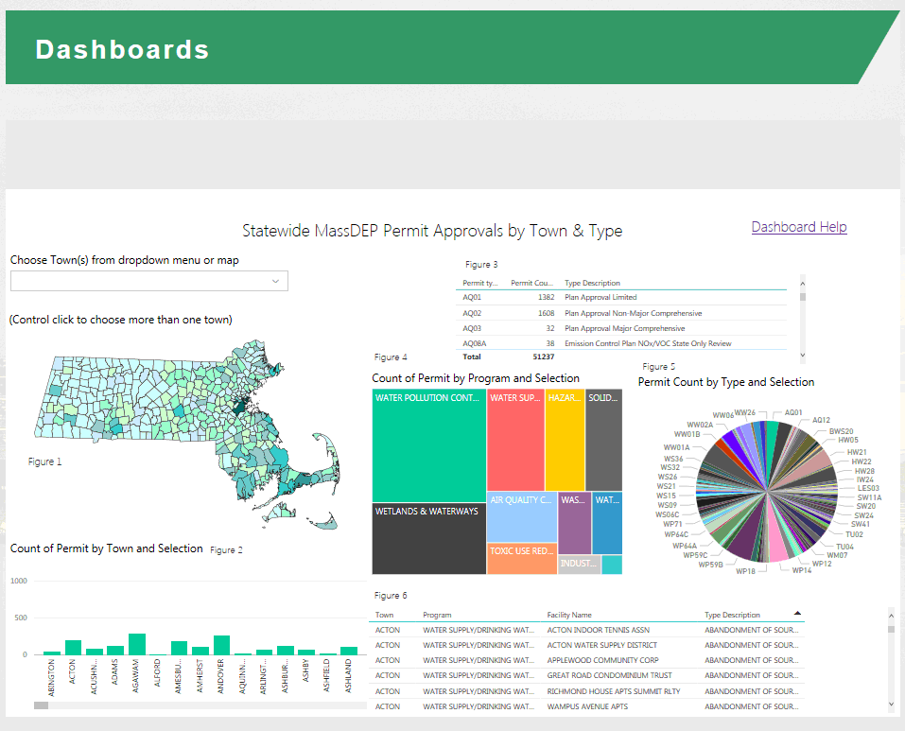
Dashboard to Search Permit Approvals

Slide 4
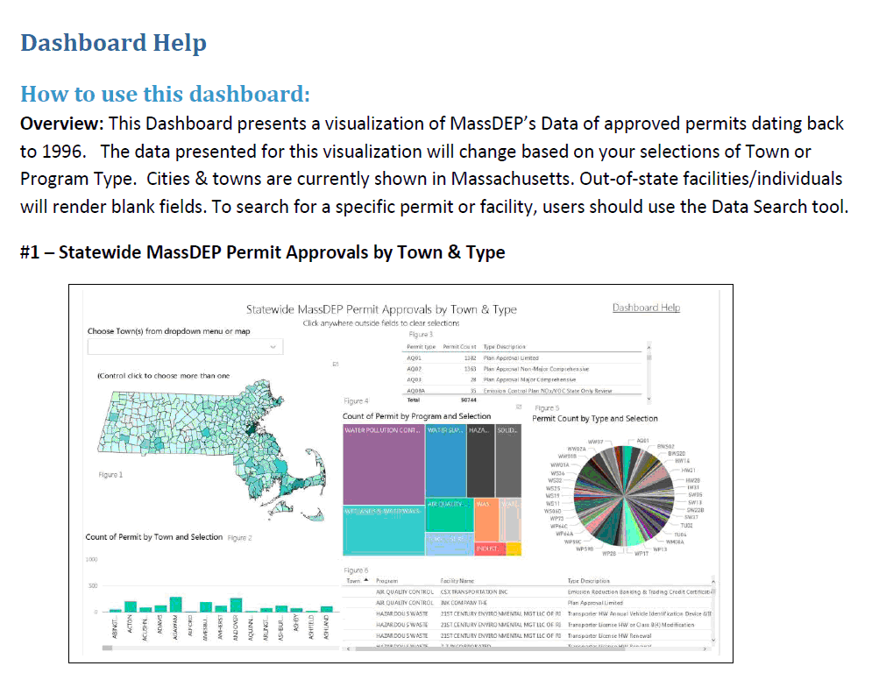
Dashboards allow users to interact with statewide data

Slide 5
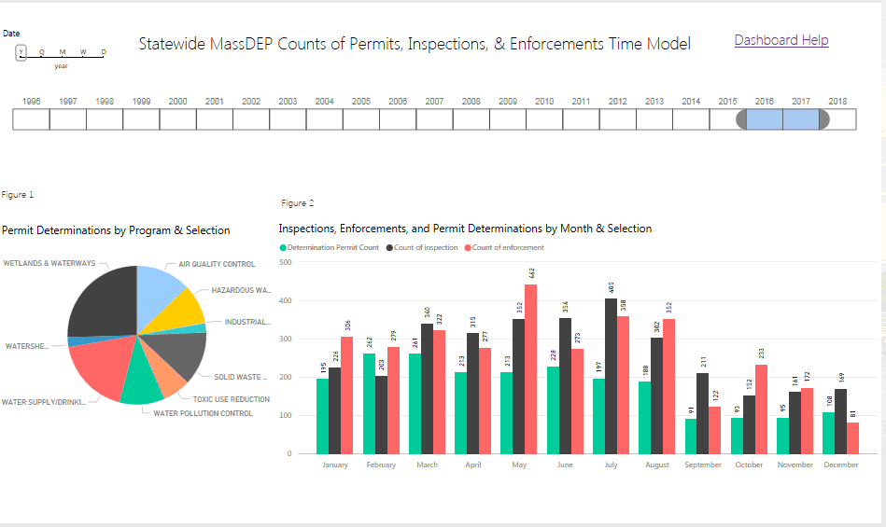
Dashboard #2: Actions Taken
Over Selected Time Periods

Slide 6
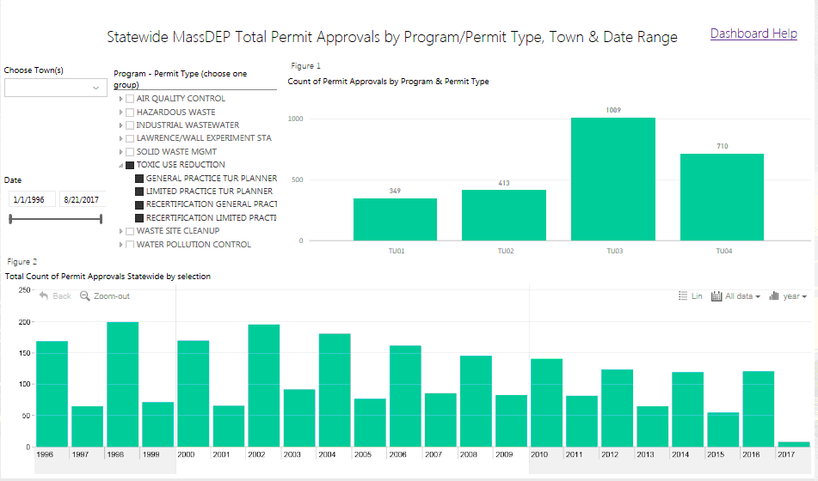
Portal #3: Permits by Program, Type and Date

Slide 7
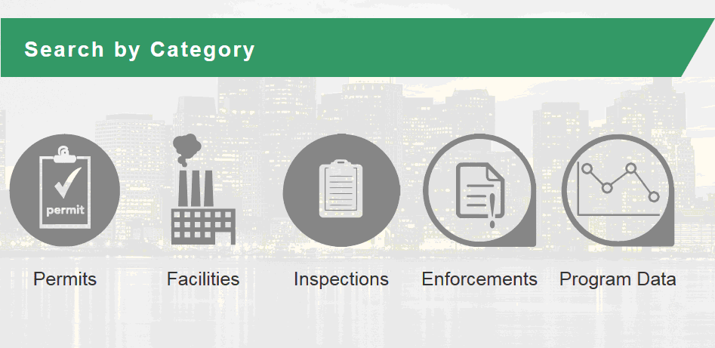
The Data Search Tools

Slide 8
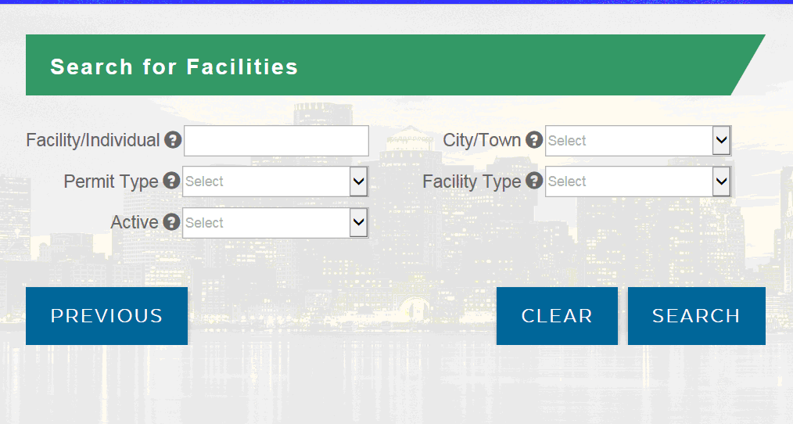
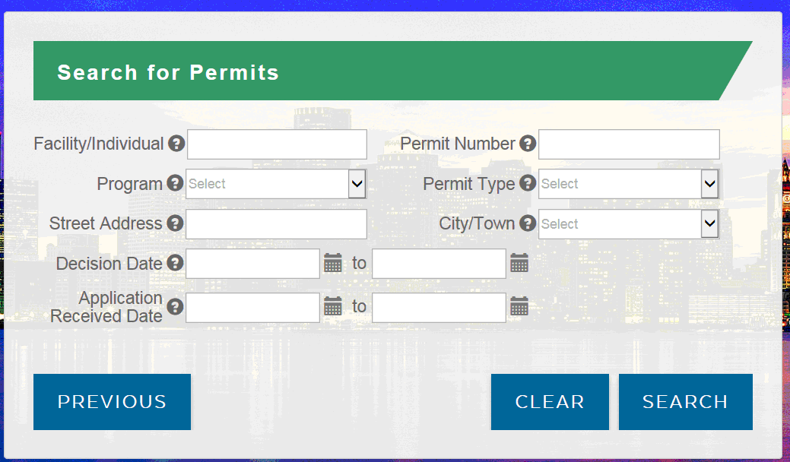
Searching for Permit or Facility Information

Slide 9
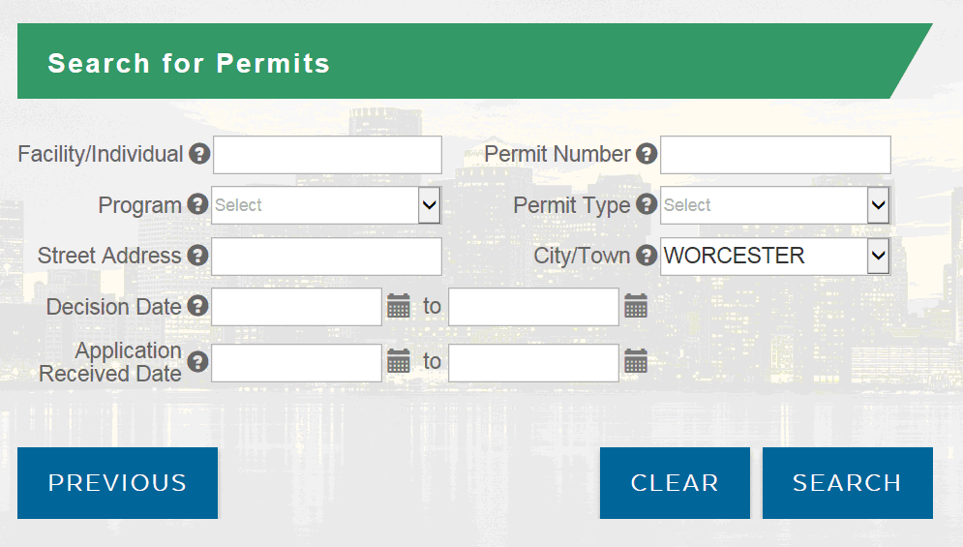
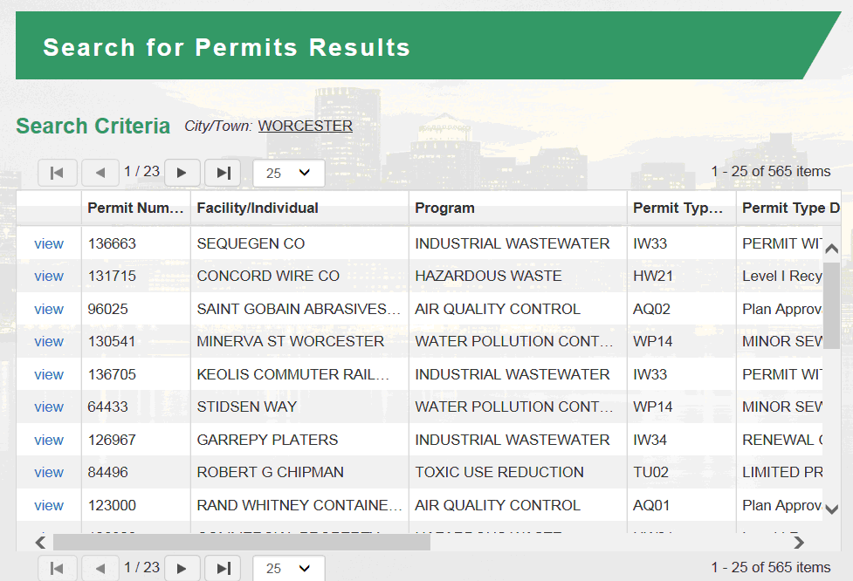
Search for permits by selected town

Slide 10
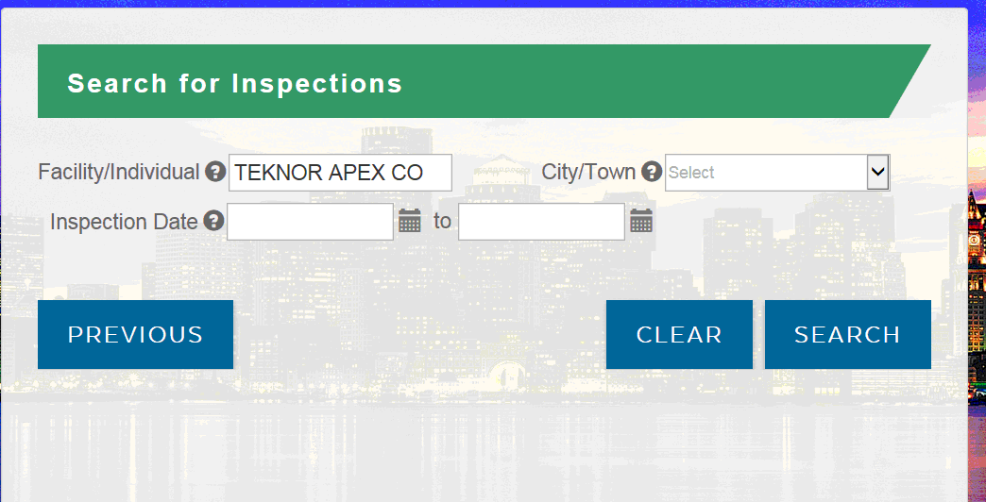
Searching Inspection History for a known facility

Slide 11
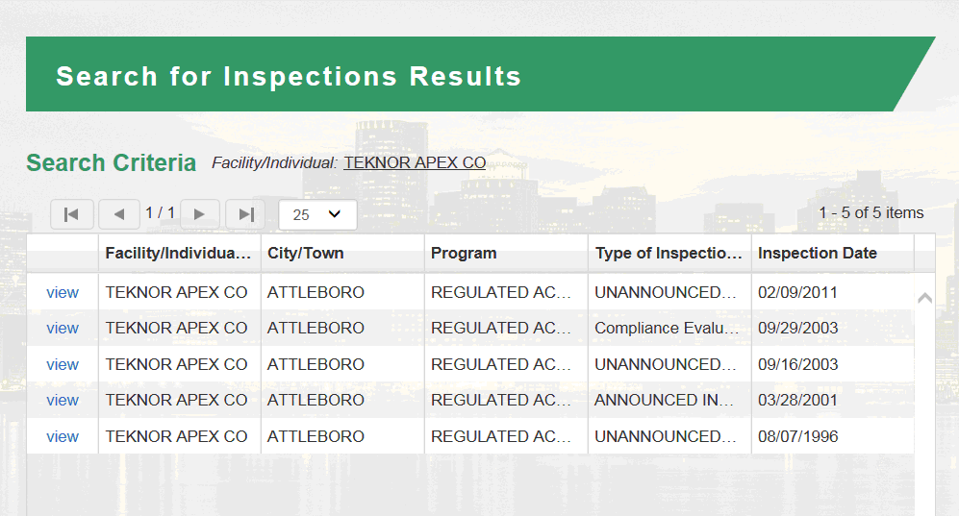
Inspection History Search Results

Slide 12
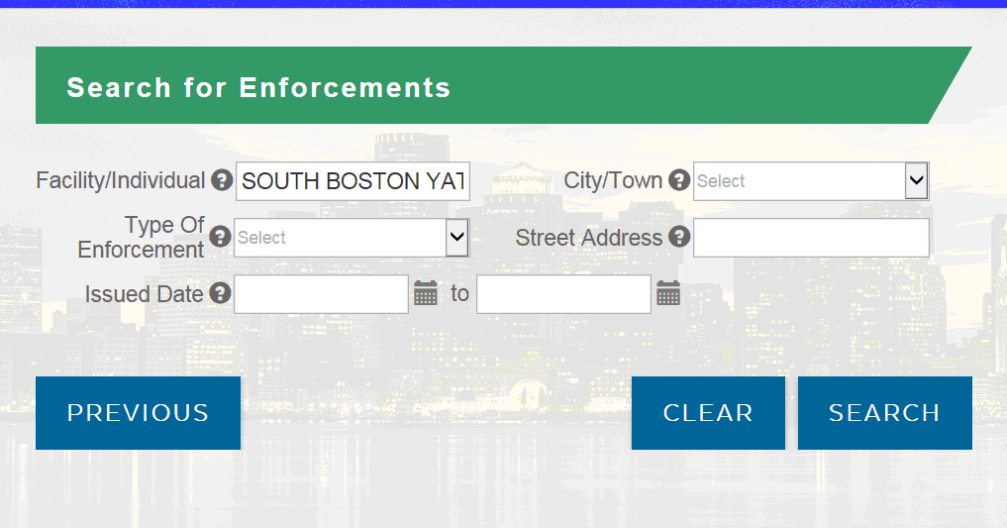
Searching Enforcement History of known facility

Slide 13
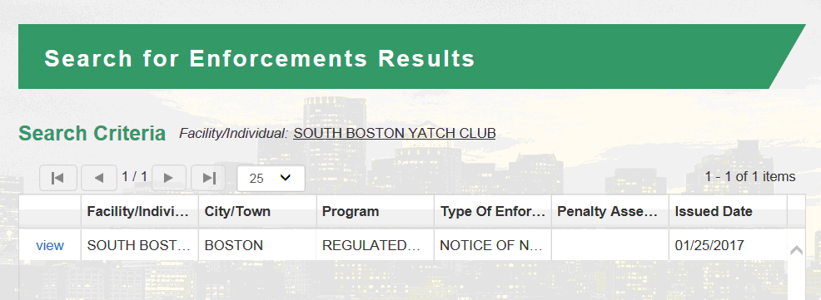
Enforcement Actions Taken

Slide 14
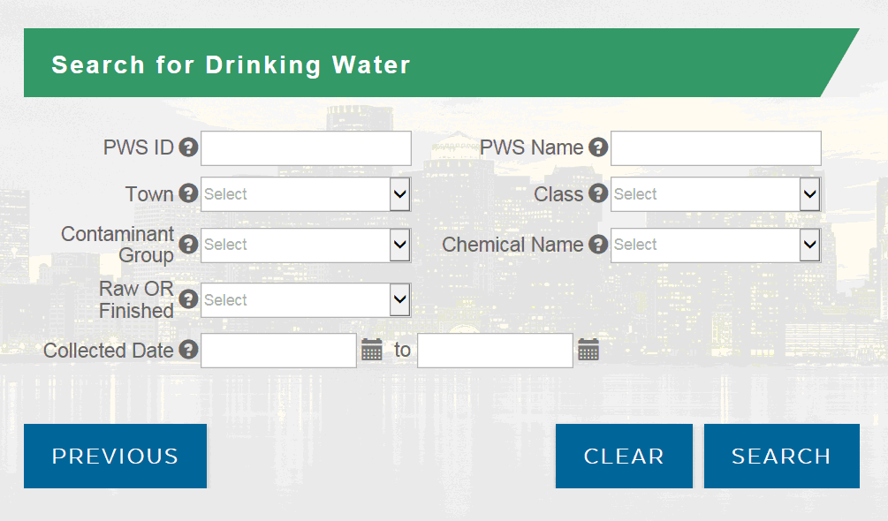
Search for Program Data
(more program data to be added)

Slide 15
For more information…
Explore the Massachusetts Data Portal!
http://eeaonline.eea.state.ma.us/portal#!/home
Contact:
  Victoria Phillips
  Director of Enterprise Information Office, MassDEP
  Victoria.Phillips@state.ma.us
  (617) 292-5956

