Slide 1
Permitting, Licensing, Registration & Enforcement
Overview

Slide 2
Real digital transformation occurs when leaders align goals and practices, manage opportunity more than risk and prioritize the future versus retrofit the present*
Improving Permitting
  Faster processing times
  Greater transparency
  Improved environmental and economic outcomes

Slide 3
Faster Processing Times
Workflow evaluation and leaning
Reusable code/Reusable workflow
Digitizing forms
  Built in error checking
  Site Mapping/GIS location
  Common facility names

Slide 4
The Whole is Greater than the Sum of its parts
Connecting Regulation to Environmental Outcomes
How does the customer interact with DNREC?
  What’s DNREC’s goal in that interaction ?
What’s the customer end-to-end process ?
  Where can web/mobile fit within that process to add value?
How can web/mobile interfaces demonstrate the link between permitting and their enjoyment of the environmental?
  What information is helpful to the customer under which circumstances? Does a phone at a boat ramp GPS get fishing info and license option ?
How can web & mobile generate additional revenue
  Bike rentals (referrals)
  Sustainable energy consultants

Slide 5
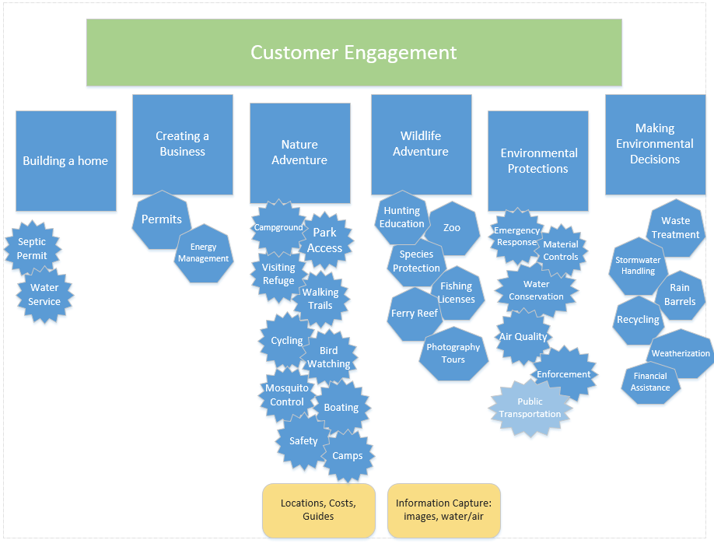
Mapping Common Customer Reasons to Contact to DNREC

Slide 6
Greater Transparency
Online searches
Customer Alerts as Permits move through phases
Searches by polygon,

Slide 7
People Act Not on What They Hear, but on What They Understand –
The customer must believe they can interact with DNREC in a way that gives them an advantage
Mobile Engagement
Where’s the best location to catch flounder ?
How do I report delict fishing gear?
Pull Communications
- One source for environmental information
How do you report a pipe leak?
What bike paths are available from Port Penn to Newark ?
How can I dispose of expired drugs ?
What’s the Ozone level today ?
How do I report injured wildlfe?
What’s the environmental compliance score for DuPont ?
Are clams from the Rehoboth Bay edible ?
Push Communications
- Bass fishing rated A this week at Herring Creek, click for pictures
- There has been a toxic release of XYZ in your area
- Mr Bob’s X Store is 100% compliant on air monitoring for 3 months
The pollen count for 7/16/14 is

Slide 8
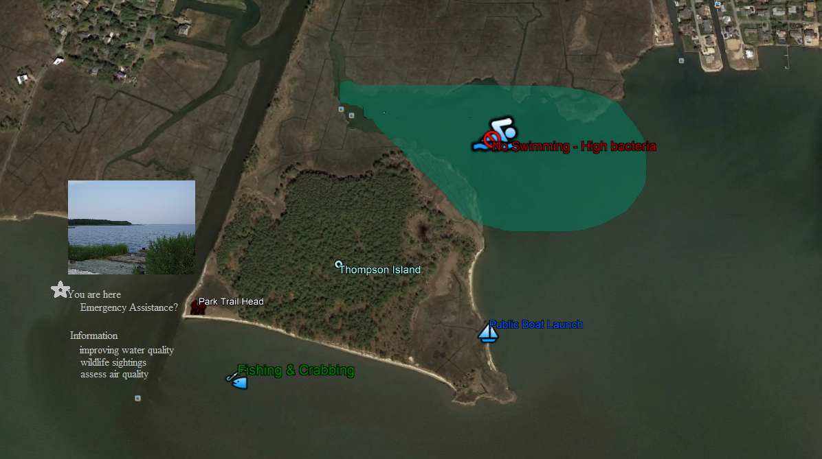
The Best Way to Predict the Future is to Create It - The mobile interface must make the connection between what information is available to the user and how it can improve their experience

Slide 9
Improved Environmental and Economic Outcomes
Mobile Inspection Applications
Wireless sensor data capture
Compliance w/ permit requirements as part of environmental profile
Faster data analytics
Predictive analysis

Slide 10
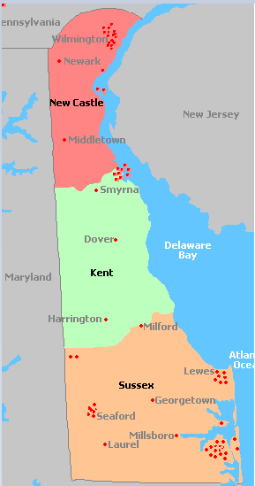
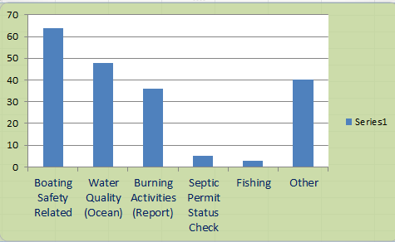
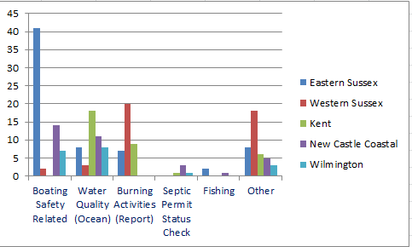
Who’s interested in What ?

Slide 11
Steps
  Review statutory and regulatory provisions
  Define internal and external Customer experience
    Improve outreach, data collection, reporting (including data analytics and predictive analysis)
    Web app prompting users through questions navigating them to appropriate resources & permits
  Streamline and Standardize workflow
    More understandable terms and conditions
    Benchmark model permitting processes
    Develop taxonomy/ontology for functions & elements of protection activities
  Improve data sharing & teamwork (including w/ jurisdictions/coordination of interrelated permits)

Slide 12
Steps
- Request for Proposal for portal solution
- Attach GIS tag to every record
- Map records based on function and location
- Mobile customer interface
- Customer notifications
  Phase alerts (received, submission approved)
- Mobile device inspection interface

