Slide 1
Virginia’s
Wetland Condition Assessment Tool
(WetCAT)
David K. Paylor
VDEQ Director

Slide 2
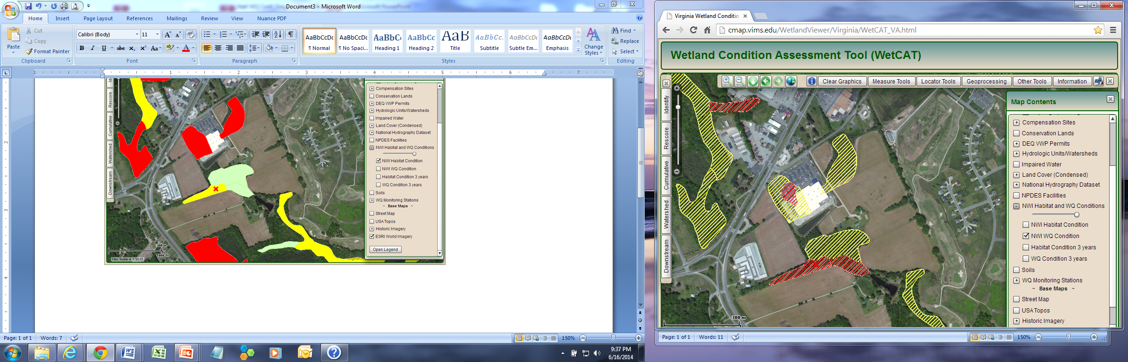
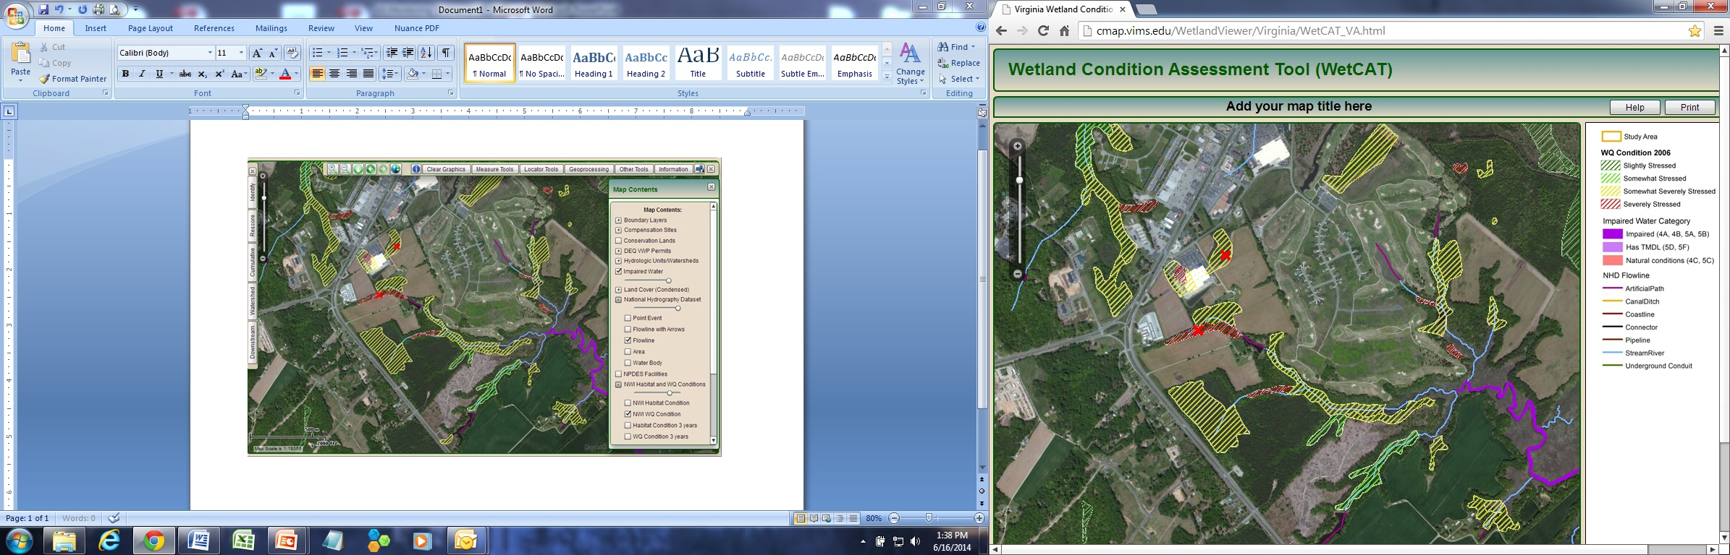

Slide 3
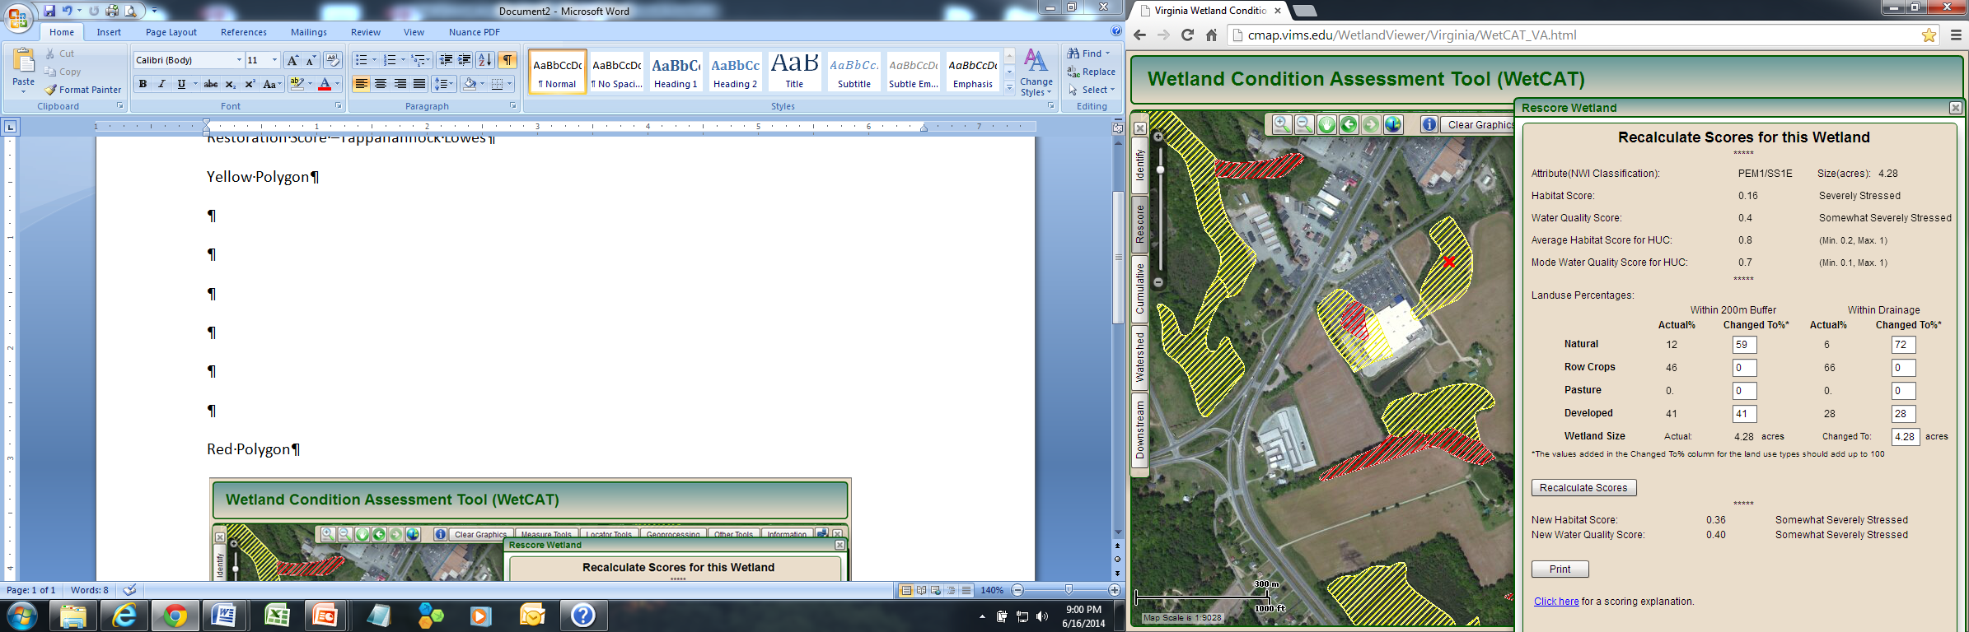
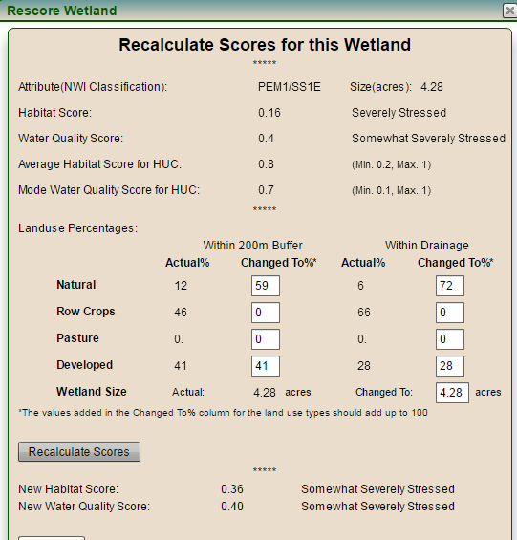
Restoration Potential

Slide 4

Alternative Analysis
Function (4.28 acres-PEM) | Present Condition Score | Project Impact Score | Restoration Score
Habitat | 0.16 | 0.16 | 0.36
Water Quality | 0.40 | 0.10 | 0.40
Function (2.18 acres-PFO) | Present Condition Score | Project Impact Score | Restoration Score
Habitat | 0.38 | 0.38 | 0.64
Water Quality | 0.10 | 0.10 | 0.40
Impaired Waters Layer

