Slide 1

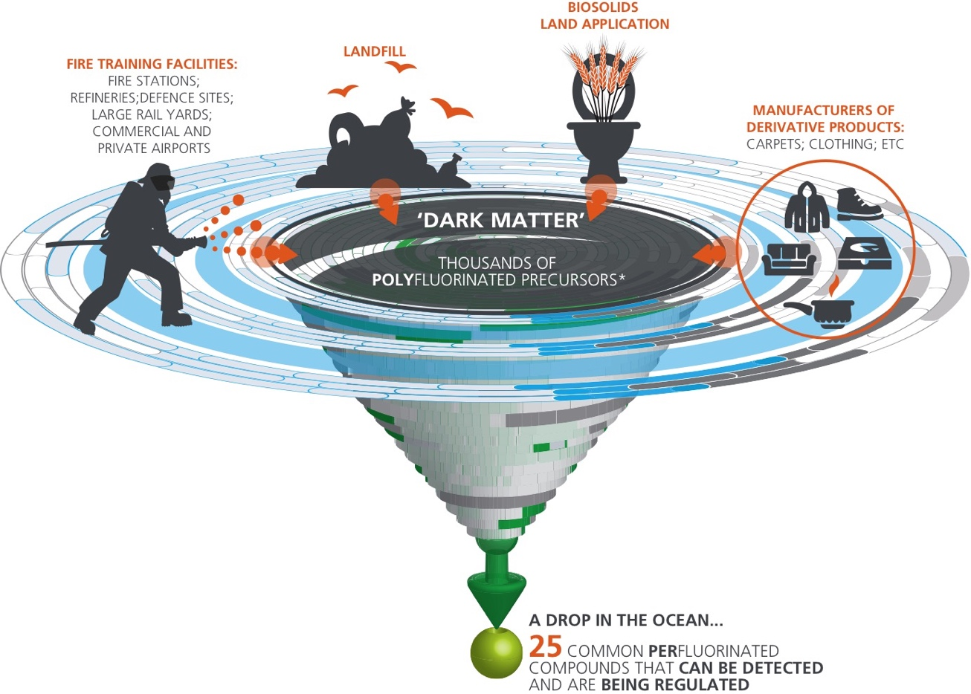
AN emerging issue (PFAS POLY- AND PERFLUOROALKYL SUBSTANCES)
Suthan Suthersan, Chief Technical Officer
PFAS in Public Water Supply
Being Prepared
  Occurrence/Vulnerability Assessments
  Prioritization
  Situational Assessment & Management
Risk Communications
  Exposure Pathways
  Toxicology
Investigations & Analysis
  Rapid Advancements in Methods and Tools
  Individual Compound Analysis
  Bulk Measurements
Treatment Technologies
  Soil (source areas)
  Groundwater
  Water Supplies
ONLY 16-39 PFCs CAN BE DETECTED BY TRADITIONAL METHODS
PFAS is in the headlines
It can come from multiple sources
Emerging Contaminants → Large Groundwater Plumes → Impacts on Water Supplies

Slide 2
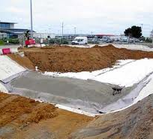
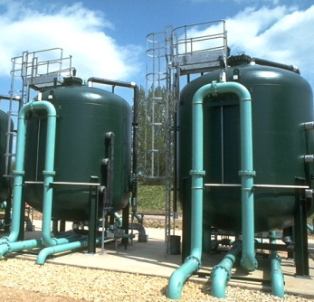
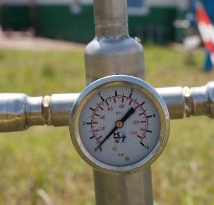
Soil and Water Treatment Options for PFAS
(Highly soluble, least adsorbable, not very biodegradable compounds)
WATER SUPPLY
EX SITU
GROUNDWATER
AND SOILS
IN SITU
SOIL
Excavation & Disposal
Capping & Containment
High Temperature Incineration
Solidification & Stabilization
Pump & Treat
Granular Activated Carbon (GAC)
Ion Exchange
Reverse Osmosis/Nano-Filtration
Other adsorbents/absorbents
In Situ Chemical Oxidation
In Situ Adsorbents
In Situ Air Sparging / Biosparging/SVE
Concentrate → Separate → Destroy
Where we need to be: Treatment Trains

