Slide 1
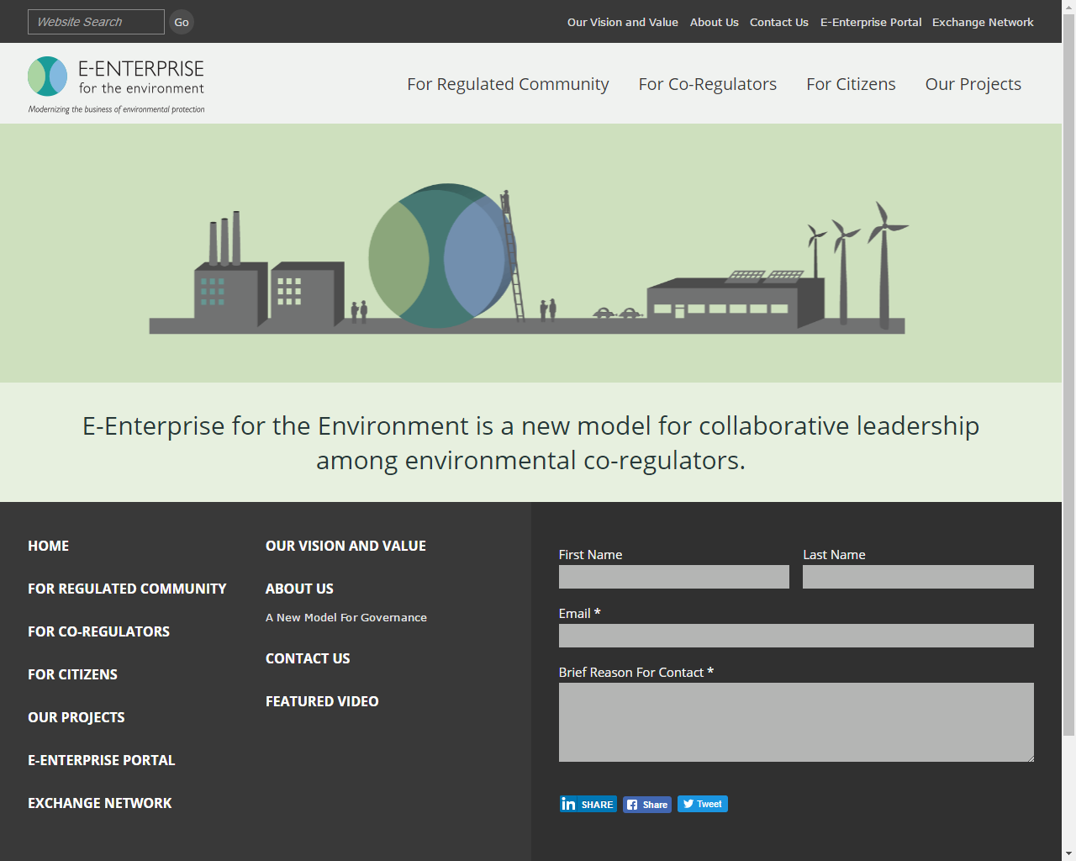
Notes:
I am privileged to have the opportunity to unveil the new E-Enterprise for the Environment website.
We’ve talked about this for a long time. As many of you may know, the site was developed by an ECOS' contractor (overseen by state, EPA and ECOS representatives over many months), and is now being maintained by ECOS.
The images have changed in order to leverage the use of the logo and the whole look and feel has been made current with where web design trends are and appear to be going. This is a point of departure from what EPA, ECOS, and E-Enterprise members saw before. E-Enterprise is supposed to reflect “streamline” and “modern” and the new website design was developed to align with this charge.

Slide 2
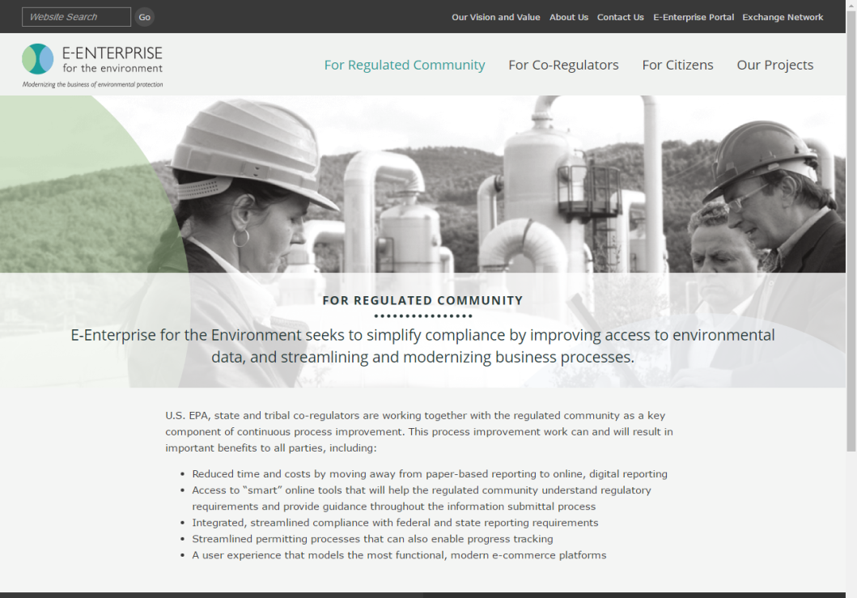
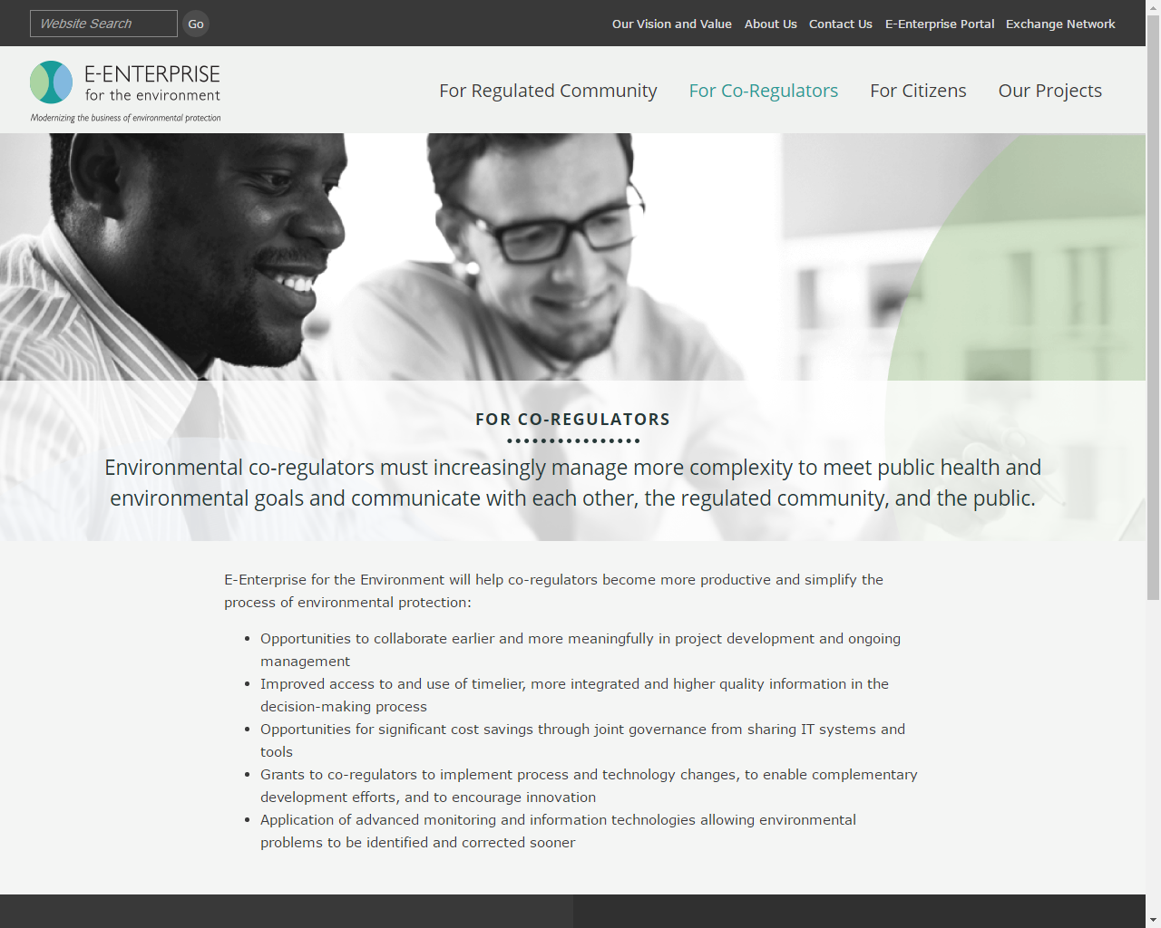
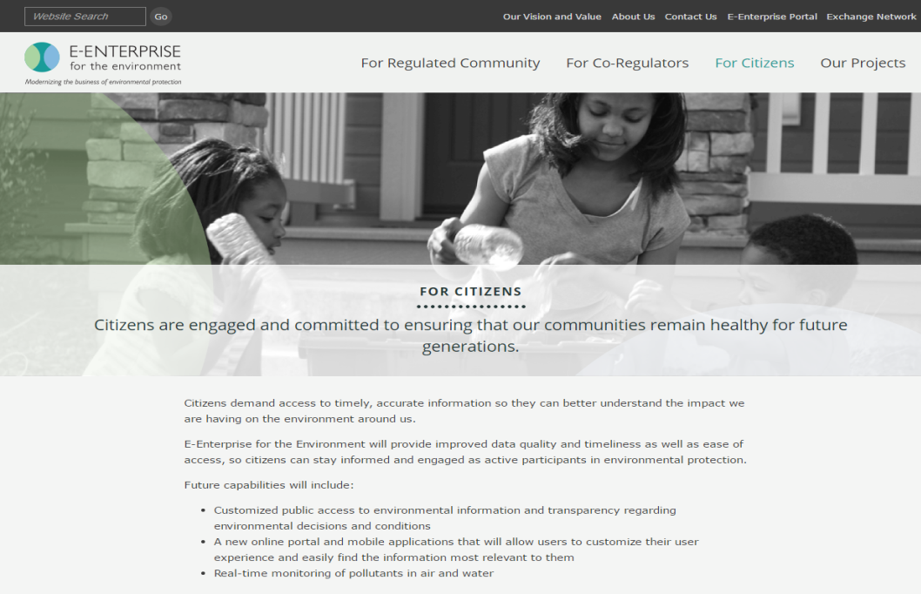
Regulated Community
Co-Regulators
Citizens
Notes:
Features:
- Three "user-based" information pages- for citizens, co-regulators, and the regulated community. Each page includes details about the benefits E-Enterprise – our new way of doing business in a joint partnership manner – benefits them.

Slide 3
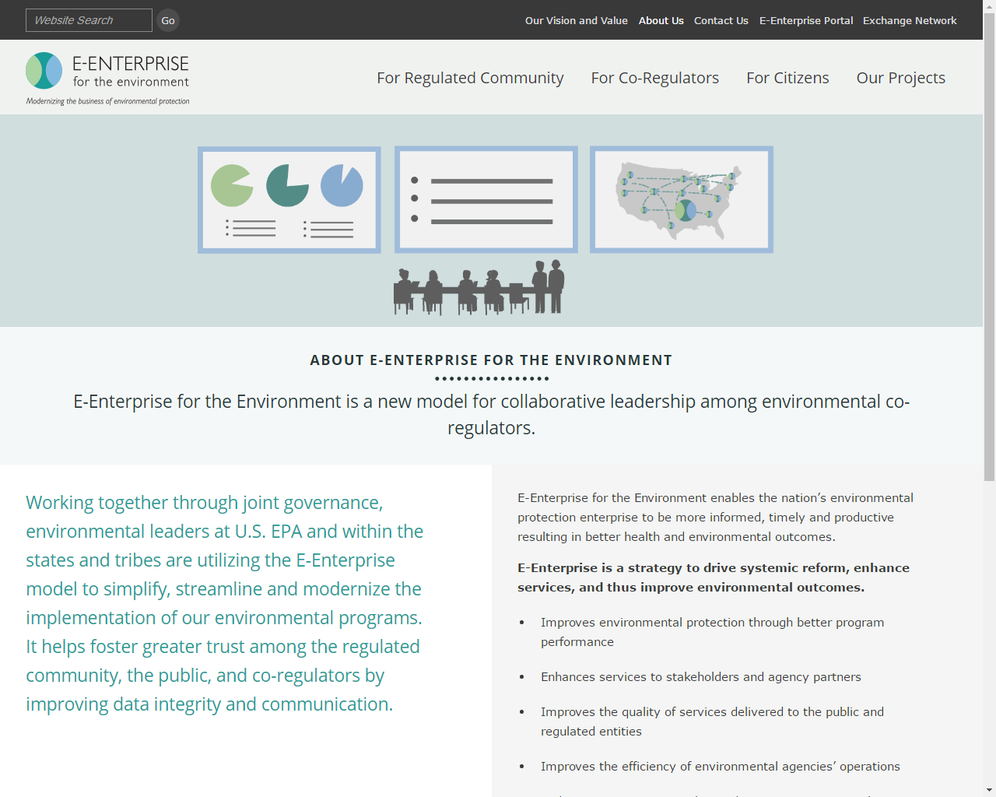
Notes:
There is an About Us page that describes how we use the E-Enterprise model to drive systemic reform, enhance services, and improve environmental outcomes. This page also lists the members of the various E-Enterprise governing bodies (EELC, EE Executive Committee, EE and Exchange Network Management Board, and the EE and Exchange Network Interoperability and Operations Team).
I would encourage anyone that is interested in getting more involved with E-Enterprise to get in touch with any of the members and we will find a way to get you involved. We would love to have you!

Slide 4
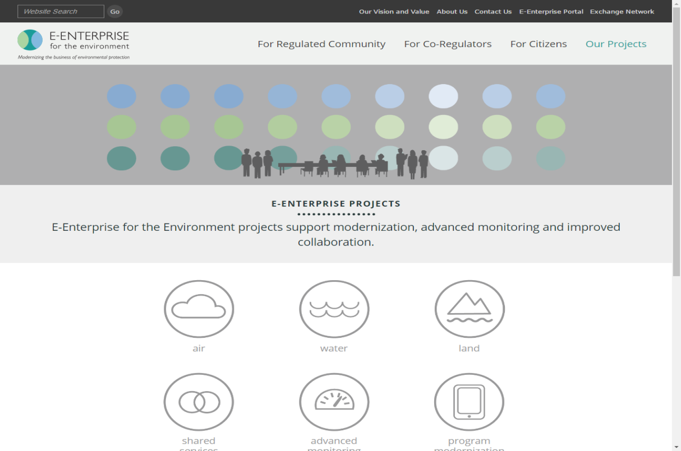
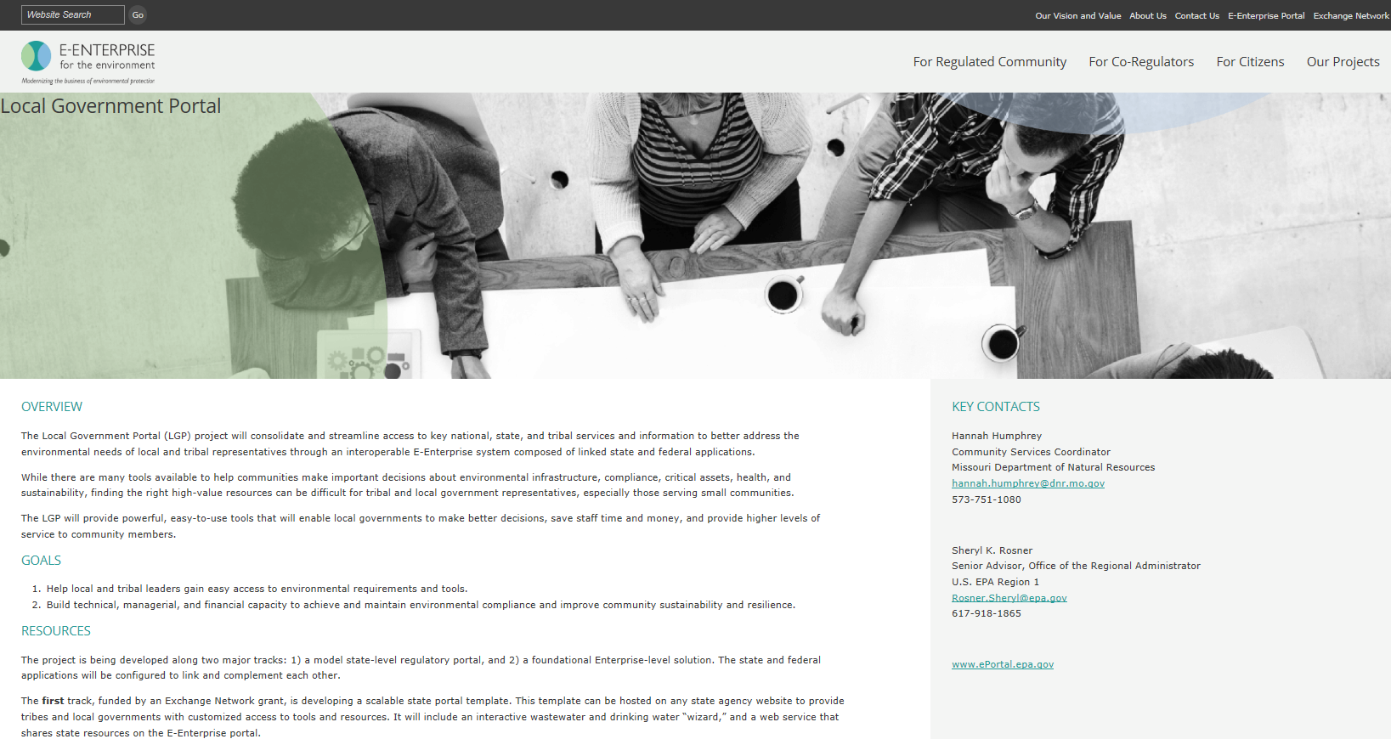
Our Projects
Local Government Portal
Notes:
If you are interested in finding out information about the E-Enterprise projects, simply click on the Our Projects link. There you will find the current projects have been categorized by topic – Air, Water, Land, Shared Services, Advanced Monitoring, and Program Modernization. The project fact sheets and co-chair contact information is provided to give you general details about the projects.

Slide 5




Local Government Portal
MODEL STATE PORTAL
LOCAL GOV’T PORTAL
PORTAL
User profile
Drinking water & wastewater wizards
Resources for Missouri Communities
User profile
Tools & widgets
Resources for Communities
LOCAL GOV’T PORTAL
Local Government
& Tribes Users
User profile
Drinking water & wastewater wizards
Resources for Arizona Communities
The Local Government Component
Notes:
The Local Government Portal project includes work along two major tracks: 1) a model state-level regulatory portal that each state may configure and deploy, and 2) a foundational E-Enterprise-level solution. The state and federal applications will be configured to link and complement each other.
The E-Enterprise portal includes many tools and widgets; the one labelled Resources for Local Communities we refer to as the Local Government Component.
The resources in the LGP are compiled by agency staff to represent all the state, federal and NGA resources applicable to environmental issues that are available to local governments. This “curation” of all applicable resources by agency staff is what differentiates this tool from what user can gain from a simple Google search.

Slide 6

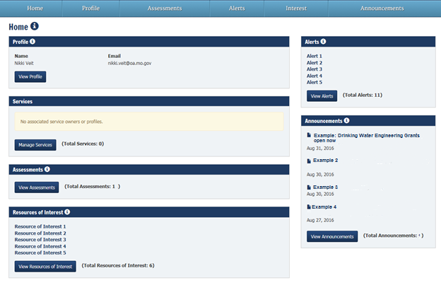
State Local Government Portal
Progress ongoing using agile development with input from local government users and assistance organizations
Notes:
Funded by an Exchange Network grant, Missouri DNR and state partner Arizona DEQ are developing a scalable state local government portal “template”.
This application can be hosted on any state agency website to provide tribes and local governments with customized access to tools and resources.
It will include an interactive wastewater and drinking water “wizard,” a link to the E-Enterprise Portal, and a web service that shares state resources to the E-Enterprise portal.
The Missouri development team is developing the application using agile methodology, and using input from testing sessions with local governments and partners. (Examples: MRWA, MPUA, MML, Dept of Economic Development, USDA RD, EPA, etc)

Slide 7
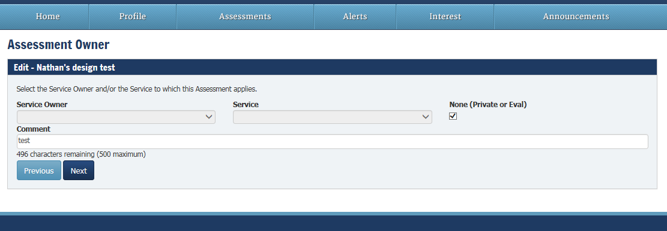
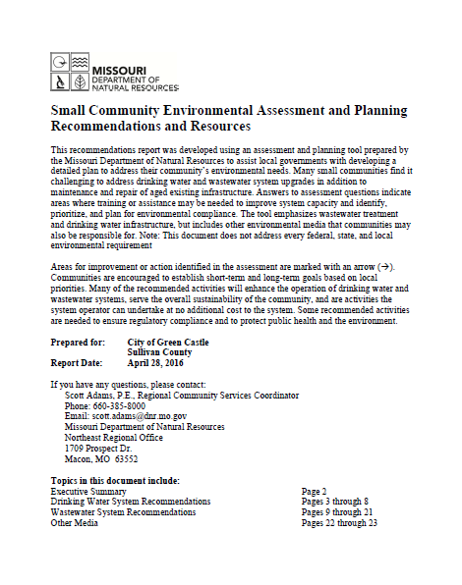
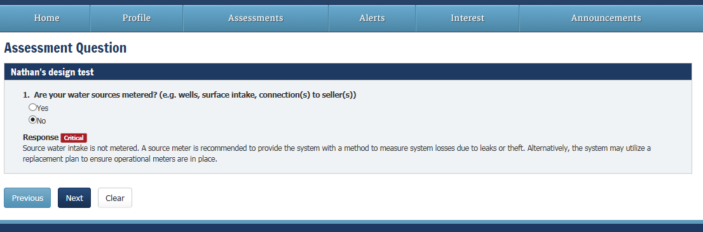
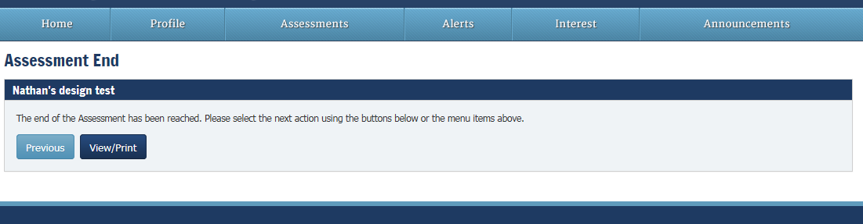

State Local Government Portal Wizard
Notes:
The wizard is the star of the state portal. Shown here are screenshots of an early version.
The user will open a new assessment and step through a series of questions about drinking water or wastewater. Questions assess technical, managerial and financial aspects of the community’s systems.
Once through all the questions, the use can click “View/Print” to open a report that lists recommendations and resources based on the community’s unique situation. The recommendations report details actions the city can take to improve the operation and sustainability of their systems, and begin to proactively plan to meet future infrastructure needs.
We expect to have a liv version online for soft release in December, and will make refinements through theremainder of our Exchnage Network grant with final release and promotion in April 2017.

Slide 8
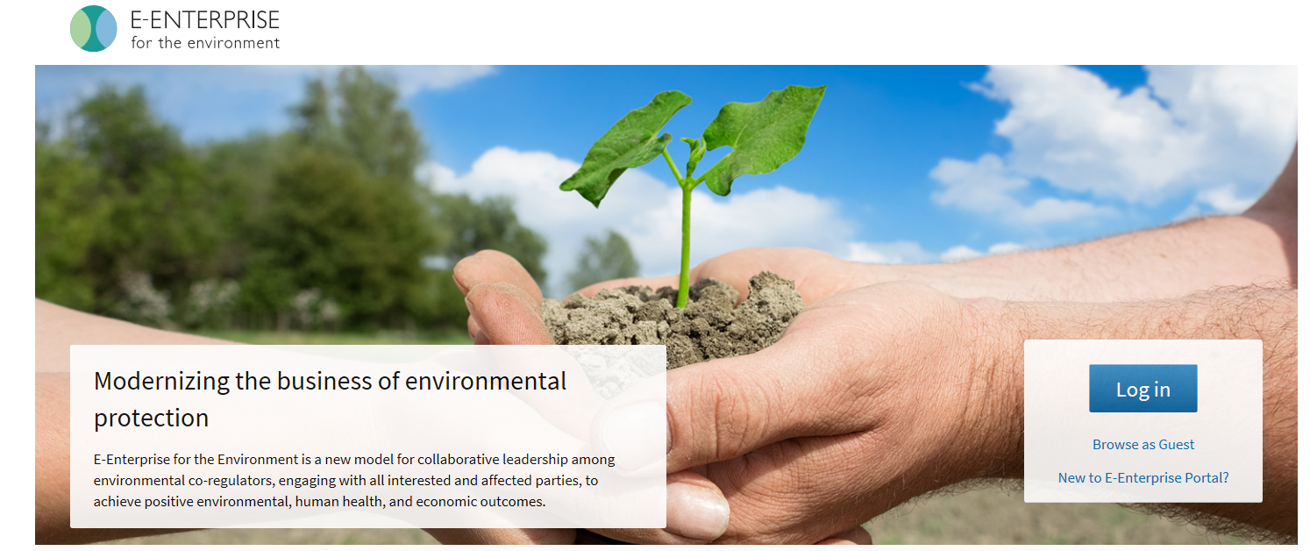
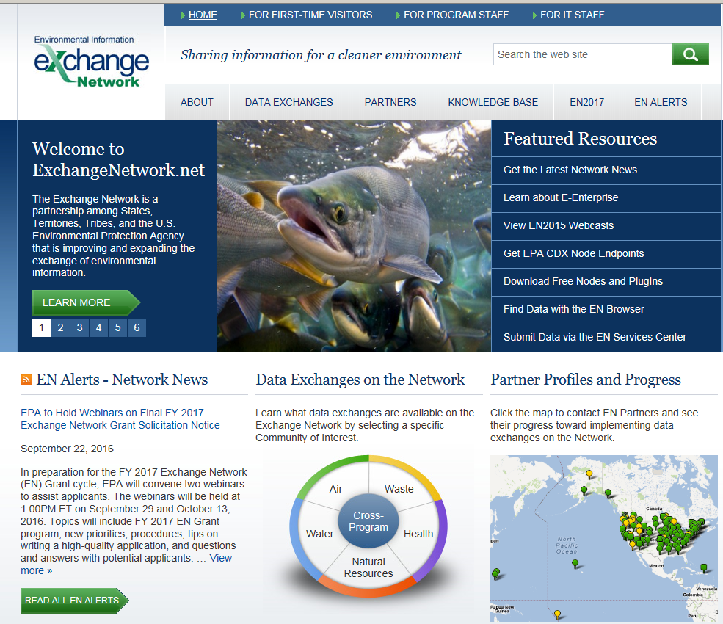
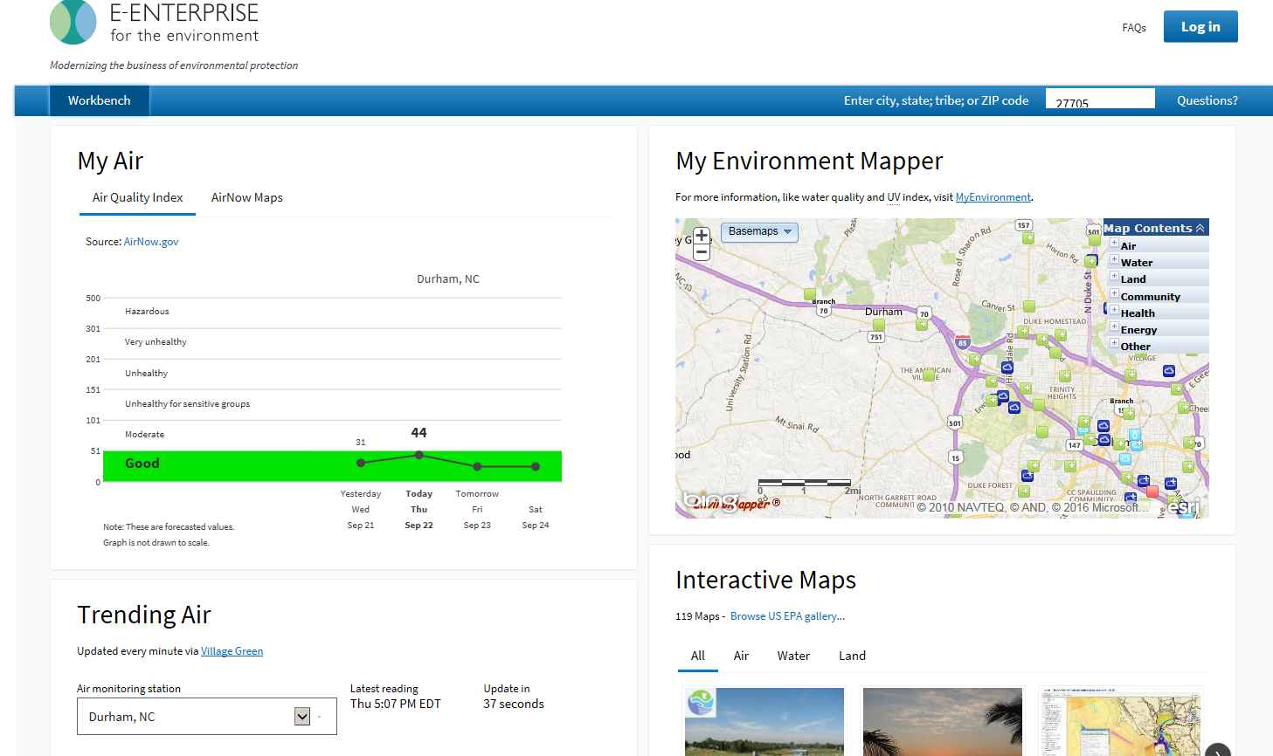
Notes:
Towards the bottom of the page, you will find links to the Exchange Network and the E-Enterprise Portal.
The Local Government Portal I briefly explained will be one component of the larger E-Enterprise Portal.

Slide 9
Questions?
Notes:
Things are definitely coming together and it is exciting! Great job to everyone that has been involved to get us to this point and I look forward to working with those that come on board in the near future.
E-enterprisefortheenvironment.net

