Slide 1
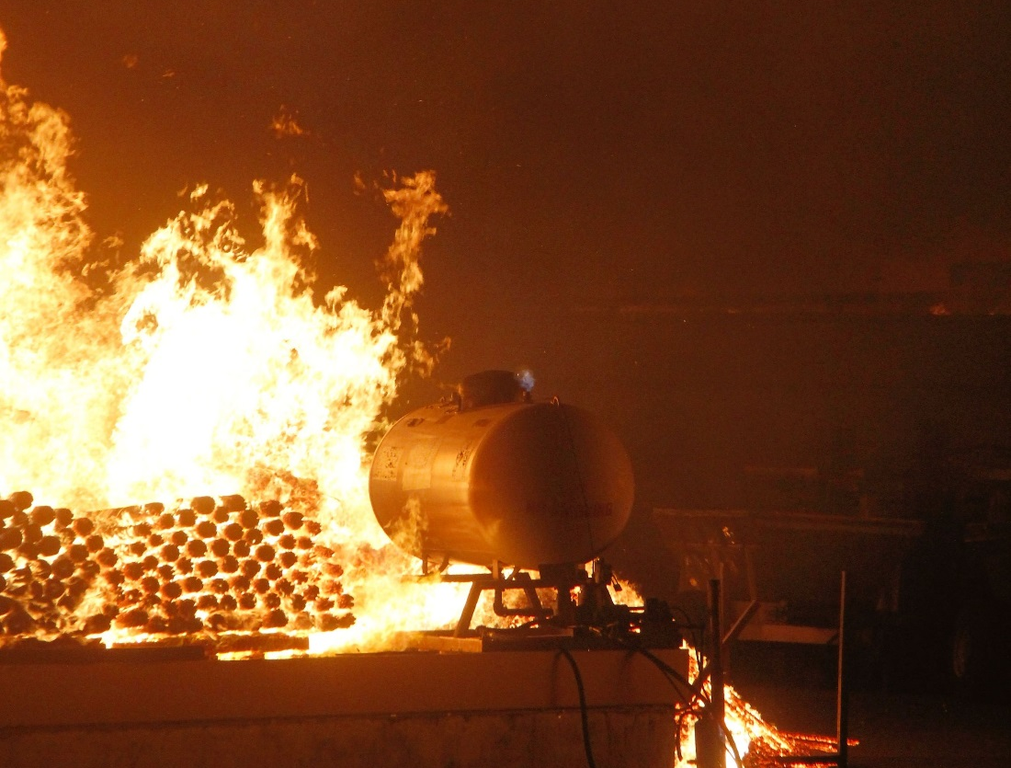

Washington State’s
EPCRA app
Essential chemical storage information made mobile for emergency responders
Maia Bellon, Director

Slide 2

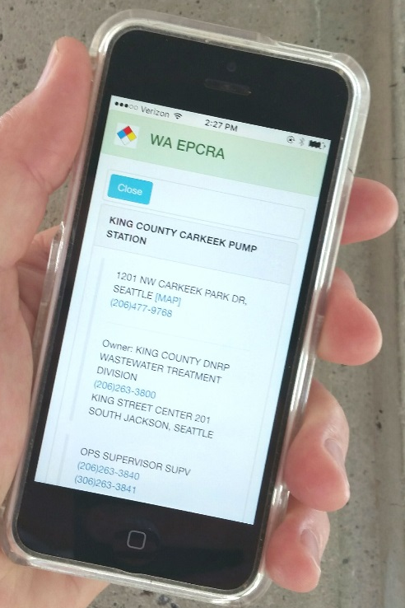
“This is a game-changer for us.
Having this paid off for us, improving the safety of responders and the public.”
– Dave Byers, Spills response manager

