Slide 1
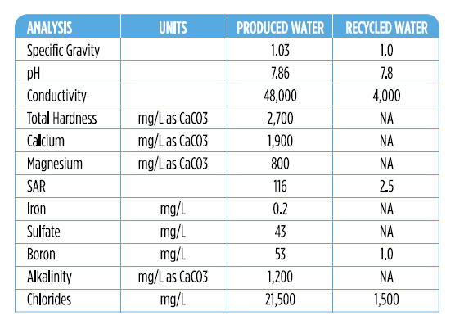
Pecos Cotton Pilot Project
Texas RRC permitted pilot project
Texas A&M identified water parameters
30,000 bbls from a single well
One crop, one growing season
5 total acres
Treated with: Dissolved Air Flotation, Ceramic Membrane, RO, Walnut Shell Filtration

Slide 2
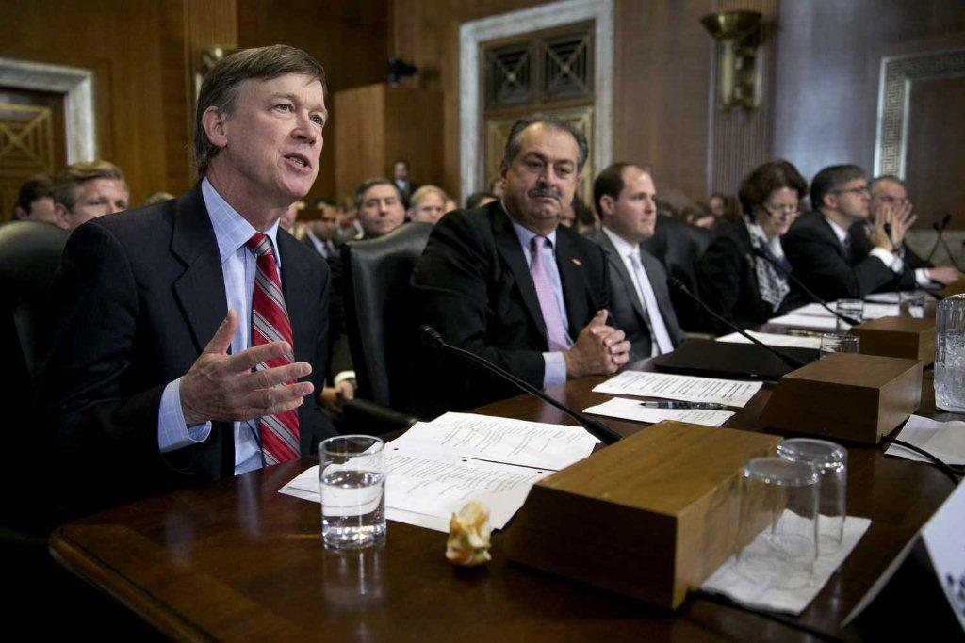
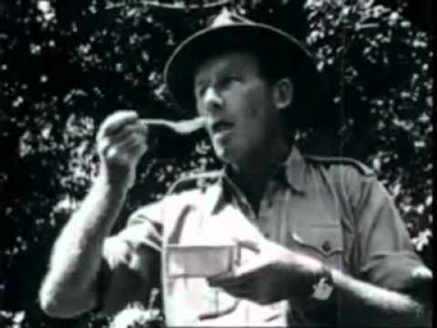
“You can drink it. We did drink it around the table, almost ritual like, in a funny way….they’ve invested millions of dollars in what is a benign fluid in every sense.”
Gov. Hickenlooper, U.S. Senate Committee on Energy and Natural Resources. – Feb. 11, 2013
DDT so safe you can eat it - 1947

Slide 3
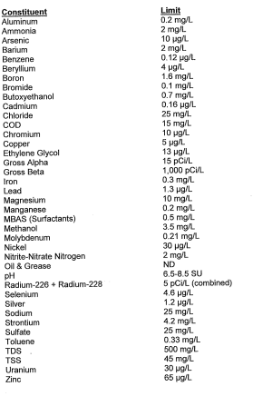
PA DEP General Permit WMGR123: Processing and Beneficial Use of Oil and Gas Liquid Waste • Authorizes reuse for HF or well development only • Treated water is “dewasted” when it meets constituent limits in Appx A OR is used to develop or HF a well • Limits assume worst case scenario: discharge to surface • Assumes distillation

Slide 4
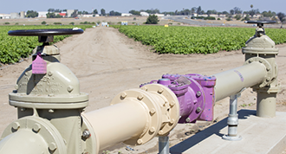
CA Title 22 Municipal Wastewater Reuse
Drought State of Emergency declared in 2014, Governor directs State Water Board to adopt statewide discharge requirements to facilitate water recycling
Uniform Statewide Recycling Criteria (California Code of Regulations, Title 22, Division 4, Chapter 3) outline constituent levels for specific uses with varying exposure pathways, and 4 corresponding levels of treated water
General Order establishes operational conditions for treated municipal wastewater recycling for nonpotable uses
Primary focus is biological, some consideration for CEC

Slide 5
Produced Water Knowledge Gaps
No measurements in water
No perceived hazard
No science follow-up
No Water Quality Criterion
No “approved” method
Methods gap
Exposure gap
Mind the Gaps!
Regulatory gap
Awareness gap
Hazard data gap

