Slide 1
2015 U.S. Scrap Tire Management Summary
August 2016

Slide 2
U.S. Scrap Tire Disposition 2015
Market or Disposition | Thousands of Tons | Millions of Tires | % change 2013-2015
Tire-Derived Fuel | 1922.67 | 117.31 | -9.3%
Cement Kilns | 753.37 | 45.97 | 3.8%
Pulp & Paper | 616.25 | 37.60 | -14.0%
Electric Utilities | 553.05 | 33.74 | -4.0%
Industrial Boilers | 0.00 | 0.00
Dedicated Tires-to-Energy | 0.00 | 0.00 | -100.0%
Ground Rubber | 1020.75 | 62.28 | 4.7%
Civil Engineering | 274.92 | 16.77 | 59.8%
Exported | 102.07 | 6.23 | -58.5%
Electric Arc Furnace | 26.00 | 1.59 | -60.3%
Reclamation Projects | 52.54 | 3.21 | 6.9%
Agricultural | 7.10 | 0.43 | 0.0%
Baled Tires/market | 9.19 | 0.56 | -69.4%
Punched/ Stamped | 41.20 | 2.51 | 2068.4%
Other | 94.86 | 5.79
Total to Market | 3551.30 | 216.69 | -3.2%
Generated | 4038.80 | 246.43 | 5.6%
% to Market/Utilized | 87.9% | 87.9% | N/A
Land Disposed | 451.40 | 27.54 | 37.7%
% Managed (includes Markets, Baled and Landfill) | 99.1% | 99.1% | N/A

Slide 3
U.S. Scrap Tire Market Summary (2007 – 2015) (in Thousands of Tons)
Market or Disposition | 2007 | 2009 | 2011 | 2013 | 2015
Tire-Derived Fuel | 2484.36 | 2084.75 | 1427.03 | 2120.29 | 1922.67
Ground Rubber | 789.09 | 1354.17 | 1093.50 | 975.00 | 1020.75
Land Disposed | 593.98 | 653.38 | 491.65 | 327.78 | 451.40
Exported | 102.08 | 102.10 | 302.48 | 245.84 | 102.07
Civil Engineering | 561.56 | 284.92 | 294.99 | 172.00 | 274.92
Reclamation Projects | 132.58 | 130.00 | 54.29 | 49.17 | 52.54
Electric Arc Furnace | 27.14 | 27.10 | 65.55 | 65.56 | 26.00
Baled Tires/market | UNK | 27.76 | 1.92 | 30.00 | 9.19
Agricultural | 7.13 | 7.10 | 7.10 | 7.10 | 7.10
Punched/ Stamped | 1.85 | 1.90 | 1.90 | 1.90 | 41.20
Baled/no market | 9.31 | 15.57 | 32.78 | No data | No data
Used Tires¹ | n/a | 371.25 | n/a | n/a | n/a
Other |  |  |  |  | 94.86
Total to Market | 4105.79 | 4391.05 | 3083.76 | 3666.85 | 3551.30
Generated² | 4595.72 | 5170.50 | 3781.00 | 3824.26 | 4038.80
% to Market/Utilized | 89.3% | 84.9% | 81.6% | 95.9% | 87.9%
% Managed(incl. baled and landfilled tires) | 102.5% | 97.9% | 95.4% | 104.5% | 99.1%
¹RMA began tracking tires culled from scrap tire collection entering domestic used passenger and light truck used tire markets in 2009. RMA changed the way it incorporated estimates of tires entering used tire markets between 2009 and 2011. In 2009, RMA included used tires as a market for scrap tires. In 2011 and 2013, RMA subtracted used tires from the total tires hauled to calculate total net scrap tire generation.
²RMA changed the basis for reporting scrap tire generated annually from state-provided data in 2005-2007 to a calculation of replacement market tires sold and vehicles scrapped for reports issued 2009 and after.

Slide 4
U.S. Scrap Tire Generation 2015
Tire Class | Millions of Tires | Market % | Average Weight (lbs) | Weight (thousands of tons)
Light Duty Tires | 248.8 | 89.0% | 22.5 | 2799.0
Passenger tire replacements¹ | 206.1 | 73.7%
Light truck tire replacements¹ | 29.1 | 10.4%
Tires from scrapped cars² | 13.6 | 4.9%
Commercial Tires | 30.9 | 11.0% | 120.0 | 1854.0
Medium, wide base, heavy truck replacement tires¹ | 17.9 | 6.4%
Tires from scrapped trucks and buses² | 13.0 | 4.6%
Total tires hauled | 279.7 | 100.0% | 33.3 | 4653.0
Used tires culled | 36.9 | 13.2% | 33.3 | 614.2
Net scrap tires | 242.8 |  |  | 4038.8
¹Factbook 2014: U.S. Tire Shipment/Activity Report for Statistical Year 2013, Rubber Manufacturers Association.
² Ward's Motor Vehicle Facts and Figures, 2014. Includes the total number of vehicles removed from service in 2013. In 2013, Ward's did not publish vehicles retired from service separated for the car and truck/bus category. Instead, it only published total vehicles scrapped from service. RMA estimated the split between cars and trucks/buses based on the average of the split from 2002 - 2012. Assumes two tires scrapped from light duty vehicles and 2.5 tires scrapped from trucks and buses.

Slide 5
U.S. Scrap Tire Trends 2007 - 2015

Slide 6
U.S. Scrap Tire Market Trends 2005 – 2015
Please note: RMA began tracking tires culled from scrap tire collection entering domestic used passenger and light truck used tire markets in 2009. RMA changed the way it incorporated estimates of tires entering used tire markets between 2009 and 2011. In 2009, RMA included used tires as a market for scrap tires. In 2011 and later, RMA subtracted used tires from the total tires hauled to calculate total net scrap tire generation.

Slide 7
U.S. Scrap Tire Disposition 2015 (percent of total tons generated annually)
Numbers may not add due to rounding.

Slide 8
U.S. Tire-Derived Fuel Markets 2015
Did you know?
Total scrap tires diverted to TDF market:
1,922,000 tons or over 117 million tires

Slide 9
U.S. Tire-Derived Fuel Market Trends 2005 – 2015

Slide 10
U.S. Ground Rubber Markets 2015 (percent of total pounds of ground rubber consumed in market)
Did you know?
Total tire rubber consumed in ground rubber markets: about 1,360,000,000 pounds
Total scrap tires diverted to these markets:
About 1,020,000 tons or over 62 million tires
Please note: Ground rubber market distribution data are based on ground rubber consumed in end-use markets, not whole tires entering these market streams. The data represented in RMA U.S. scrap tire market summaries refer to the weight of whole tires diverted to all scrap tire markets, including ground rubber, whereas this chart refers to the weight of processed ground rubber (with wire, fluff and agglomerated rubber removed) that is consumed in ground rubber end-use markets.

Slide 11
U.S. Ground Rubber Market Distribution 2007 - 2015
Pleases note: Ground rubber market distribution data are based on ground rubber consumed in end-use markets, not whole tires entering these market streams. The data represented in RMA U.S. scrap tire market summaries refer to the weight of whole tires diverted to all scrap tire markets, including ground rubber, whereas this chart refers to the weight of processed ground rubber, with wire, fluff and agglomerated rubber removed that is consumed in ground rubber end-use markets.

Slide 12
U.S. Civil Engineering Markets 2005 - 2015

Slide 13
U.S. Stockpiled Scrap Tires 1990 - 2015
Did you know?
In 1990, about a billion scrap tires were in stockpiles in the U.S.
By 2015, over 93% of those tires have been cleaned up! Only 67 million more stockpiled tires still to go.

Slide 14
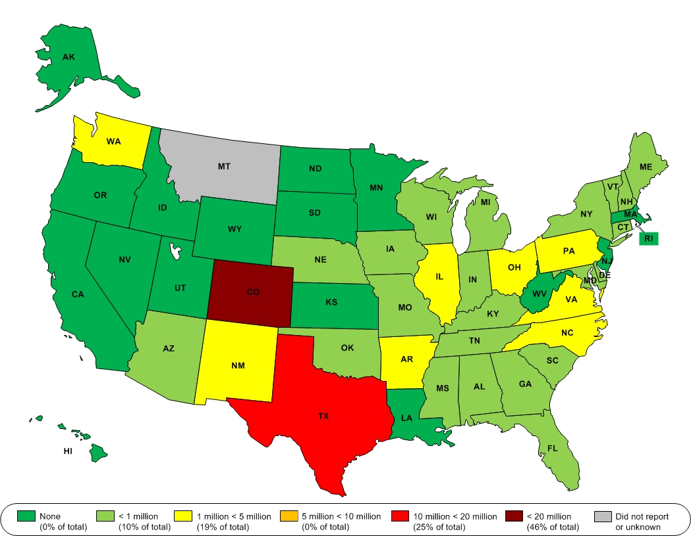
Where are scrap tires still in stockpiles?

Slide 15
Overview of Current State Programs

Slide 16
Overview of Current State Programs

Slide 17
Overview of Current State Programs

Slide 18
Overview of Current State Programs

Slide 19
About the Rubber Manufacturers Association
RMA is the national trade association representing tire manufacturers that make tires in the United States. RMA’s scrap tire management efforts are a reflection of the tire industry’s commitment to the concept of shared responsibility for its products when not suitable for use on vehicles.
RMA began its scrap tire program in 1990 under the auspices of the Scrap Tire Management Council. RMA works with all stakeholders, including states, U.S. EPA and the industry to develop markets, reduce scrap tire stockpiles and implement state regulations that that foster sustainable scrap tire markets. RMA supports all scrap tire markets that are environmentally sound and economically feasible.

