Slide 1
Sustainable Waste Management: low hanging fruit for businesses and States in mitigating GhGs
Paul Gilman
Chief Sustainability Officer
2016 ECOS Spring Meeting
Pathways to Partnerships:
Advancing Environmental Protection

Slide 2
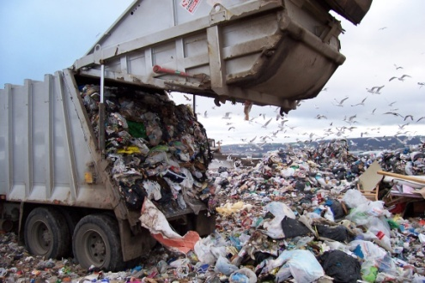

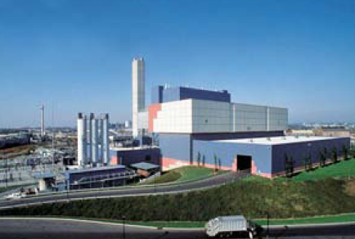
Two Choices for Post-Recycled Waste
Landfills are a major source of man-made methane
Methane is 34X more potent than Carbon Dioxide over 100 years
Leachate generation: ground water contamination
Non sustainable use of land
Renewable energy generation from landfills:
65 kWh per ton of waste
or
Landfill
90% reduction of waste in volume
Clean energy generation
Recovers metals for recycling
Offsets on average one ton of carbon dioxide equivalent for each ton of waste processed
Renewable energy generation from EfW:
550 kWh per ton of waste
EfW
  Energy from Waste produces 9 to 14 times the energy per ton compared to landfills.

Slide 3





















Who’s Doing It? Zero Landfill Society

Slide 4
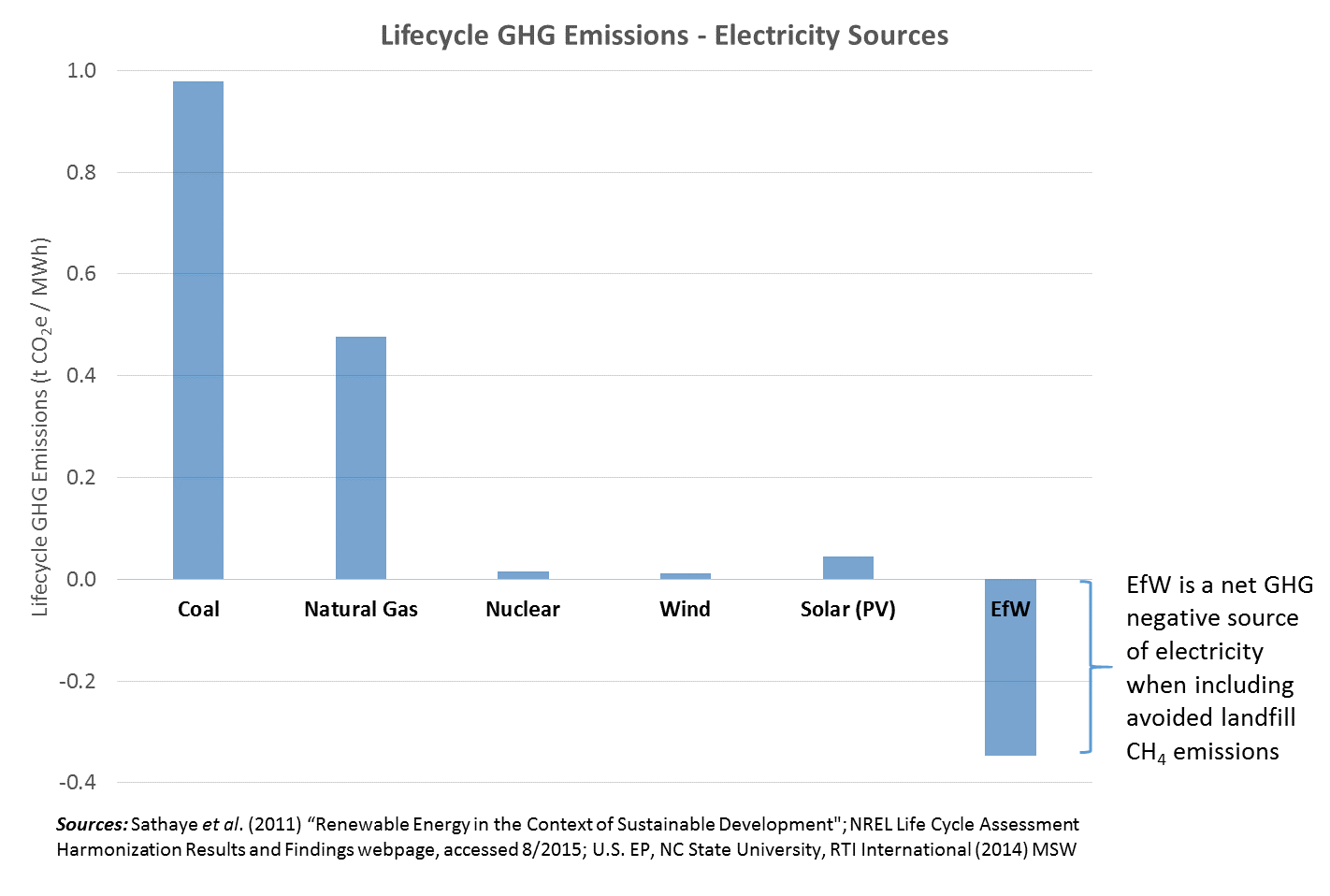
Electricity Sources: GHG Comparison

Slide 5
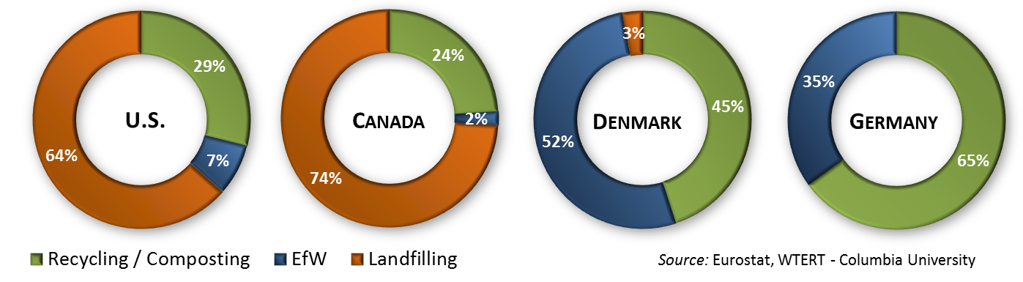
The United States has Fallen Behind...

Slide 6
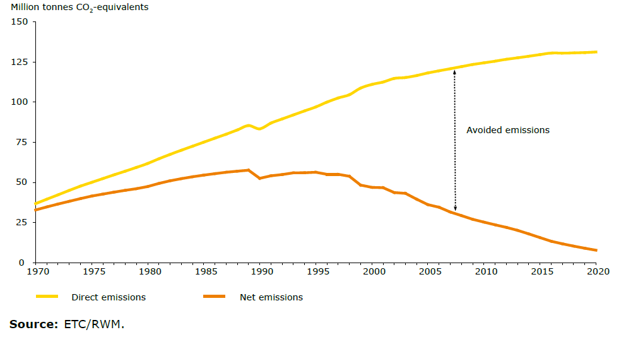

EU: Translating Sustainable Waste Management into GHG Success
EEA Briefing, “Better management of municipal waste will reduce greenhouse gas emissions”

Slide 7
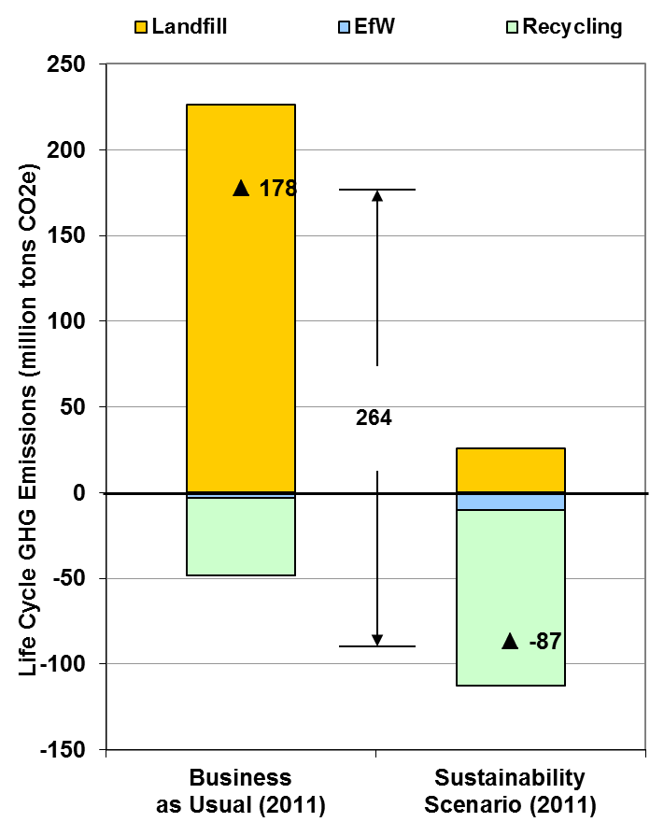
What if the U.S. did it that way?
 | Business as Usual* |  | Sustainability Scenario
Recycling | 28.9% |  | 65%
EfW | 7.6% |  | 25%
Landfill | 63.5% |  | 10%
GHG Savings
264 million tons CO₂e
≈ closing 63 coal-fired power plants
Energy savings
2.2 Quadrillion Btu primary energy
≈14% of our imported oil (2013)
Economic Benefits
$130B in direct economic activity
350,000 new permanent jobs
* Source: Columbia University, 2014

Slide 8
What if our whole planet did it that way?
The billion tons of greenhouse gases avoided is the equivalent of:
  Closing 1000 large coal-fired power plants
  Building 2 million 1MW wind machines
  Doubling our nuclear power plant capacity

Slide 9
EfW under the EPA Clean Power Plan
Excluded from Regulation
  Stack CO₂ emissions do not count against state mass goals
  EfW facilities do not have an emission rate requirement
Eligible to generate Emission Rate Credits (ERCs)
  New capacity added after 2012 can generate ERCs for states with rate-based plans
National Association of Clean Air Administrators
  Considering EfW language for their comprehensive Model State Plan
Notes:
9

