Slide 1
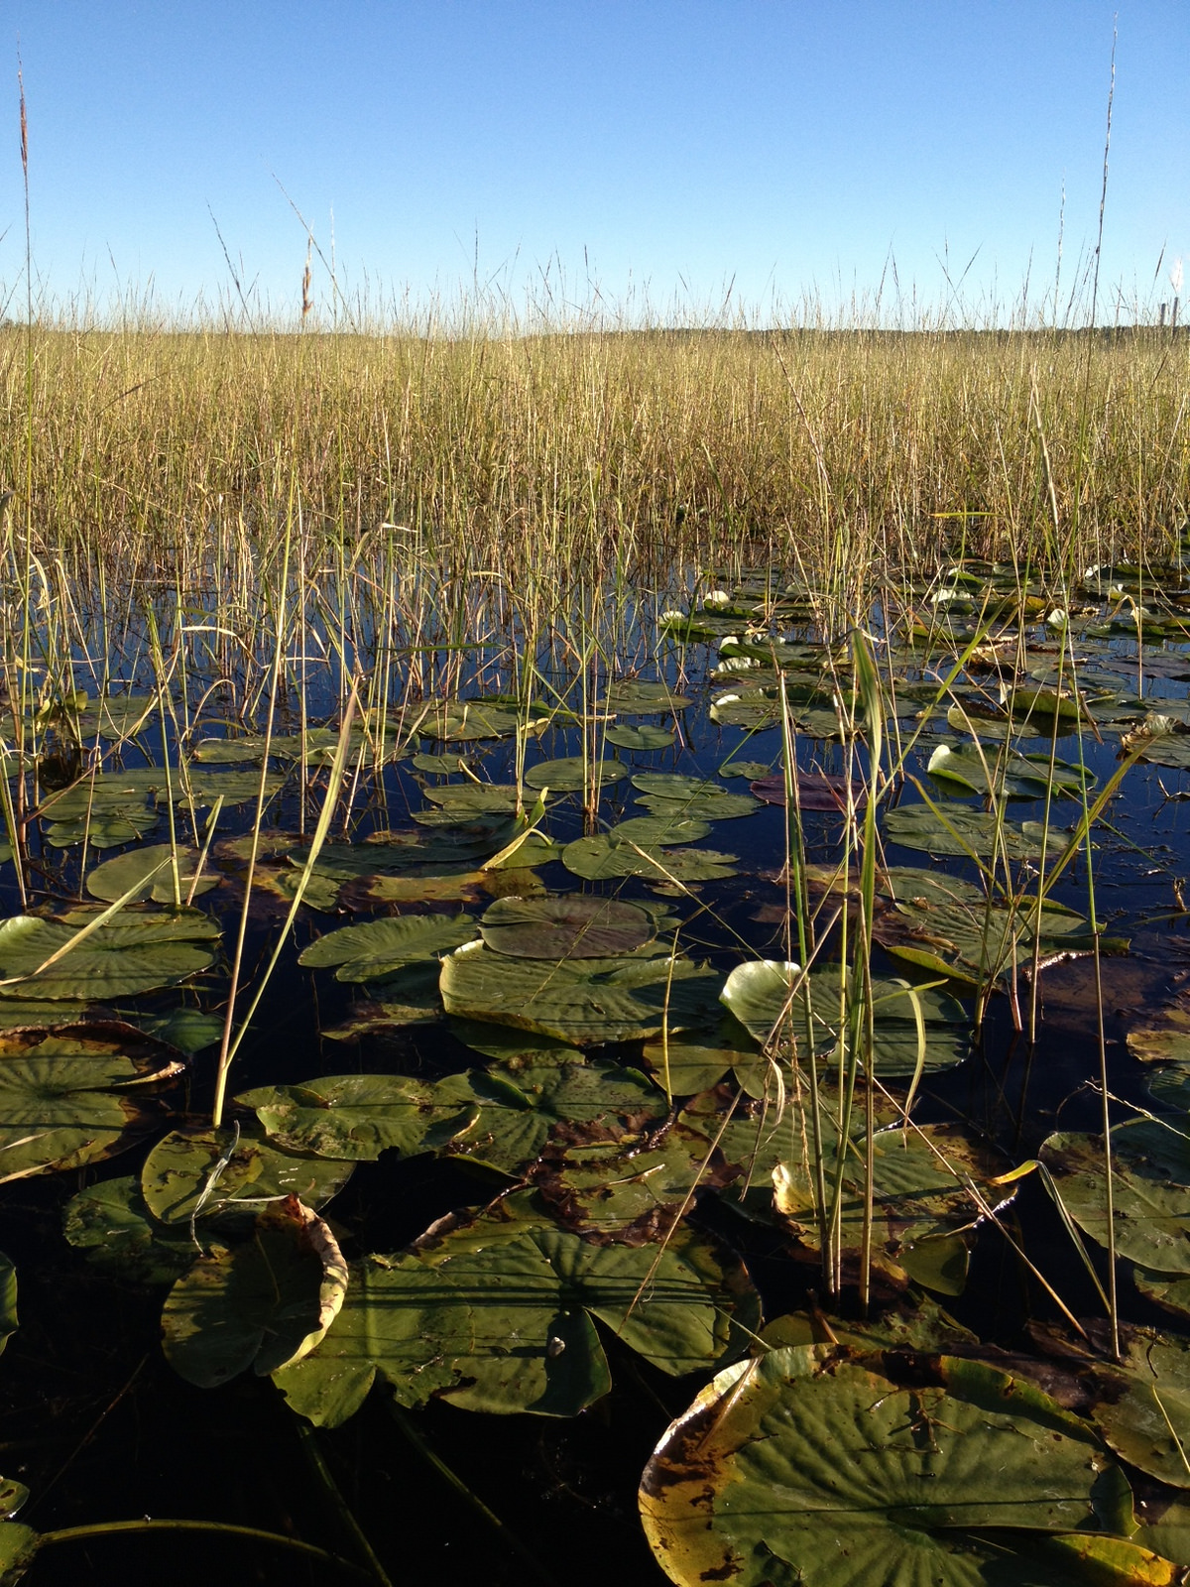
Wild Rice Sulfate Standards in Minnesota
Our Mission: Protect and improve the environment
and enhance human health
April 13, 2016

Slide 2
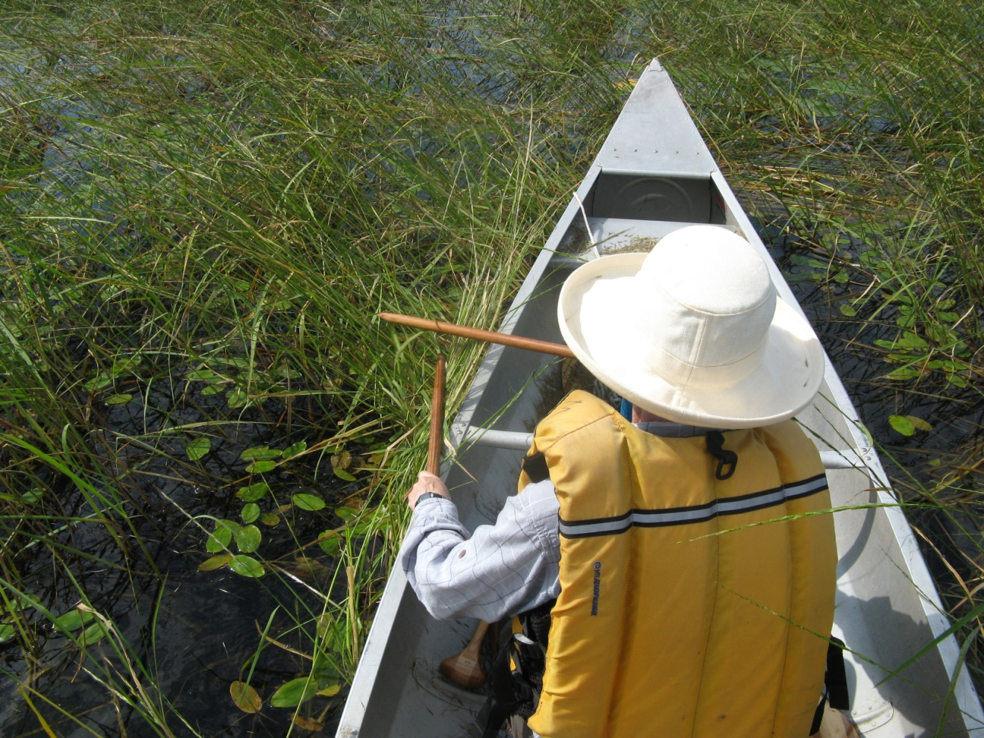
Why is it important to protect wild rice?
Cultural spiritual, economic significance
Minnesota’s state grain
Sensitive to sulfate

Slide 3
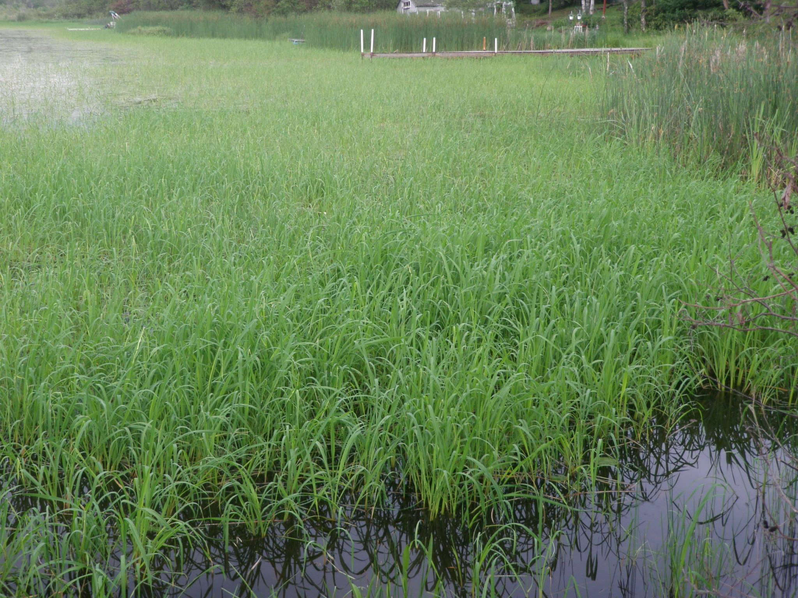
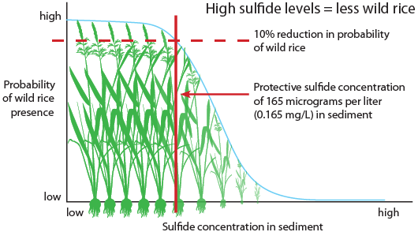
Wild rice is sensitive to sulfate pollution

Slide 4
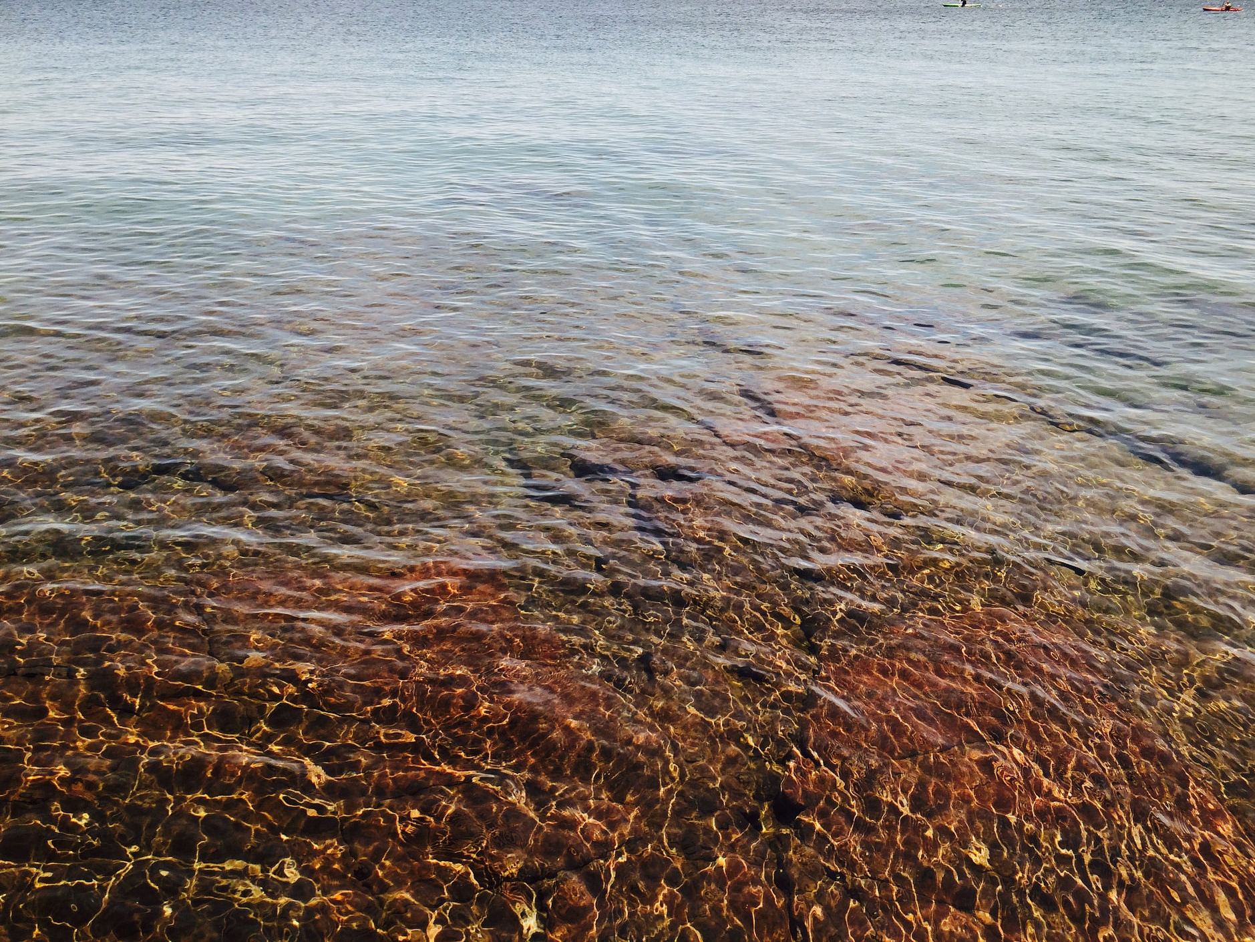
Sources of sulfate in wild rice waters
Natural sources: driven by geology
Can be elevated due to:
Sulfate-rich source waters
Runoff
Industrial processes
Municipal wastewater
Concentration by water treatment

Slide 5
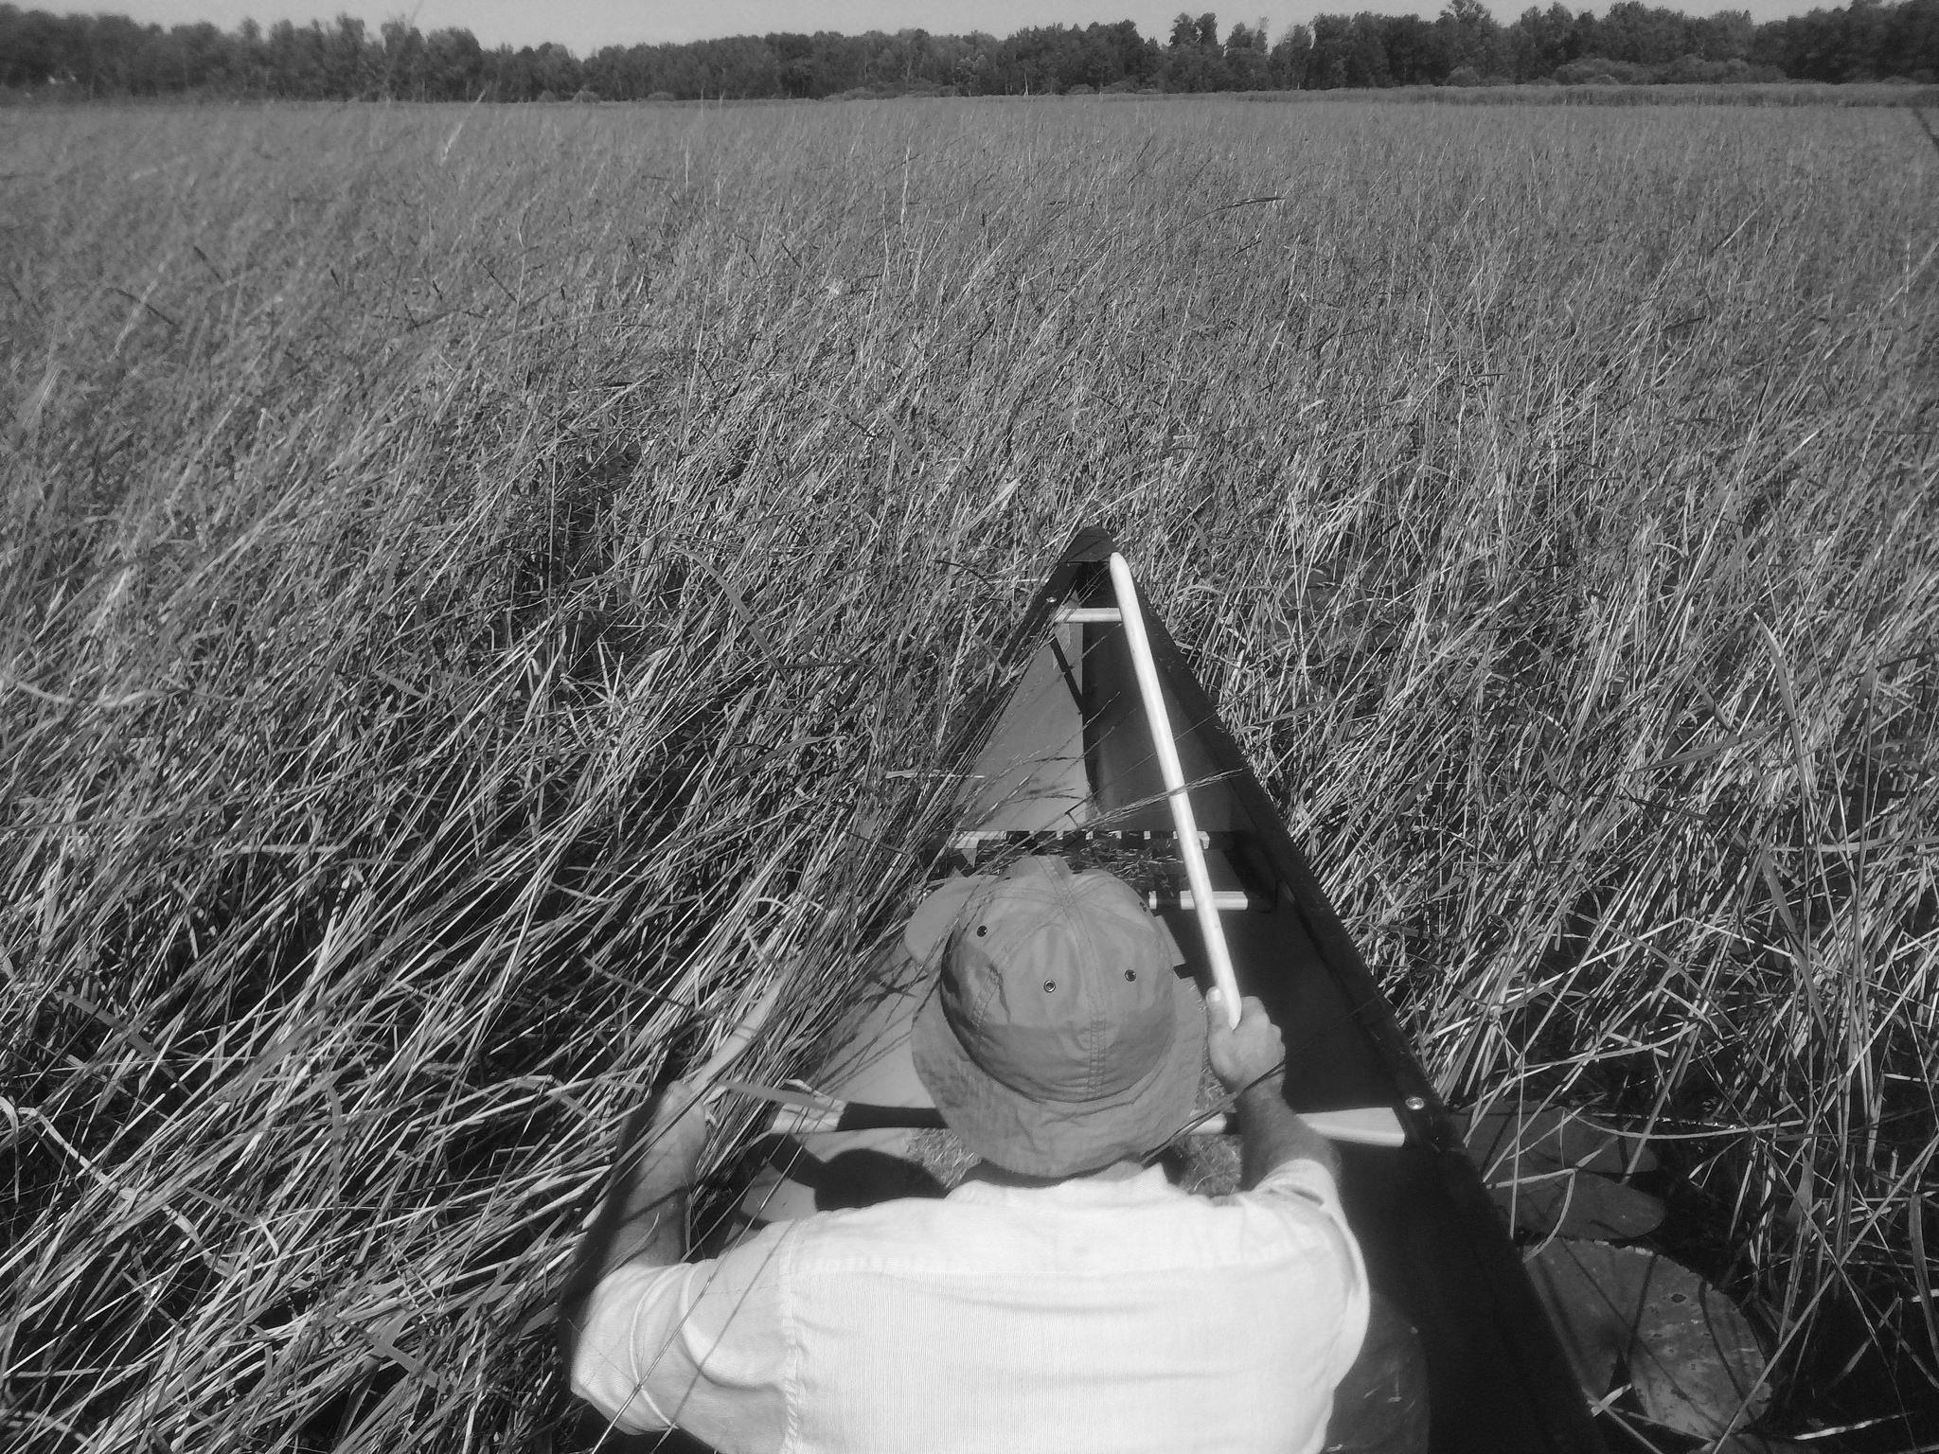
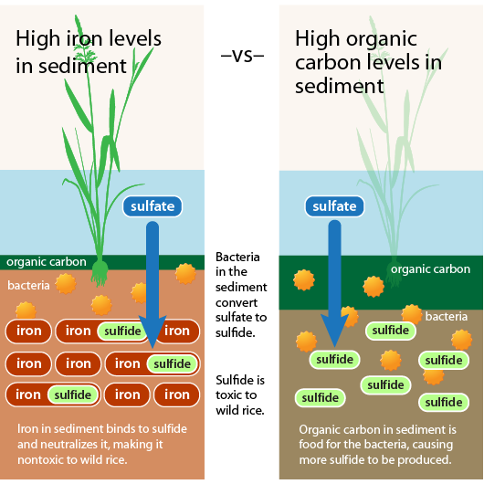
The sulfate-sulfide relationship depends on iron and organic carbon

Slide 6
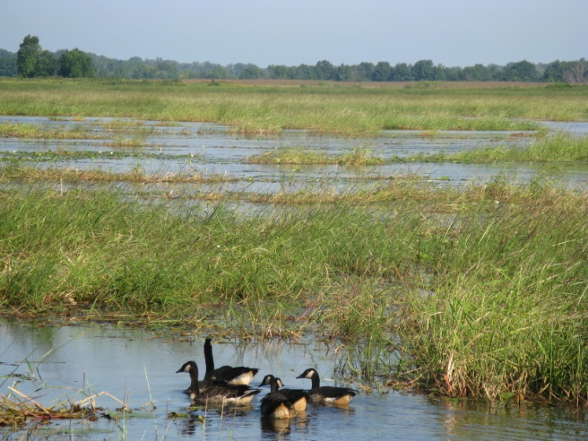
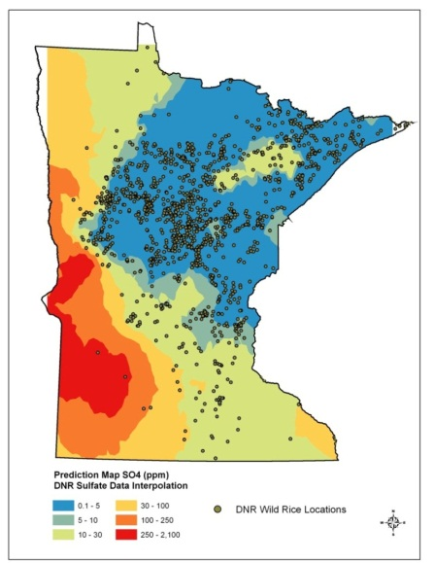
Where is wild rice grown in Minnesota?

Slide 7
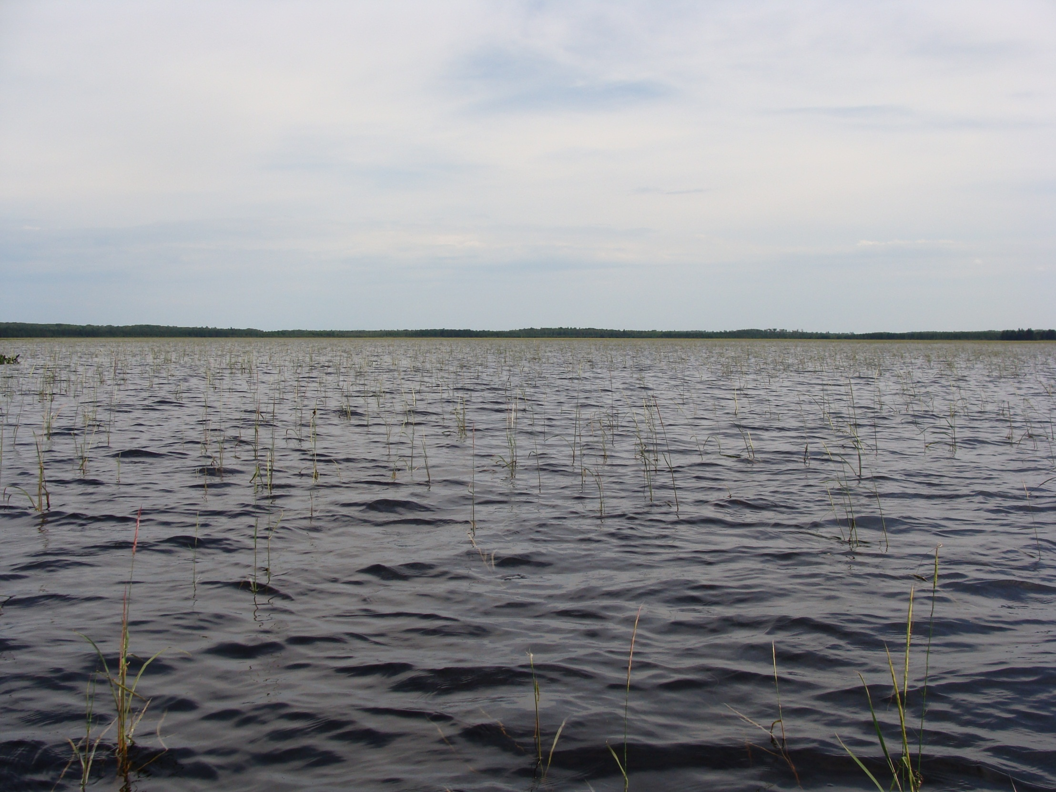
State statute protects “wild rice waters”
Self-perpetuating population
Wild rice currently present, or has been present since 1975
8,000 stems over the surface of a lake, wetland, or reservoir
800 stems over a river-mile reach

Slide 8
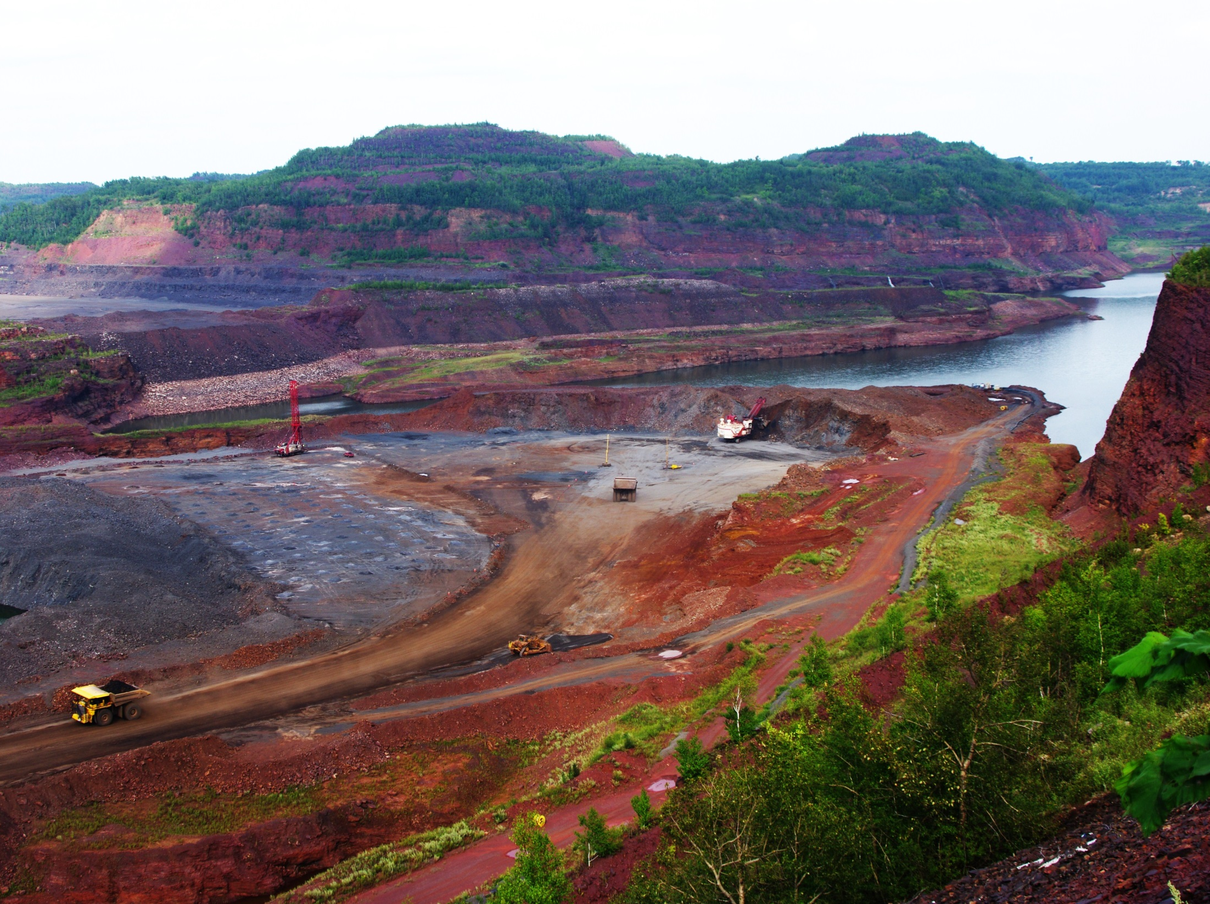
Minnesota’s taconite industry and the sulfate standard

Slide 9
Proposed solution: a variable sulfate standard
Sulfate = 0.0000136 x Organic Carbon^{-1.410} x Iron^{1.956}

Slide 10
Learn more about Minnesota’s wild rice sulfate standard:
www.pca.state.mn.us/wildrice

